Slide 1
Leveraging Canvas

Slide 2
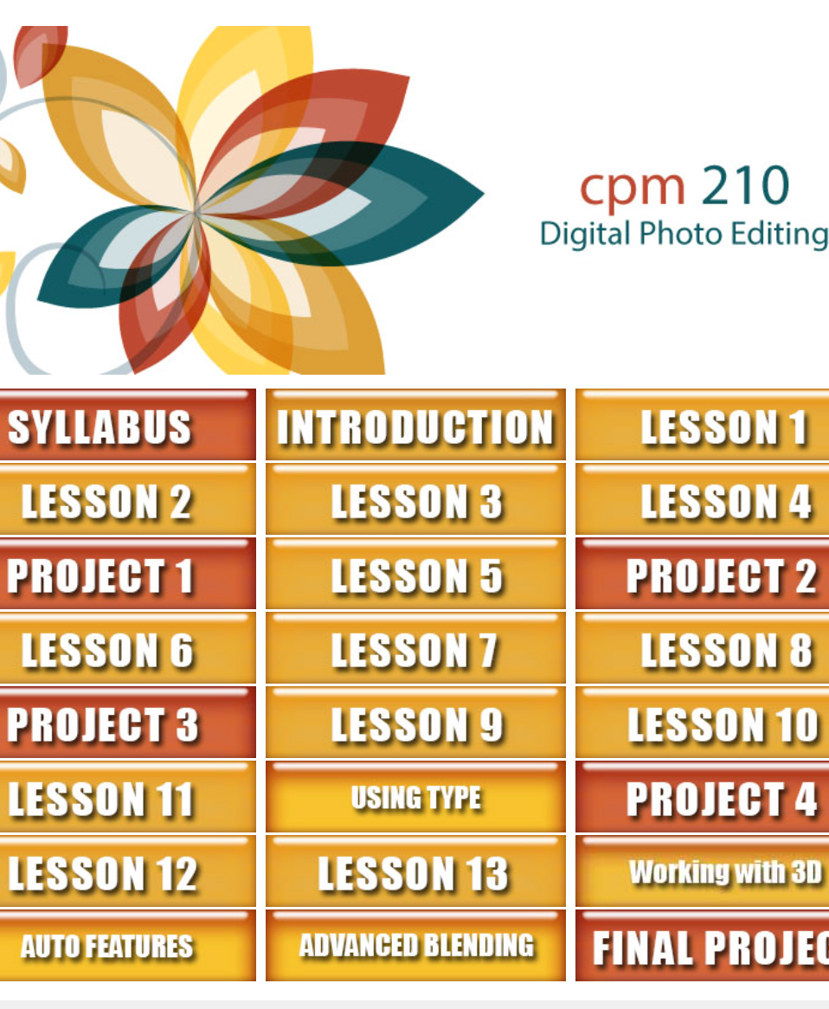
Growth
75% of instructors use Canvas
54% at start

Slide 3
Faculty Resources
Faculty Commons
Groups/Departments
Professional Development
Long Range Planning
Best Practices

Slide 4
“Why is she wasting my time?”
“It’s all Greek to me.”
“It’s in Chinese (I think) what am I supposed to do? I think I’m in the wrong class.”
“I get it. I immediately saw why I need to be clear, succinct and explicit in my design!”

Slide 5
Student Resources
Orientation
Academic Success
Writing and Math Tutoring
Assessment
EPortfolio
Academic Advising

Slide 6
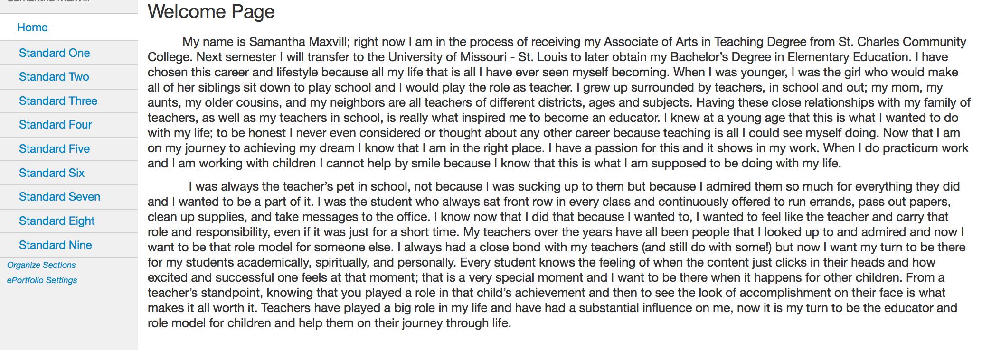
ePortfolio

Slide 7
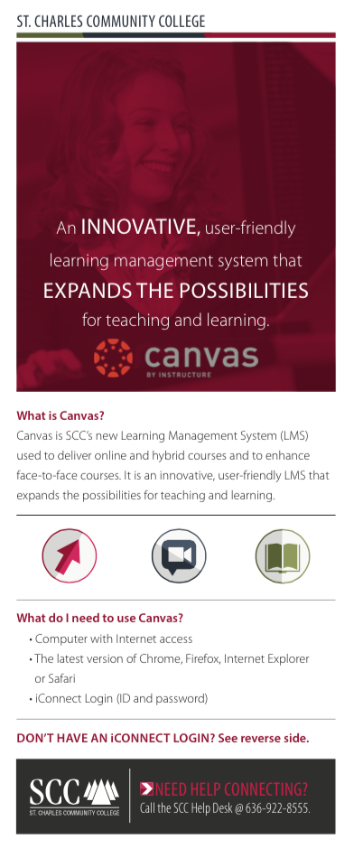
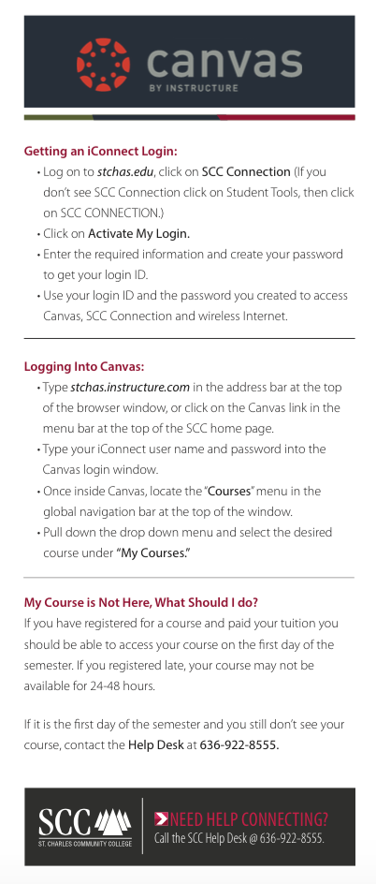

Slide 8
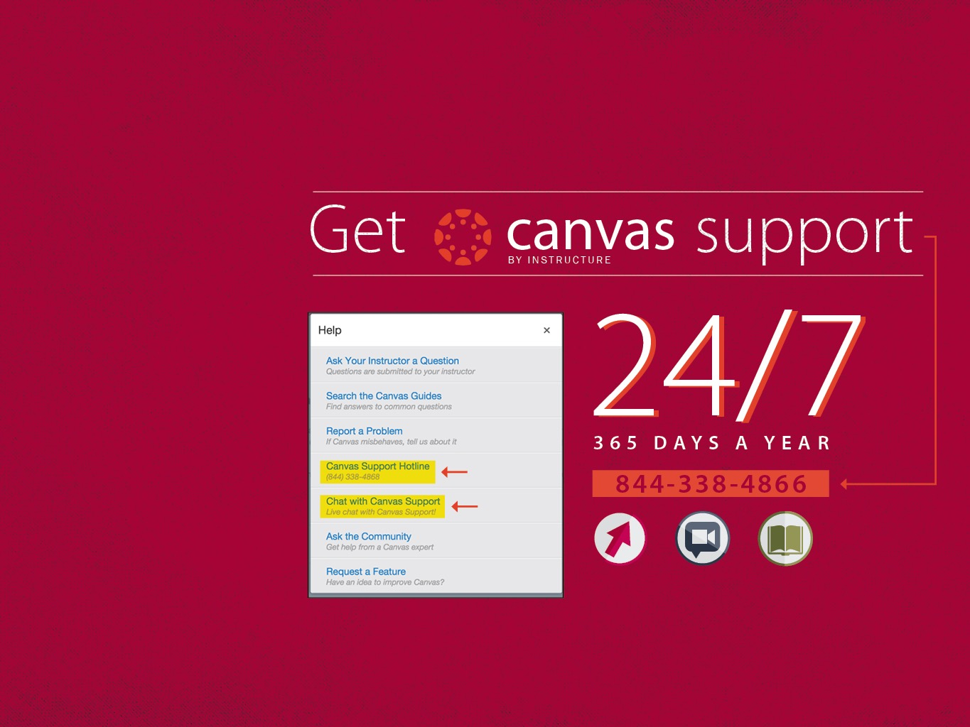

Slide 9
Feedback
Maybe cut down –too long
Lots of good information
Liked the photos
Audio would be nice
Loved parent module
liked the whole focus of most of the general questions I had. It did help clear up some things.
I still do have personal questions but the basic things are pretty much taken care of now.
It gave me a lot of tips and it showed the way without taking control.
Maybe improve the degrees a little more for me to understand or tell examples of majors and careers that go with certain degrees.
I liked how it had humor to keep some of us connected

