Slide 1
Assessment of Textbook-Free Courses in the Biochemical Engineering Field As Vehicles for Lifelong Learning
Daniel Forciniti
Missouri University of Science and Technology, Rolla MO

Slide 2
Background
I have been teaching a Bioseparations course without a textbook for 10+ years and a Bioreactors Class for a couple of years.
The material has been given to the students through Blackboard
The material consists of
(1) A number of scientific papers and vendors’ material for each of the main core topics,
(2) A series of power point slides that I use to support my lectures (the slides are not used as the main teaching method in this class),
(3) Reading guidelines

Slide 3
Objectives
To investigate the effect of using alternative ways to deliver content in place of textbooks on the ability of the students to become lifelong learners.

Slide 4
Life Long Learning
Performance Criteria
Defining Concepts
Learning Outcome
Able to plan one’s own learning.
Able to asses and monitor one’s own learning.
Able to independently find and use technical information.
Self Directed
Self Regulated
Self Motivated
Reflective
Lifelong Learning
http://depts.washington.edu/celtweb/

Slide 5
Textbooks
few of us would consider teaching a course without using a textbook .
Over the years, they have become more colorful, more encyclopedic, and accompanied by more ancillary materials such as CD-ROMs, study guides, and websites.
The question most instructors ask themselves is most likely which textbook to use, not whether to use a textbook.
But does the use of textbooks really help students learn better?
—Gary Reiness (editor, CBE Life Science Education)

Slide 6
Use of Textbooks
Study by Podolefsky and Finkelstein (2006) (800 students in four physics classes)
Only 37% of students regularly read
Less than 13% read often and before the lecture
There is no correlation between reading habits and course grades.
Students identify textbook with homework and lecture with exams.

Slide 7
Use of Textbooks
From Carpenter and Bullock (2006) (British Publishers study)
Textbooks are important but the students do not know why. Do the instructors?
Some leave students to pick from a reading list, while a roughly equal number suggest students pick one of several alternative main course texts.
It is worth comparing this British experience in which only 15% of lecturers ‘adopt’ a required text with the American practice in which the almost universal practice is for the Professor to choose one book for his or her course, which is then bought new or used by the vast majority of students.
A greater anxiety is that some lecturers may not be aware of how critical they are in the decision to purchase and may not appreciate that a less than strong endorsement for a book means is it less likely to be bought.

Slide 8
Reflection by Paulsen and Feldman (1999)
“Faculty, in their roles as college teachers and designers of learning environments, should assume a greater responsibility for promoting motivationally and educationally productive epistemological beliefs among their students”.
Or……Naïve (Textbook?) vs. sophisticated (Textbook free?) epistemological beliefs

Slide 9
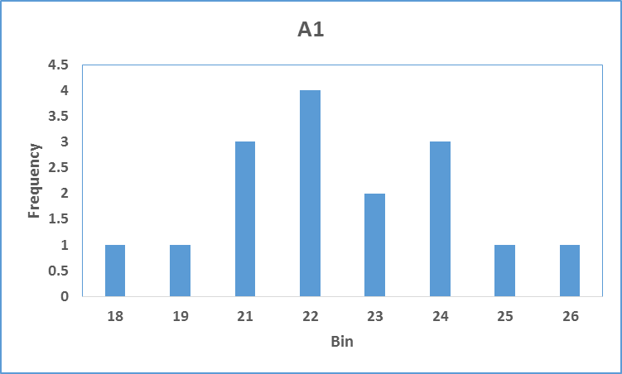
Survey that measures epistemological beliefs (Hoskins et al. 2011)
Knowledge is certain.
If two different groups of scientists study the same question, they will come to similar conclusions. (R)
The data from a scientific experiment can only be interpreted in one way. (R)
Because scientific papers have been critically reviewed before being published, it is unlikely that there will be flaws in scientific papers. (R)
Because all scientific papers are reviewed by other scientists before they are published, the information in the papers must be true. (R)
Sometimes published papers must be reinterpreted when new data emerge years later.
Results that do not fit into the established theory are probably wrong. (R)
Thermodynamics
Bioseparations

Slide 10
Ability is innate.
I think professionals carrying out scientific research were probably straight-A students as undergrads. (R)
You must have a special talent in order to do scientific research. (R)
Thermodynamics
Bioseparations

Slide 11
Attitude toward science.
Science is a creative endeavor.
I have a good sense of what research scientists are like as people.
I do not have a good sense of what motivates people to go into research. (R)
Scientists usually know what the outcome of their experiments will be. (R)
Collaboration is an important aspect of scientific experimentation.
Thermodynamics
Bioseparations

Slide 12
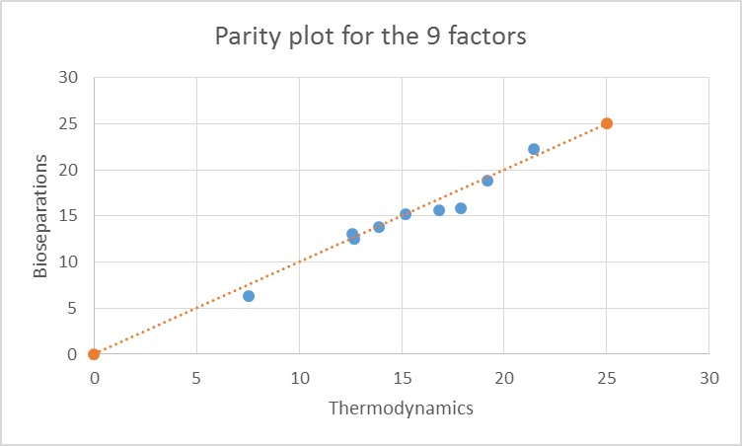
Comparison between Sophomores and Juniors
Factor 1: Decoding Primary Literature
Factor 2: Interpreting Data
Factor 3: Active Reading
Factor 4: Visualization
Factor 5: Thinking Like a Scientist
Factor 6: Research in Context
Aspect 1: Knowledge is Certain
Aspect 2: Ability is Innate
Aspect 3: Attitude Toward Science
 | Thermodynamics |  | Bioseparations |  | P(T<=t)
Factor | Mean | Variance | Mean | Variance | P(T<=t)
A1 | 21.4 | 9 | 22.3 | 4 | 0.12
A2 | 7.5 | 1.9 | 6.1 | 6.9 | 0.04
A3 | 19.2 | 3.3 | 18.9 | 3.6 | 0.28
F1 | 17.9 | 8.5 | 15.8 | 13.8 | 0.03
F2 | 15.2 | 5.8 | 15.2 | 3.4 | 0.5
F3 | 13.9 | 5 | 13.8 | 5 | 0.44
F4 | 12.7 | 4.3 | 12.6 | 9.7 | 0.44
F5 | 16.8 | 7.6 | 15.6 | 7.4 | 0.08
F6 | 12.6 | 3.4 | 13.1 | 3.7 | 0.2

Slide 13
My Own Motivation (before epistemology)
My own cultural background (been “raised” textbook free)
Textbooks in Biochemical engineering are of little use because of the dynamics of the field.
For example, the hybridoma technique to produce monoclonal antibodies was developed 40 years ago and today the production of monoclonal antibodies is the most rapidly growing pharmaceutical sector. Moreover, monoclonal antibodies or antibodies fragment are produced today using disposable technology, non-existent 20 years ago.

Slide 14
Example of Materials provided to the students
Introduction to Bioseparations
Graslund, S. et al. (more than twenty authors).. Protein production and purification. Nature Methods, 5: 135-147 (2008).
Good review (quite detailed) of purification of recombinant proteins.
Ladisch, M. 2004. The role of bioprocess engineering in biotechnology. The Bridge. A publication of the National Academy of Engineering. 34(3).
Opinion by one of the leaders of the field. (#2)
Asenjo, J.A. and Andrews, B.A. Mini-review—Challenges and trends in bioseparations. J. of Chemical Technology and Biotechnology, 83:117-120 (2008).
Kind of sketchy review by an engineer. The modeling part is to be taken with care.
Dolnik, V. Capillary electrophoresis of proteins 2005-2007. Electrophoresis, 29: 143-156 (2008).
Good review about capillary electrophoresis of proteins. It has a good description of the technique. We will focus on the modeling part, which is not covered by this article.
Genentech, MetMAb, Pertuzumab Fact sheet.
Wilken, L.R. and Nikolov, Z.L. Recovery and purification of plant-made recombinant proteins. Biotechnology Advances, 30: 419-433 (2012).
Good review about the challenges of the recovery of recombinant proteins expressed in plants.
Ponchon, L. and Dardel, F. Large scale expression and purification of recombinant RNA in Escherichia coli. Methods, 54: 267-273 (2011).
A good review about RNA production and purification.
Deshmukh, R.R., Warner, T.N., Hutchison, F., Murphy, M., Leitch II, W.E., De Leon, P., Srivatsa, G.S., Cole, D.L., Sanghvi, Y.S. Large-scale purification of antisense oligonucleotides by high-performance membrane adsorber chromatography. J. of Chromatography A, 890:179-192 (2000).
Specific example of RNA purification. For the avid reader.
Josefberg, J.O. and Buickland, B. Vaccine Process Technology. Biotechnology and Bioengineering, 109:1443-1460 (2012)
A bit out of topic but it shows how broad is the bioseparation field.
Aggarwal, S. What’s fueling the biotech engine –2011 to 2012. Nature Biotechnology, 30: 1191-1198 (2012).
A very good compilation of economic data. This is a “must” read.
Biopharma report on infectious diseases.
You should read this article.

Slide 15
Evaluation
Long term students' evaluations. There are no indications, in the students’ comments, that the lack of a textbook is a major hurdle in this Bioseparations class. There are, however, some indications that some students feel “fragile” without a textbook.
Survey to Alumni last 20 years: Shortly
Recent Survey
Q1. you think this class has helped you to:
know how knowledge is organized,
how to find information
how to use information in such a way that others can learn from it
None of the above
All of the above
Q2. Lifelong learners are those who are: (1) better prepared to plan their own learning, (2) able to assess and monitor their own learning, and (3) able to independently find and use technical information
Do you think that a textbook free class like this one has helped you to become a lifelong learner?
1. Strongly agree 2. Agree 3. Disagree 4 Strongly disagree.
Q3.
The best material for a class is:
A single textbook
Multiple Textbooks
Scientific papers
Vendors Literature
1+3+4
2+3+4
3+4

Slide 16
Question 2: Biorectors: 2.75 (0.45 SD)
Bioseparations: 2.85 (0.38)
Q3. Nobody selected a single textbook as the best delivery system!

Slide 17
Questions
Do they know how to read a primary source?
Population affected: current students
What are the epistemological beliefs of our students?
Population affected: current and former students.
How do their epistemological beliefs correlate with the ability to become life long learners?
Population affected: current and former students
Are textbooks a hurdle for the students’ development into sophisticated thinkers?
Population affected: current and former students

Slide 18
C.R.E.A.T.E. steps (Hoskins et al., 2011) (or how to teach how to read a paper). About using primary sources to transition from naïve to sophisticated beliefs.
Consider. Concept map paper introduction, note topics for review, define new issue(s) to be addressed, begin defining relevant variables and determining their relationships.
Read. Define unfamiliar words, annotate figures, create visual depictions (sketch “cartoons”) of the individual sub studies that underlie each figure or table. Transform data presented in tables into a different format (graph or chart).
Elucidate hypotheses. For each figure, define the hypothesis being tested or question being addressed by the work that generated the data illustrated. Rewrite the title of each figure in your own words.
Analyze and interpret the data. Using the hypotheses, questions, cartoons, diagrams, and charts and/or graphs, determine what the data mean. Fill in a data analysis template for each figure to track the logic of each experiment and prepare for class discussion. After all figures and tables have been analyzed, create a concept map for the paper, using each illustration as a map node to reveal the logic of the study design.
Think of the next Experiment . “If I had carried out the studies described in this paper, how would I follow up?” Design two distinct studies, and cartoon one on a transparency for in-class discussion .

Slide 19
New Survey (linking epistemological beliefs, life long learning and textbook free classes.) All questions given below are rated on a SD – SA scale of five choices. Those that would be reverse scored are marked with an (R).
Epistemologic Beliefs:
If two people are arguing about something, at least one of them must be wrong. (R)
Most things worth knowing are easy to understand. (R)
Really smart students don’t have to work as hard to do well in school. (R)
How well you do in school depends on how smart you are. (R)
No matter who you are, you can significantly change your intelligence level.
You can change even your basic intelligence level considerably.
To do academic research, you need to have had straight A’s as a student. (R)
There is more than one right answer to any given problem.
Results that do not reflect established theories are most likely incorrect. (R)
Data from a given experiment can only lead to one conclusion. (R)
Because all scientific papers are reviewed by other scientists before they are published, the information in the papers must be accurate. (R)
Theories and facts can change with time and new information.
Primary Source Beliefs:
Scientific literature is difficult to interpret. (R)
I am confident in my ability to critically review scientific literature.
I am confident that I can defend my ideas about experiments.
If I am presented data (graphs, tables, charts), I am confident that I can reach conclusions about its meaning.
It is easy for me to relate the results of a single experiment to the big picture.
The way that you display your data can affect whether or not people believe it.
When I read a scientific paper, I carefully read the methods section in order to understand how the data was collected.
If I look at data presented in a paper, I can visualize how that data was produced.
After I read a paper, I feel that I could explain it to someone else.
I accept information produced in peer-evaluated journal articles without challenging it. (R)
When reading scientific literature I am primarily concerned with the data and conclusions presented, and less concerned about the experimental methods used to obtain the data. (R)
A textbook contains all the necessary information to master a subject area. (R)
Textbooks are checked and edited multiple times, so it is unlikely that they contain incorrect knowledge. (R)

Slide 20
Life Long Learning:
I usually only read scientific articles if a class assignment requires it. (R)
Scientific articles are only useful to researchers and academics. (R)
I believe that everything worth knowing can be learned in college and from on the job experience. (R)
I am likely to read new scientific literature in my field when it is published.
I believe that learning after college is essential to professional success.
If a piece of information is important, my professors and employers will provide it for me. (R)
I can stay current with scientific progress by simply watching the news and surfing the internet. (R)
I plan to read research journals after I graduate.

Slide 21
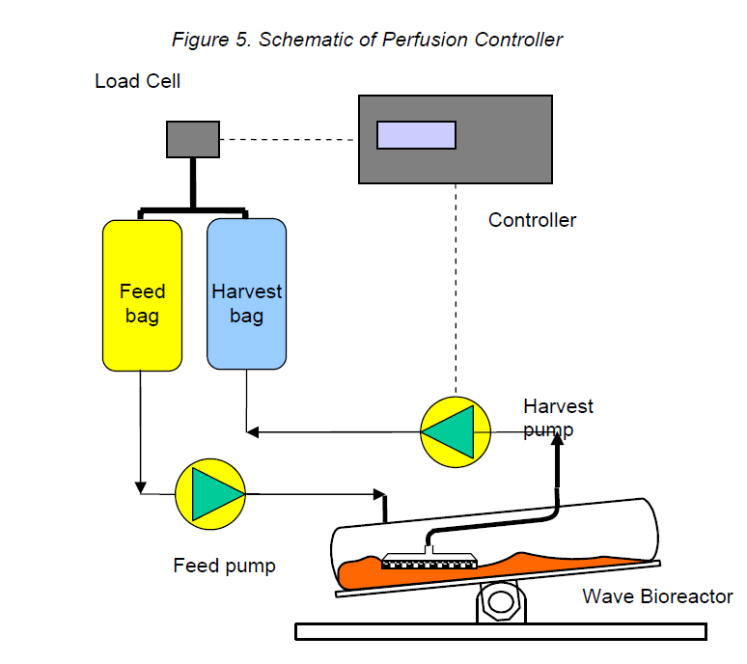
Lifelong learning assessment (yearly)
By the end of this course, the student will be able to:
Find relevant sources of information about disposable reactors in the library and on the web.
Determine the information needed to design and control a wave reactor.
How?
Ask groups of students to prepare summaries of portions of the project.
Have a preliminary presentation and pinpoint themes for further investigation.
Ask students to conduct both self and peer assessments

Slide 22
Survey to alumni Limited to Biochemical engineering emphasis graduates
Background of the respondent (year of graduation, highest degree, current occupation, etc.)
Explore epistemological beliefs of respondent.
Explore life long learning concepts of respondent.
Explore value of textbook free classes on life long learning of the respondent
Limit survey to 30 question or less.

Slide 23
Reflection by Paulsen and Feldman (1999)
“Faculty, in their roles as college teachers and designers of learning environments, should assume a greater responsibility for promoting motivationally and educationally productive epistemological beliefs among their students”.
…….Or to teach them not to have naïve beliefs……
Thanks to the Missouri S&T Vice Provost for Undergraduate Affairs for its financial support.
With the help of Alex Evans and Amer Al-Lozi

