Slide 1
Gamification in Online Learning: History of Science for Engineers
Dr. Kathleen Sheppard
History and Political Science
Missouri University of Science & Technology
Dr. John Stewart
Center for Teaching Excellence
University of Oklahoma

Slide 2
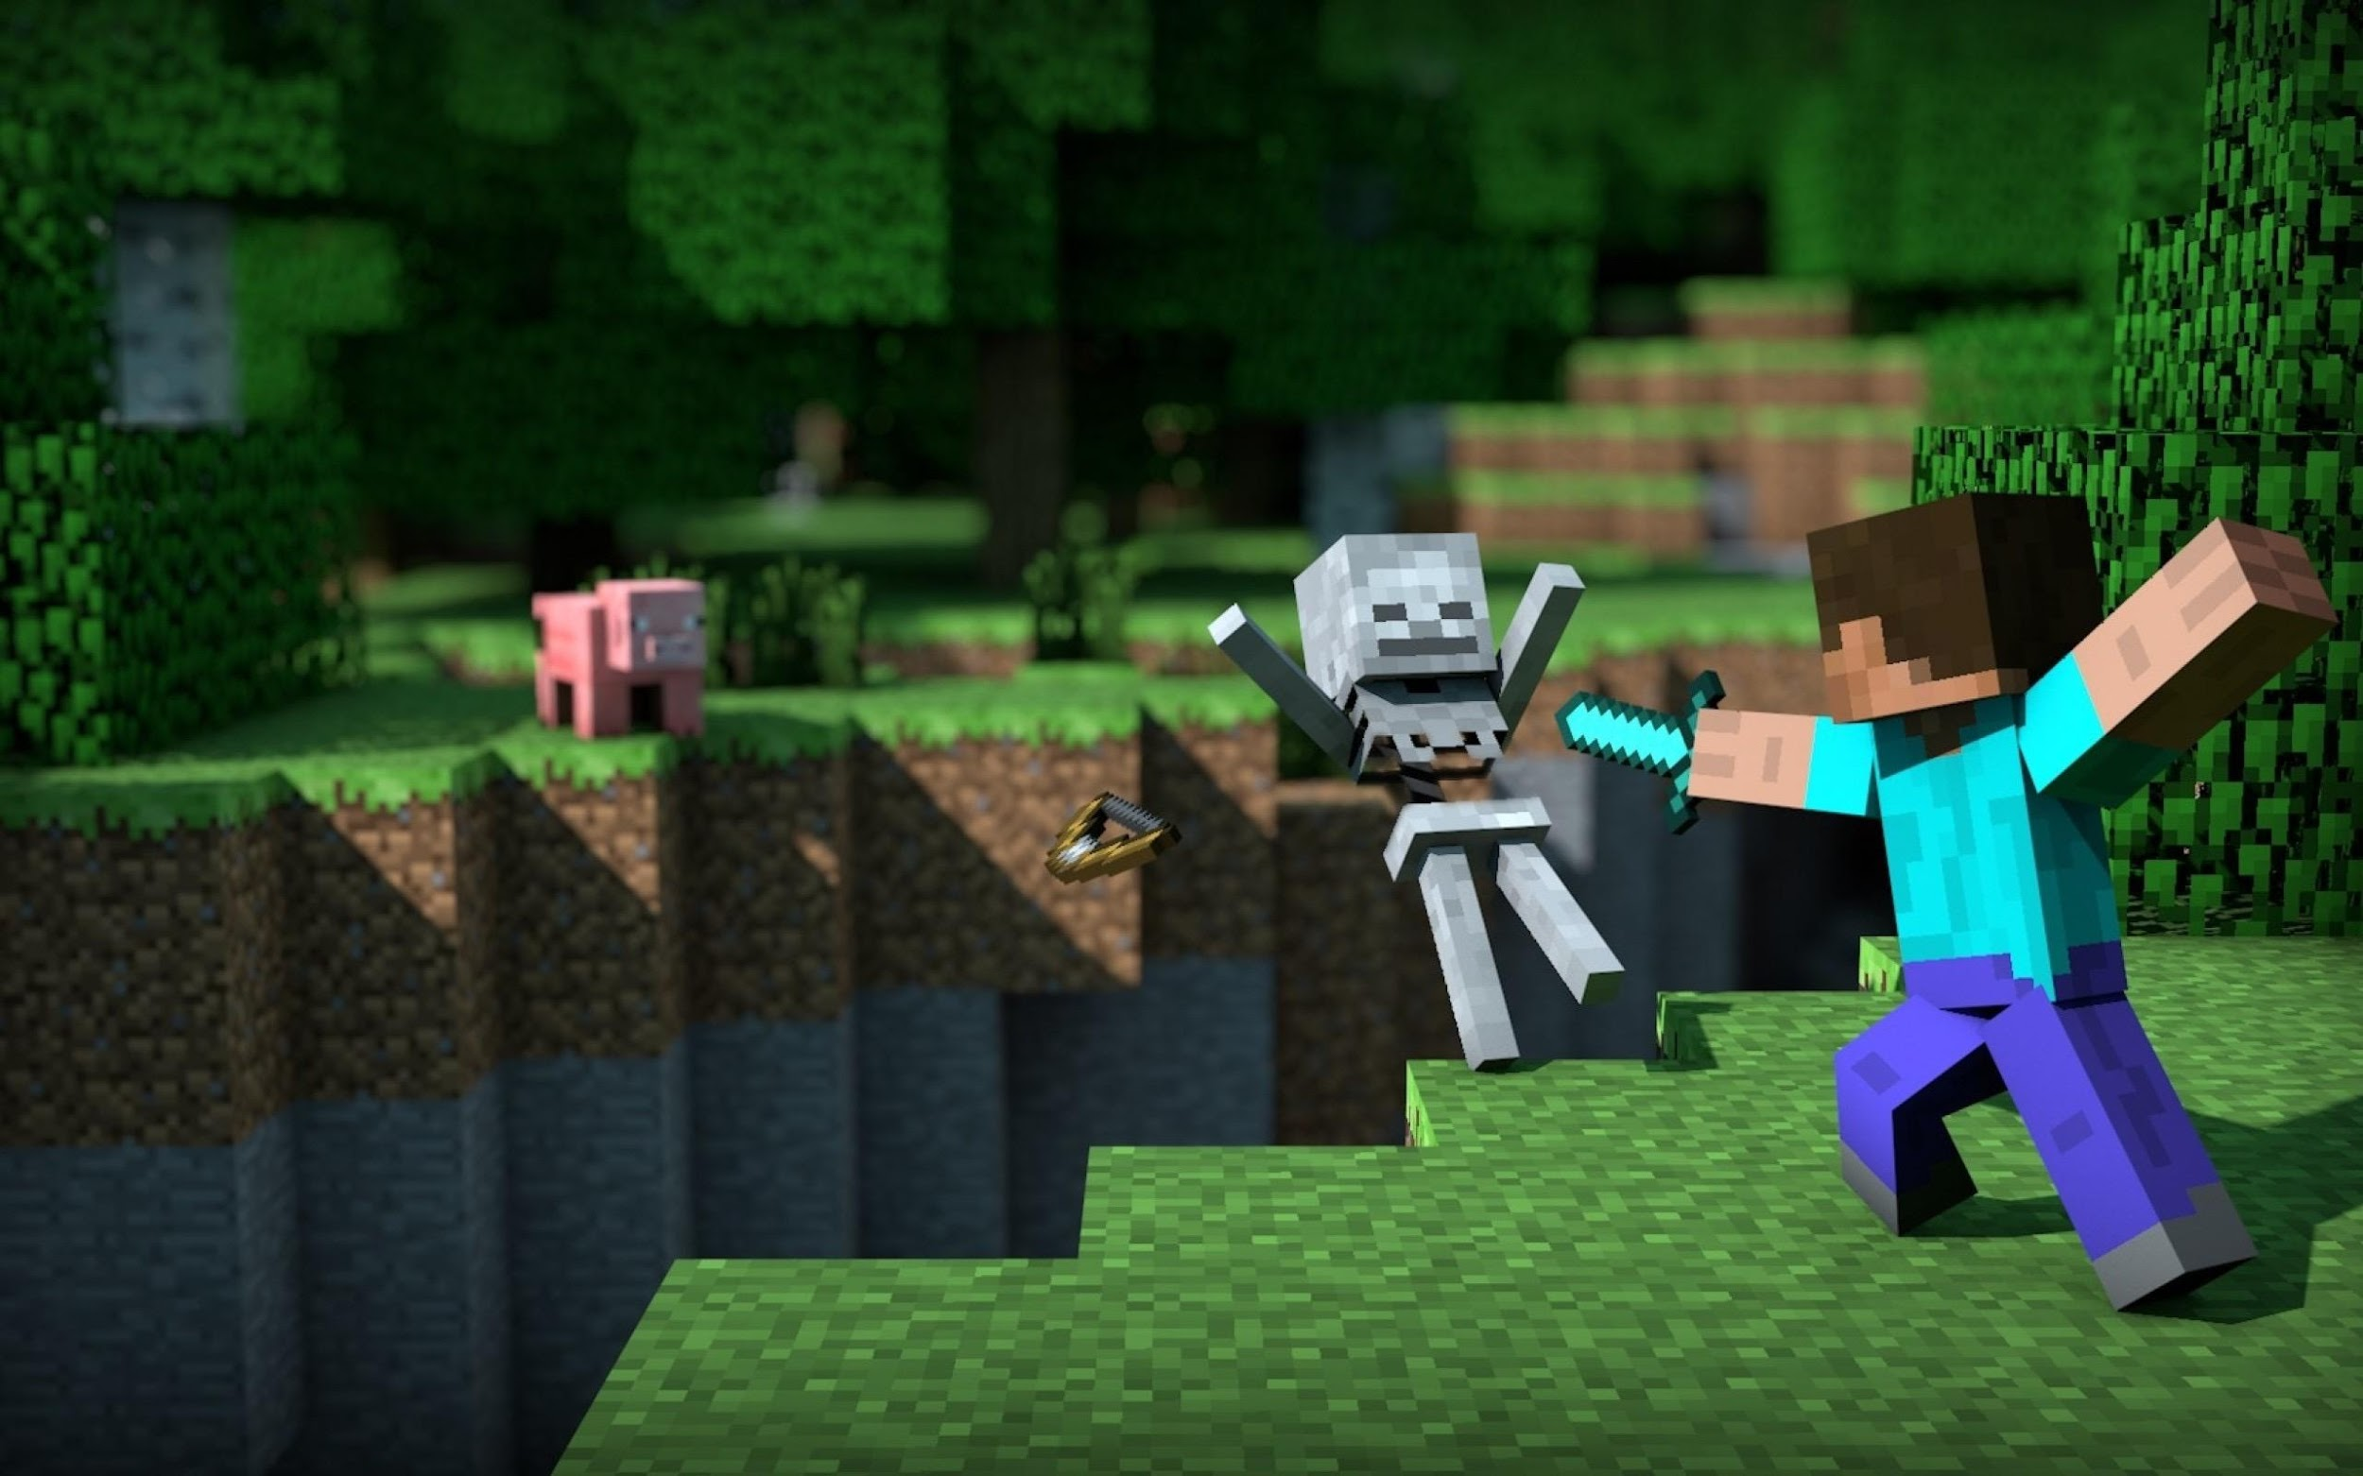
Gamification
Notes:
Games used as pedagogical tools - Civilization, Minecraft, SimCity, WoW, etc.
Not to be pedantic, but I’m not referring to using games as pedagogical tools

Slide 3
Notes:
Gamification refers to “structuring the entire course as a game”

Slide 4
Why this format?
Gamification “attempts to harness the motivational power of games and apply it to real-world problems.”
(Lee and Hammer, 2011: 1)
Notes:
Lee, J. J. & Hammer, J. (2011). Gamification in Education: What, How, Why Bother? Academic Exchange Quarterly, 15(2).

Slide 6
Midbrain dopaminergic activity has been shown to increase when we are exposed to a variety of pleasures including food, money, and computer games.
Dopamine orients attention and enhances the making of connections between neurons, which is the brains’ basis for learning.
Paul Howard-Jones, “Toward a Science of Learning Games”

Slide 7
Maximum signal [dopamine release] corresponded to the maximum available reward in that context.
[An] anticipatory ramp of dopamine, together with the previous spike, resulted in uncertain reward generating more dopamine overall than either 100% certain or wholly unexpected reward. In other words, uncertain reward appears to increase the type of dopaminergic response that has been linked to motivation.
Paul Howard-Jones, “Toward a Science of Learning Games”

Slide 8
Traditional Face-to-Face
Four themes, each time running through the whole chronology:
Cosmos
Planet
Body
Technology
Notes:
John’s is the same minus the technology theme

Slide 9
Topic Map

Slide 10
Chronological Map

Slide 11
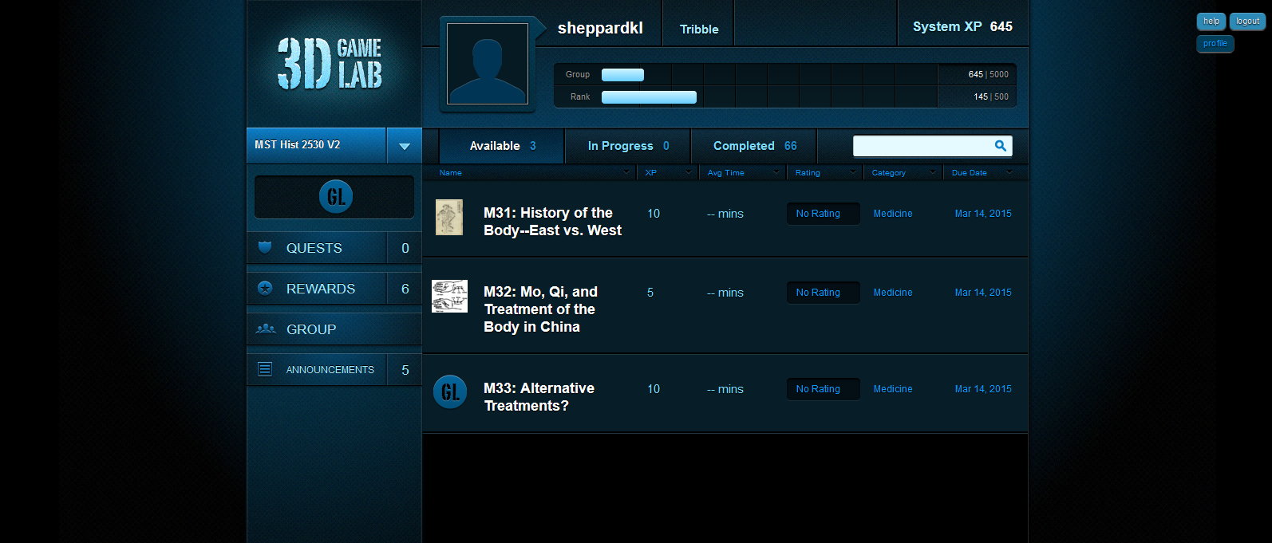

Slide 12
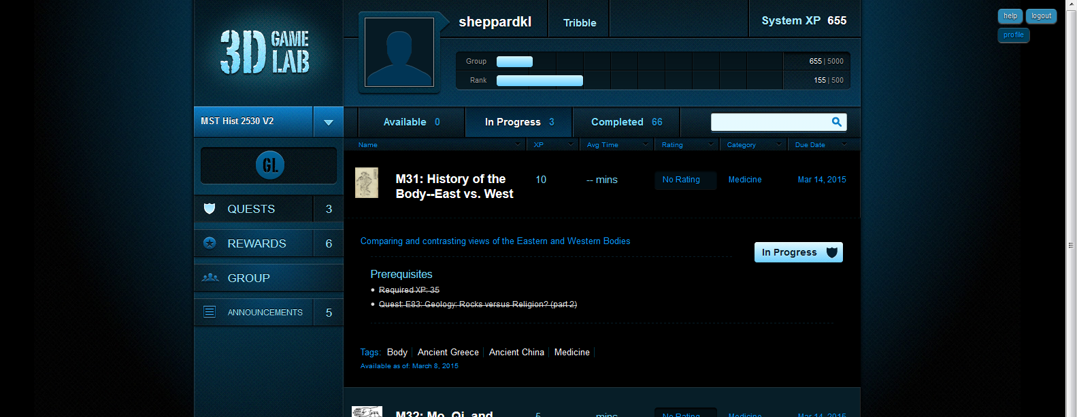

Slide 13
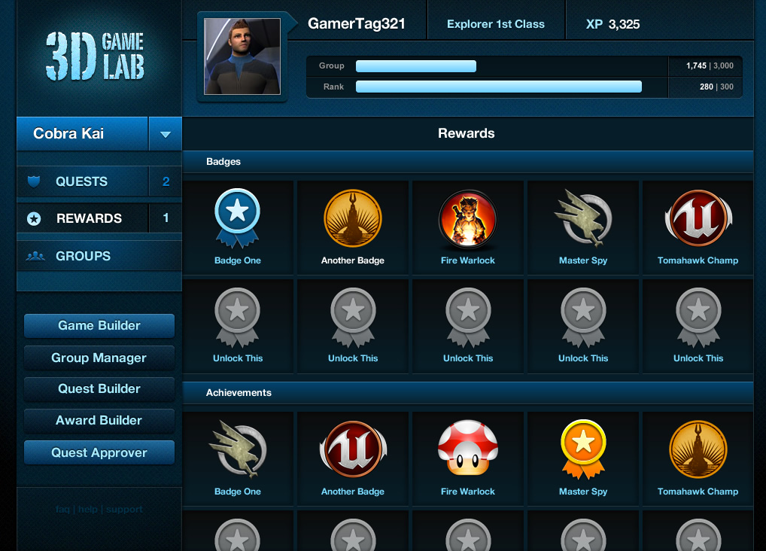
Notes:
Extrinsic motivation through xp accumulation, leveling, badging, and rewards

Slide 14
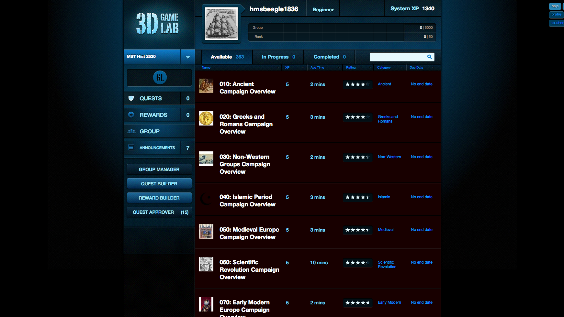
Notes:
This game atmosphere allows for freedom, uncertainty, and a low-risk environment where failure in to grasp a concept or pass an assessment simply prompts another attempt or supplementary work

Slide 15
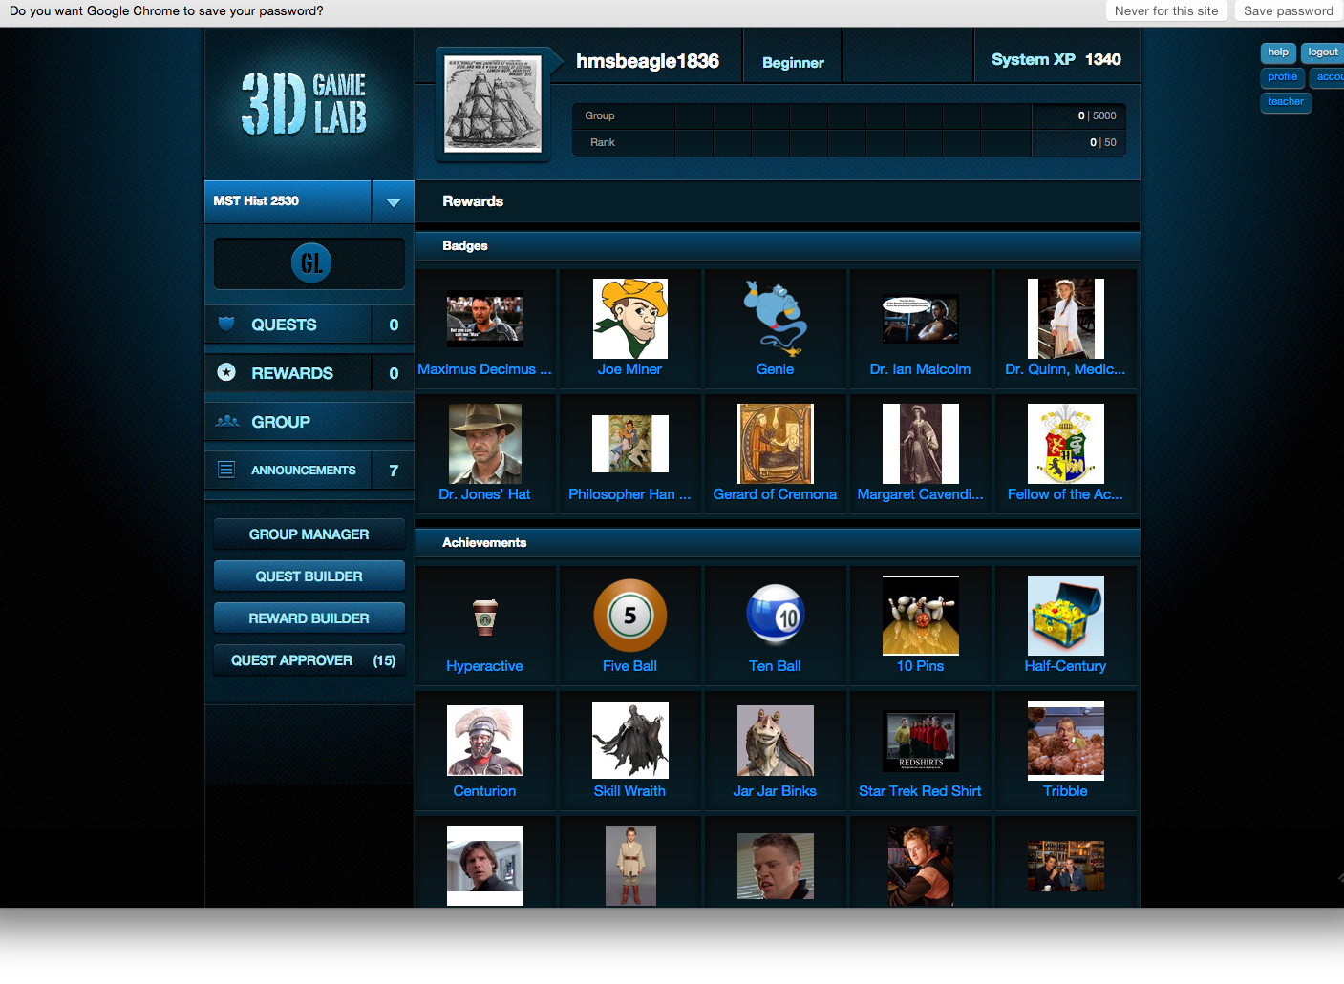

Slide 16
Collaborative Technology
3dgamelab.org
Hackpad
VoiceThread
Google Drive - file sharing
YouTube

Slide 17
Strengths of the Design
Modular design
Gamification - XP, rewards, leaderboard
Badges
Student choice of path
Challenges traditional grading

Slide 18
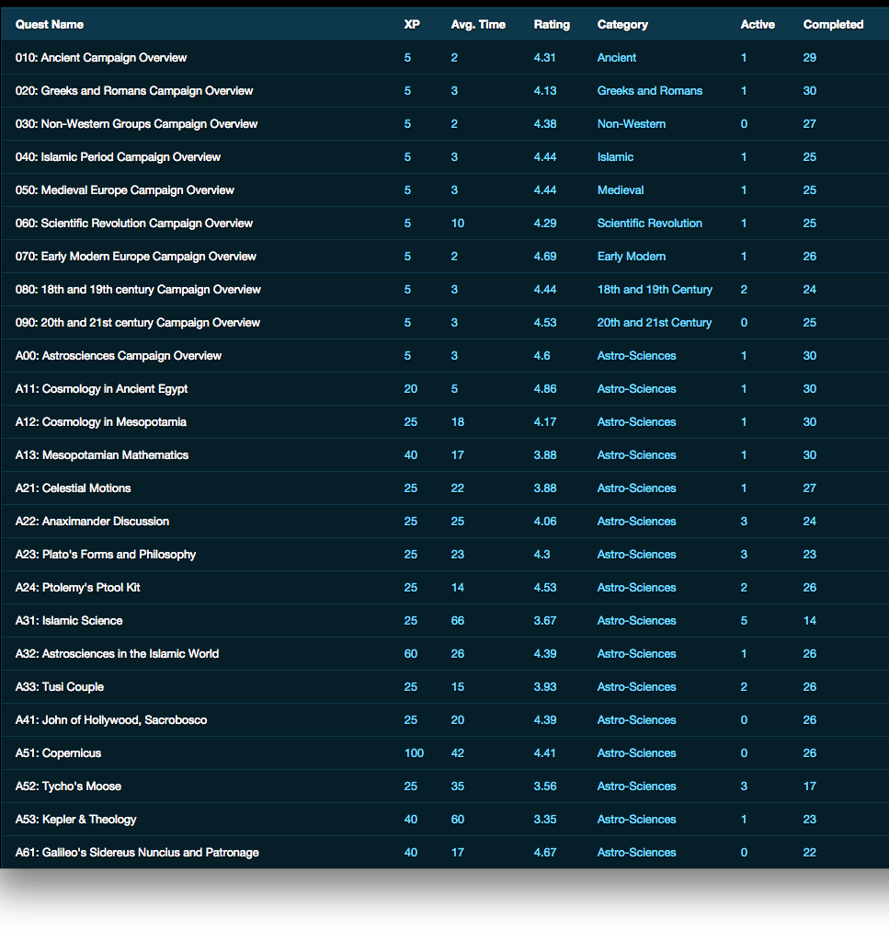
Student Feedback

Slide 19
Limitations of the Design
Just another LMS
The silo effect as opposed to open web
students will lose access at some point
Responses
We agree
The badges are exportable

Slide 20
Limitations of the Design
Coding problems
Self-replication glitch
Teacher side GUI is limited
Gradebook integration
Platform may be undersupported
Notes:
“

Slide 21
Outcomes--Face to Face
Of 1000 students over 10 semesters
Grade average: 85%
Standard distribution
Drop rates: 10%
standard rates for humanities at both institutions
Students are comfortable with the traditional face-to-face format

Slide 22
Outcomes--Online
Of 29 students
8 had no online course experience
16 had at least one online course
4 had blended course experience
Drop rates: 4 of 31 total
12.9 %
Grades: 23 As; 1 B; 2Ds; 1F
Average: 91%
Online format is self-paced
but the students recognize their own procrastination

Slide 23
Outcomes--Blended
Of 29 students
7 had no online course experience
17 had at least one online course
5 had blended course experience
Drop rates: 3 of 29
10.3%
Grades: 10As; 12Bs; 1C; 1D
Average: 89%
Blended
They like that they get the face-to-face contact
Like that the online portion has deadlines

Slide 24
Conclusions
Learning objectives for this class (in any format) are:
Improve writing skills
Engage with primary and secondary sources
Reconsider preconceptions about science

Slide 25
Skills Tracking

Slide 26
Learning Management Systems

