Slide 1
Building Expectations: Targeting Student Learning By Using Auxiliary Online Teaching and
Learning Materials
Missouri S&T, March 13, 2015
Tara Tansil-Gentry M.A.,
Harriette L. Spiegel, Ph. D.
Donald Shaw, Ph.D.

Slide 2
Value Added
Learning outcomes targeted
Learning assessed in many different ways
Guided student learning
Enhancing instruction

Slide 3
Course Home Screen

Slide 4
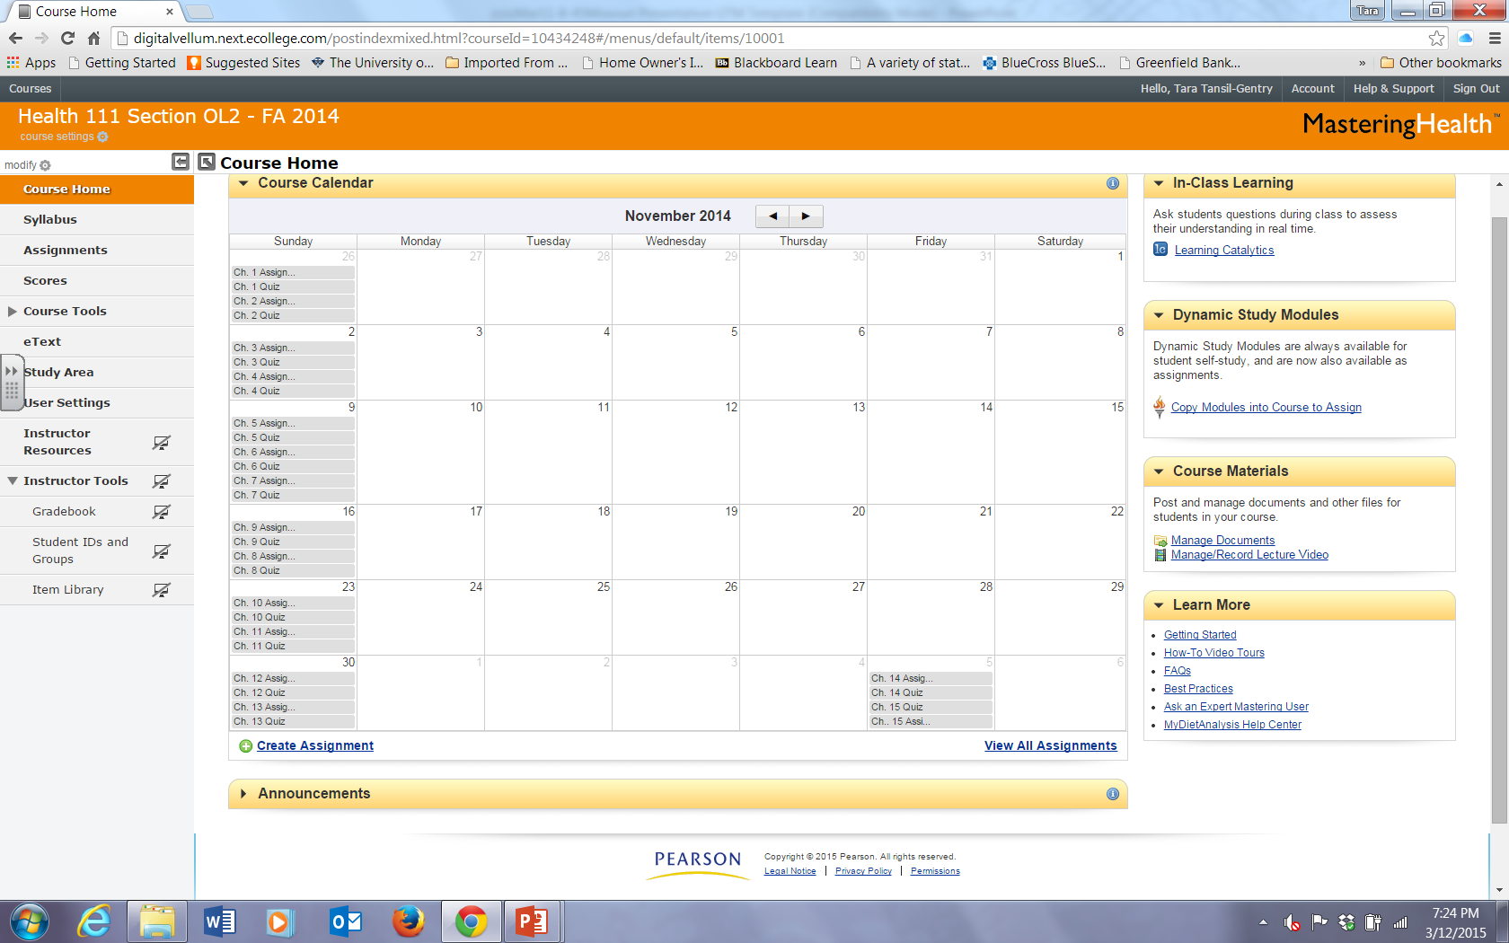

Slide 5
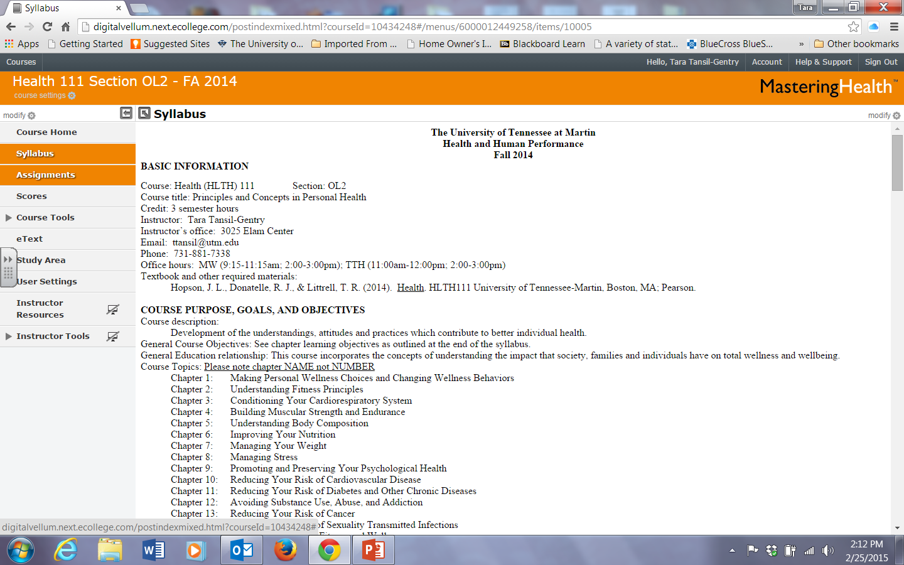

Slide 6
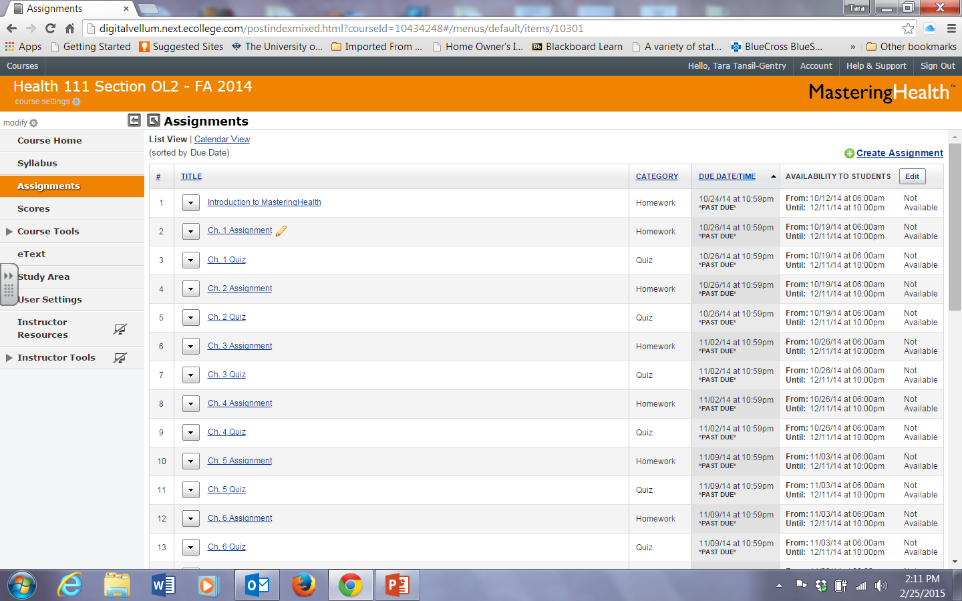

Slide 7
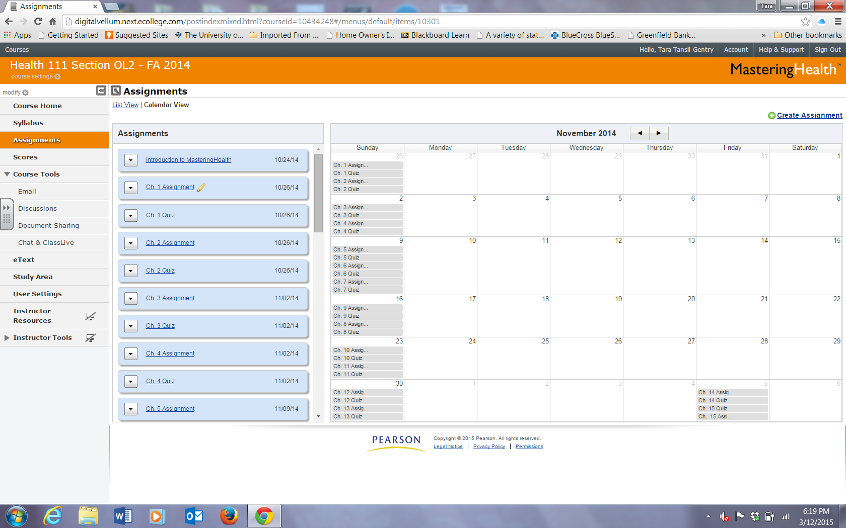

Slide 8
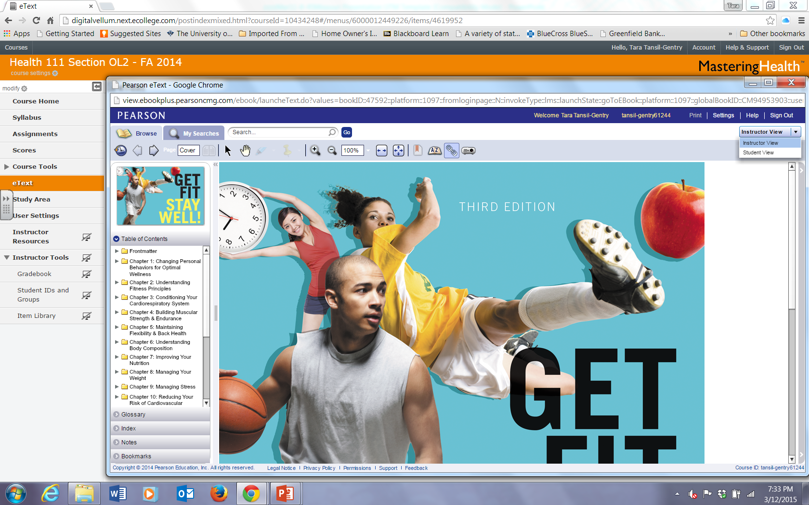

Slide 9
Addressing Learning Styles: Guiding Students in Their Learning

Slide 10
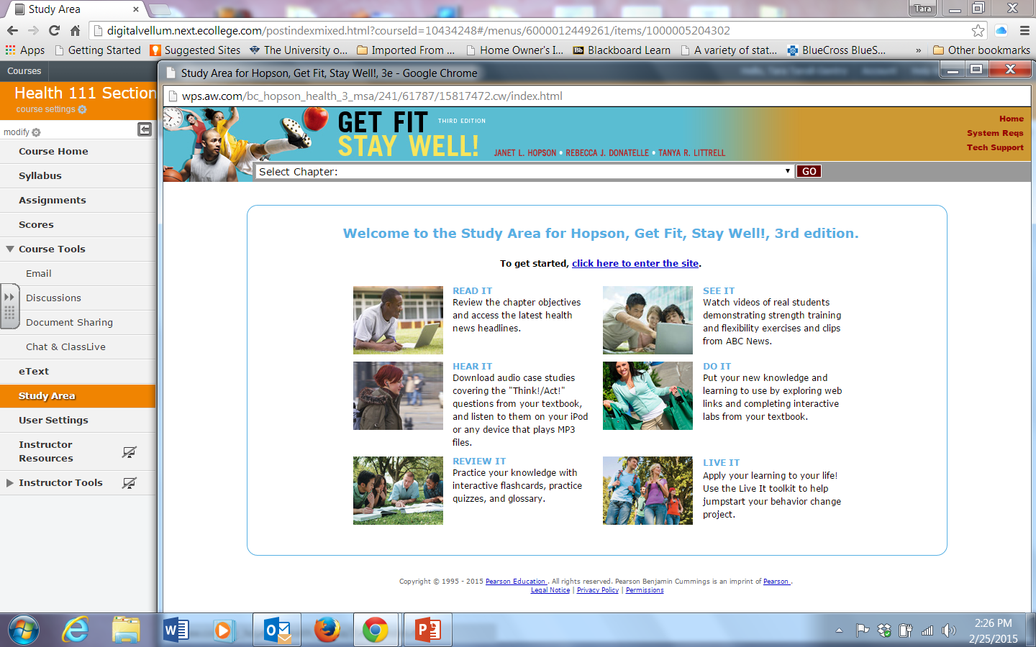

Slide 11
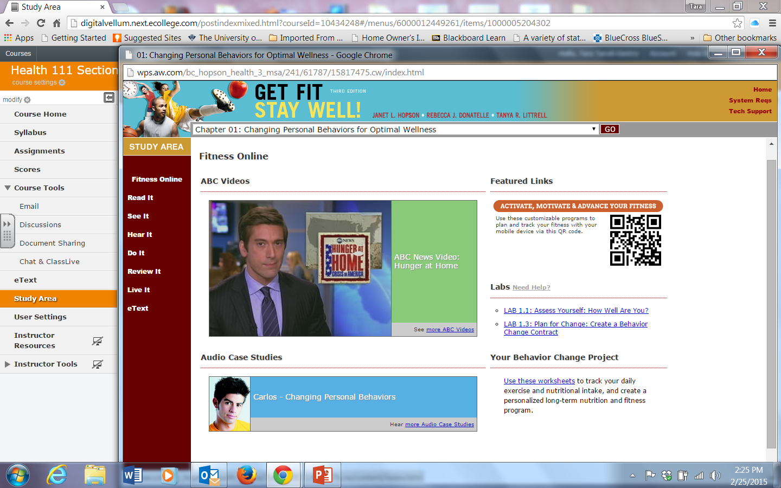

Slide 12
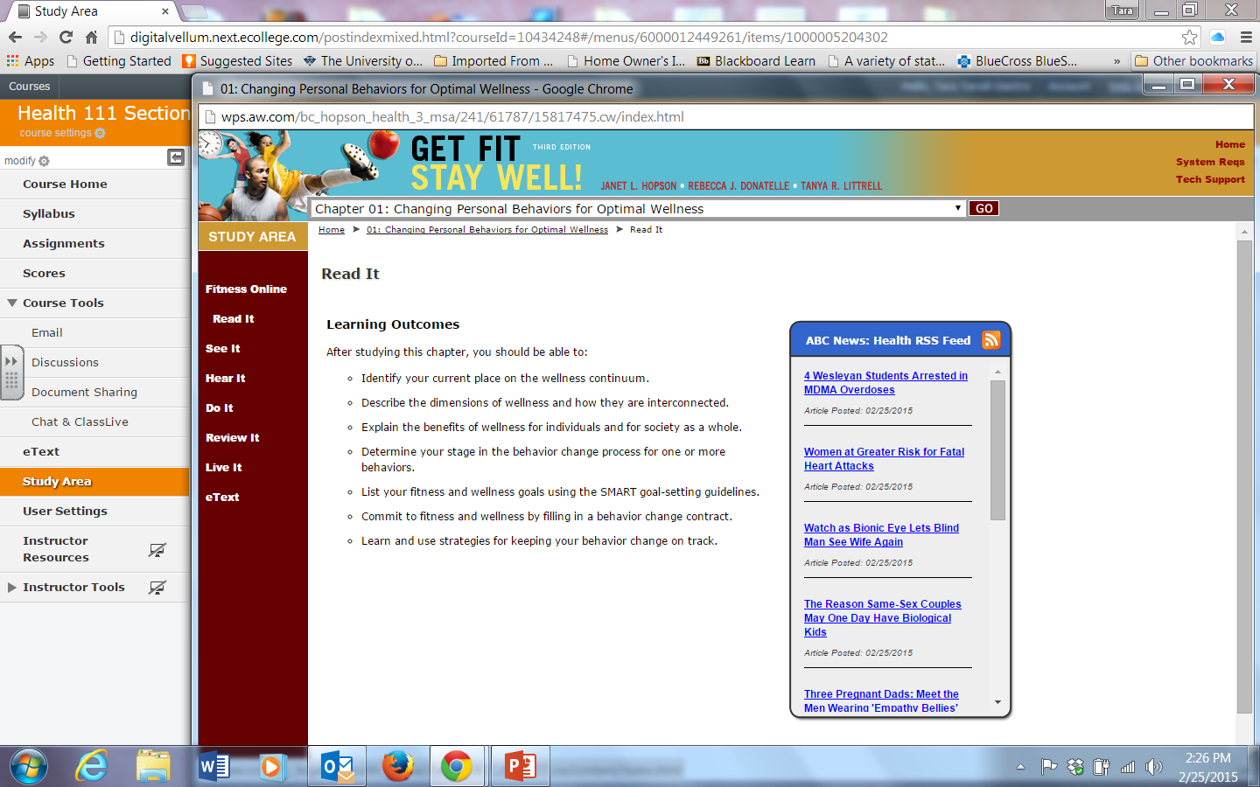

Slide 13
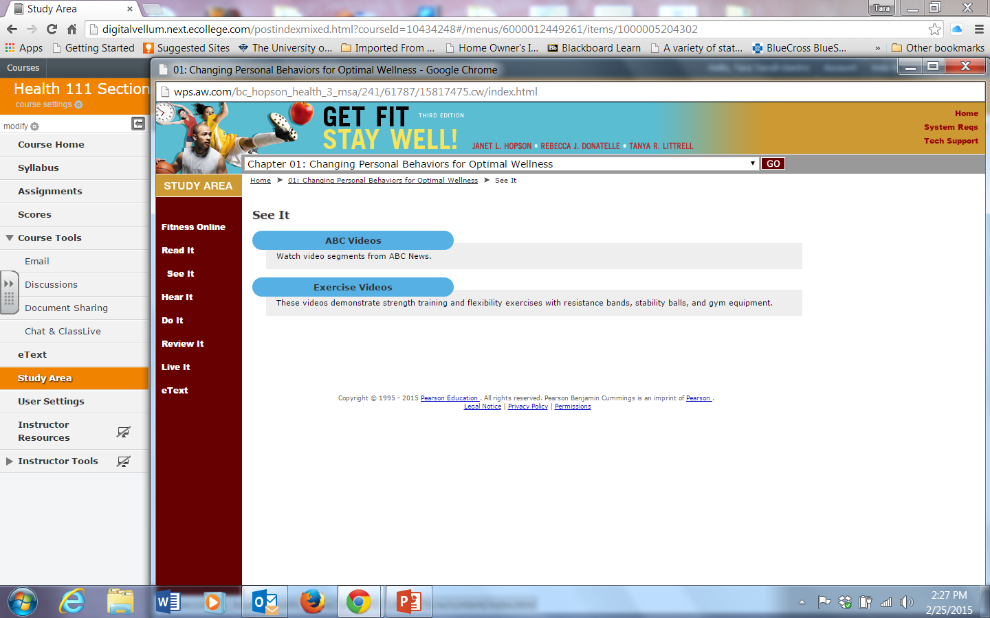

Slide 15
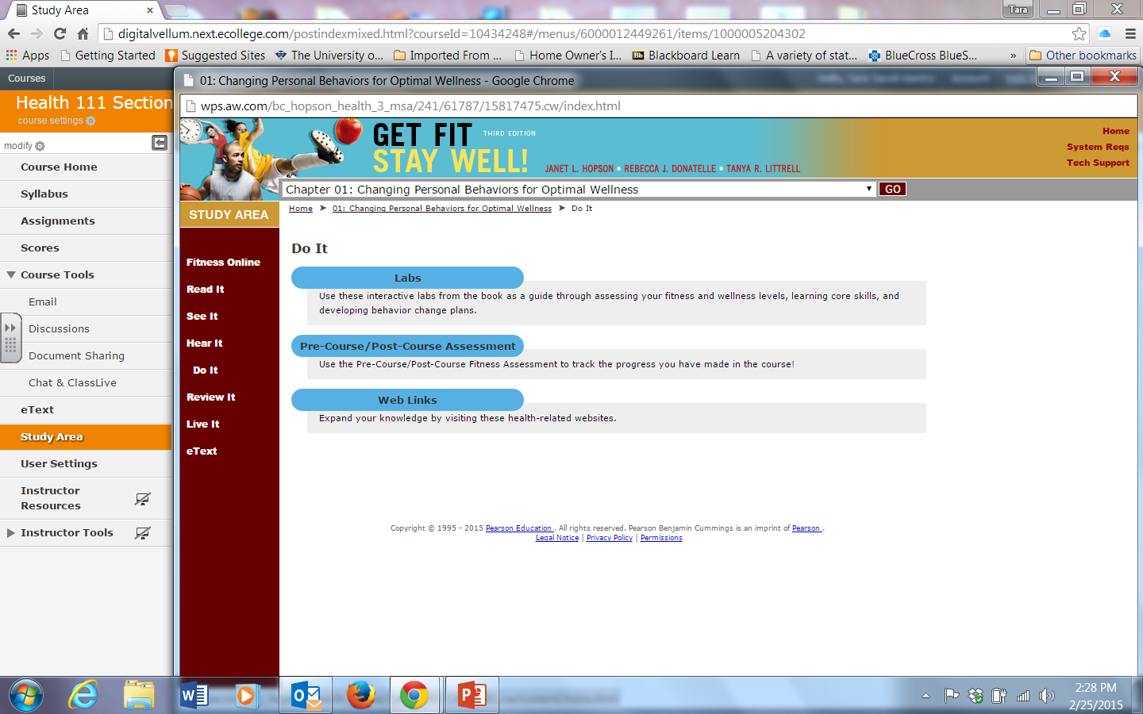

Slide 16
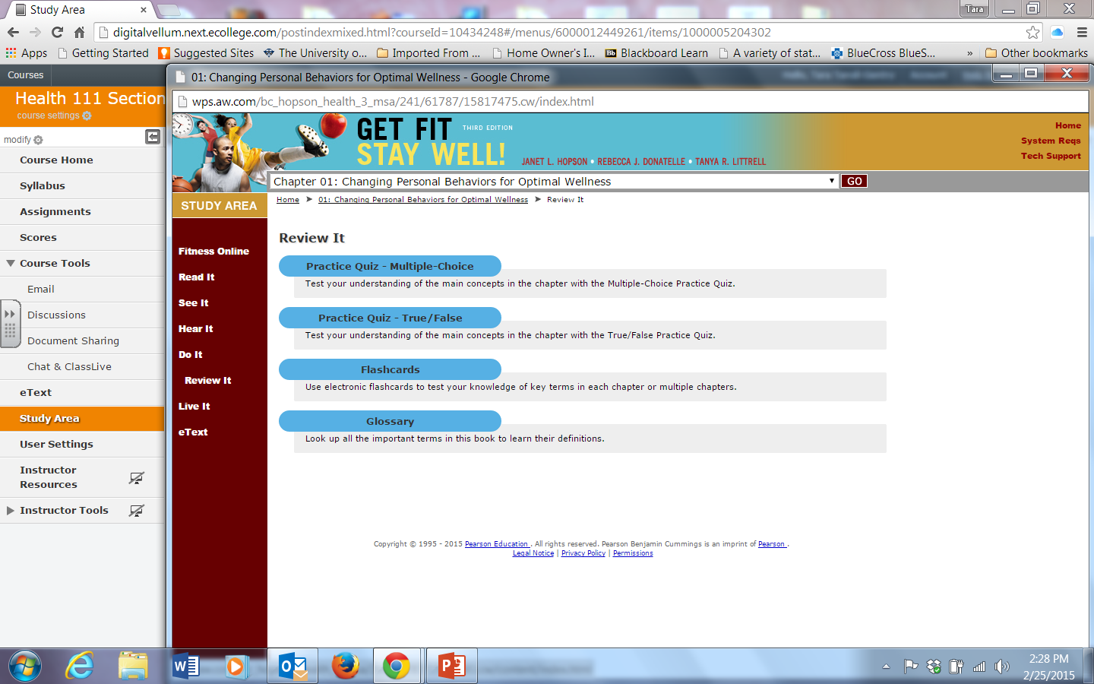

Slide 17
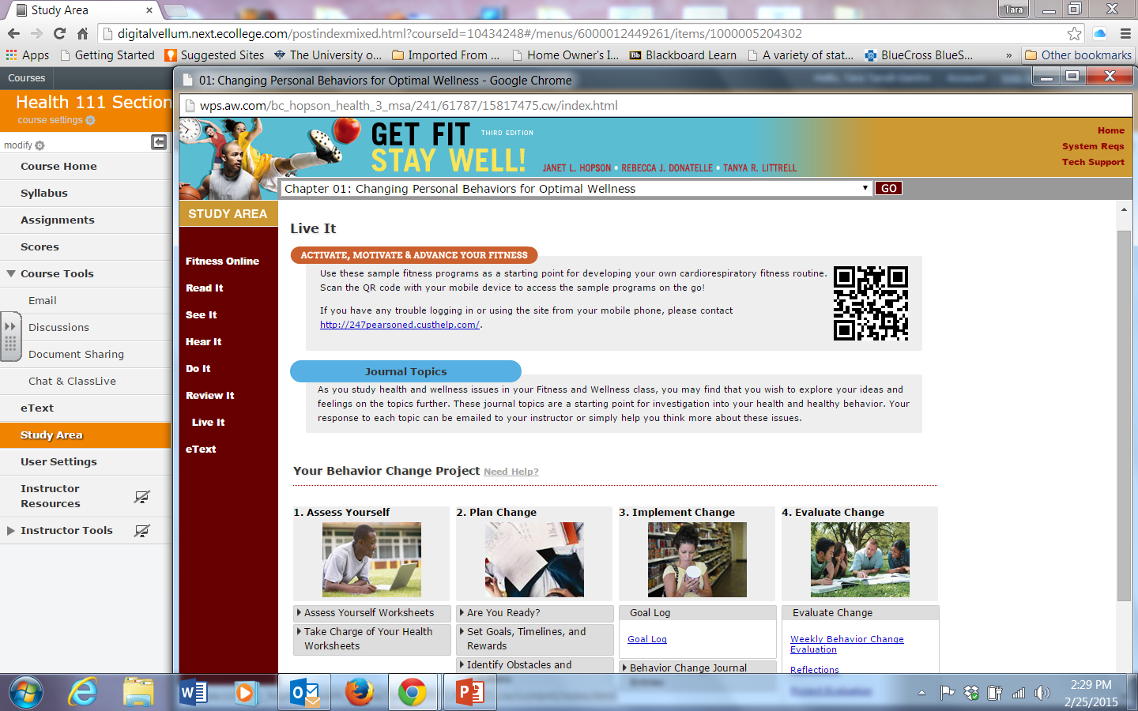

Slide 18
Effective Tools for Enhancing Instruction & Learning

Slide 19
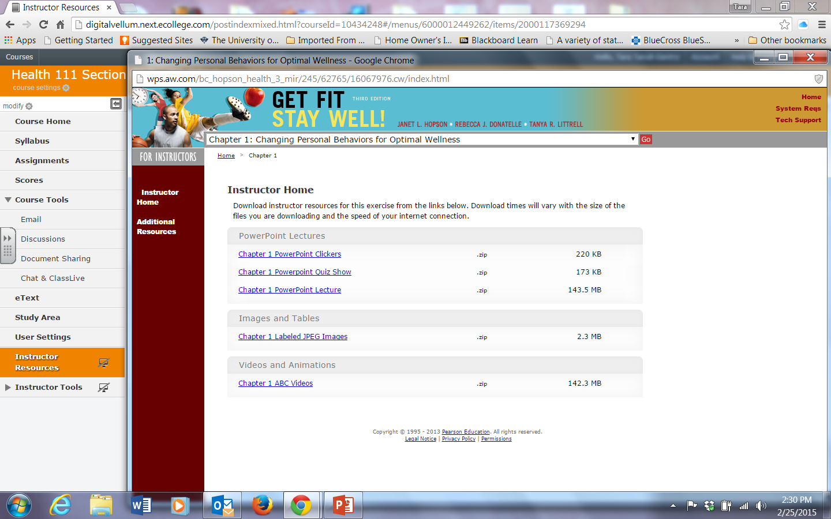

Slide 20
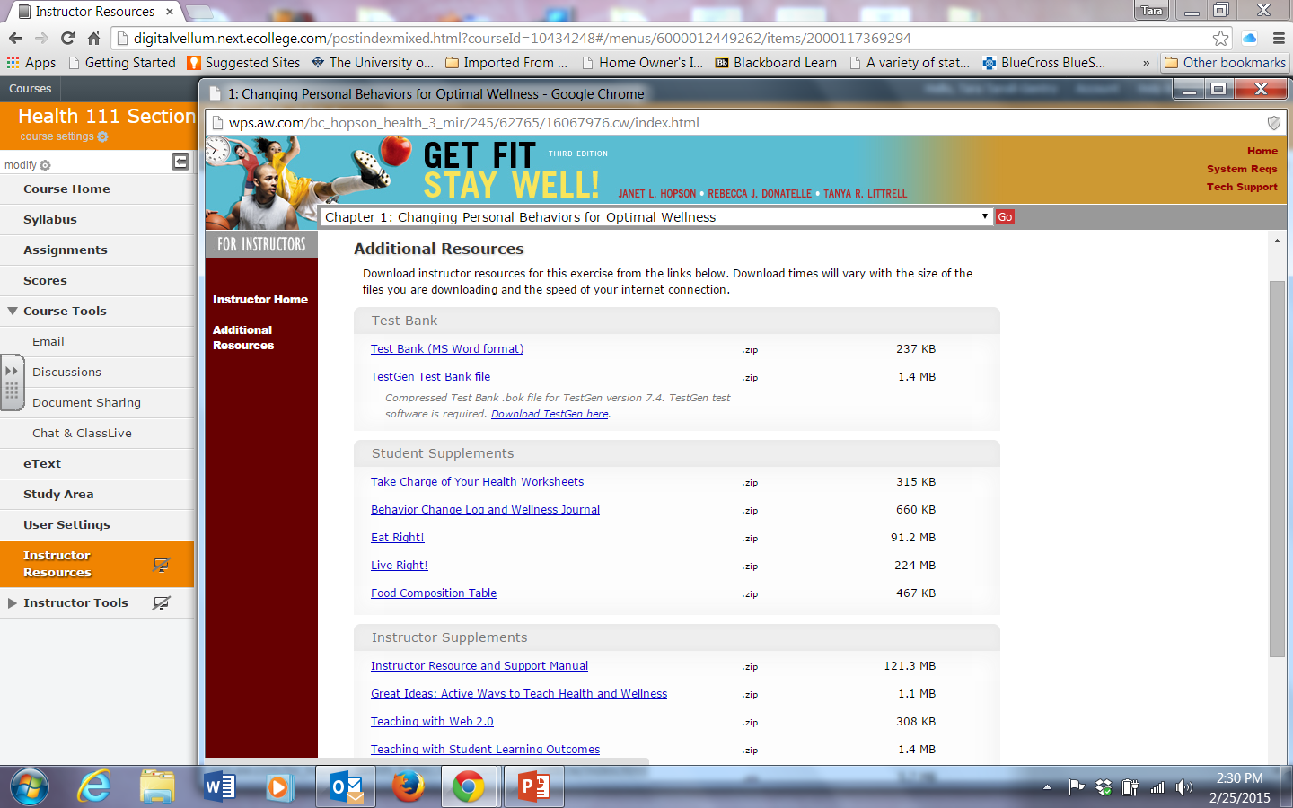

Slide 21
Assessment

Slide 22
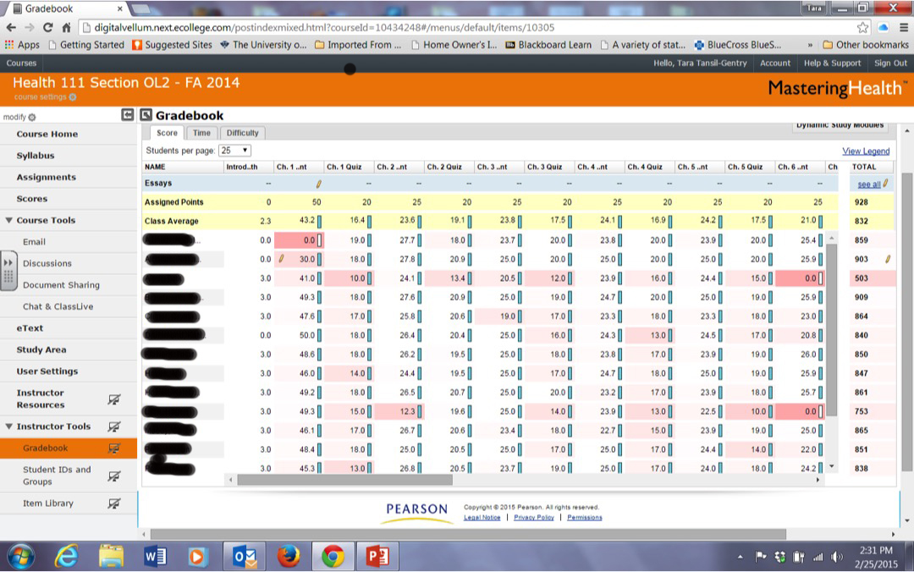

Slide 23
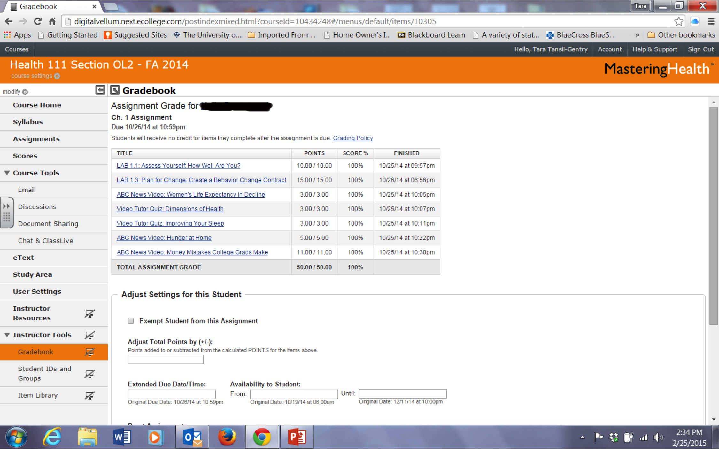

Slide 24
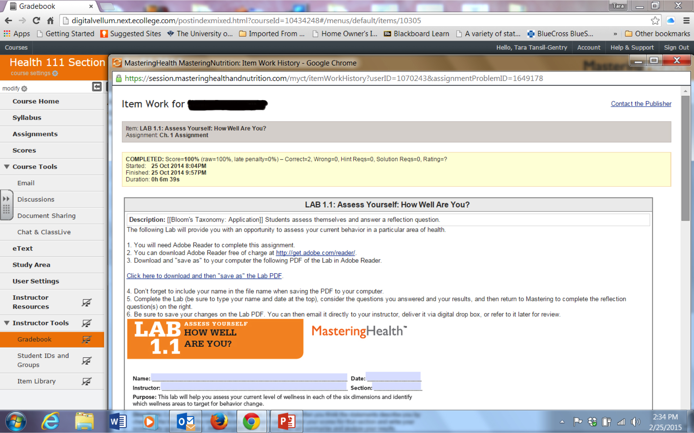

Slide 25
Creating an Assignment

Slide 26
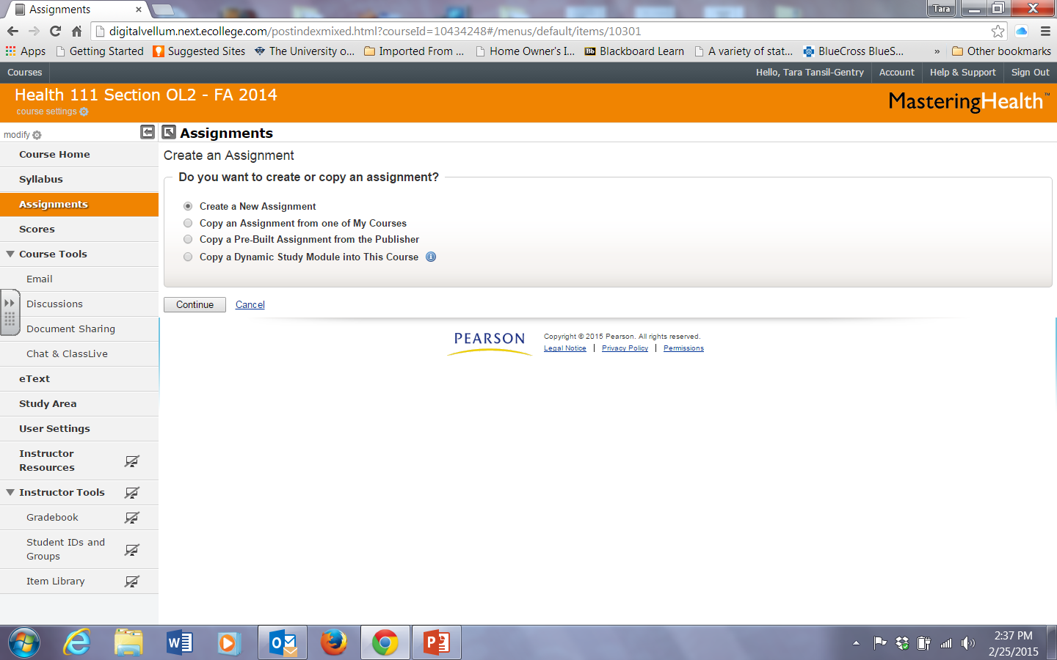

Slide 27
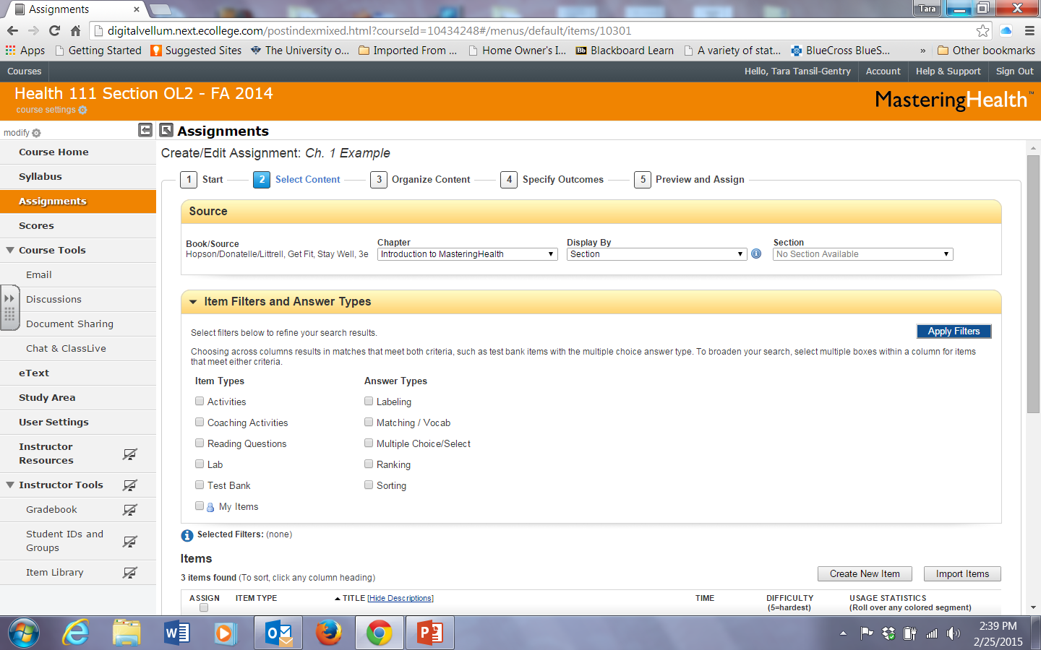

Slide 28
Measuring Learning Outcomes

Slide 29
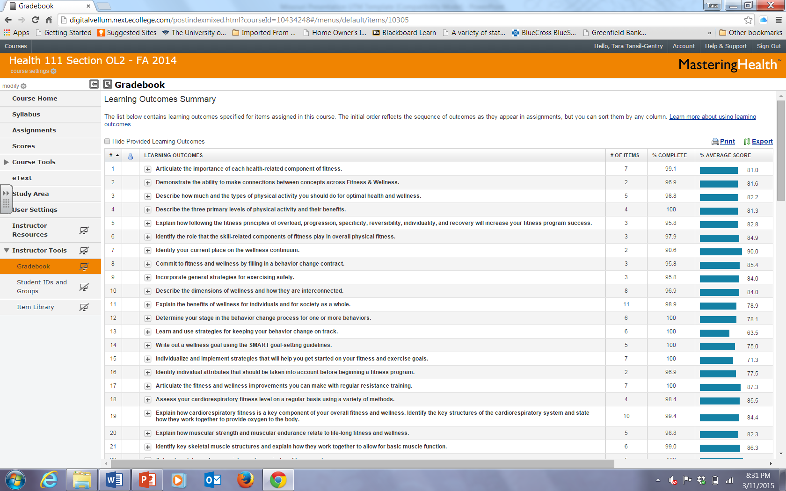

Slide 30
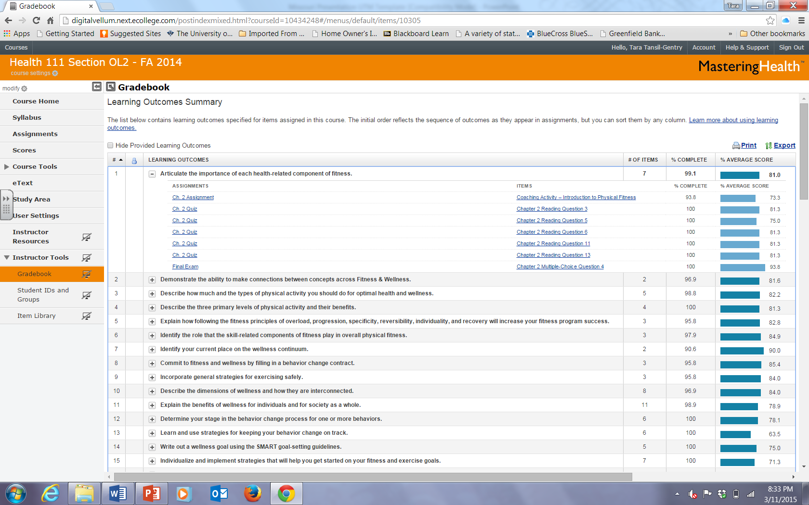

Slide 31
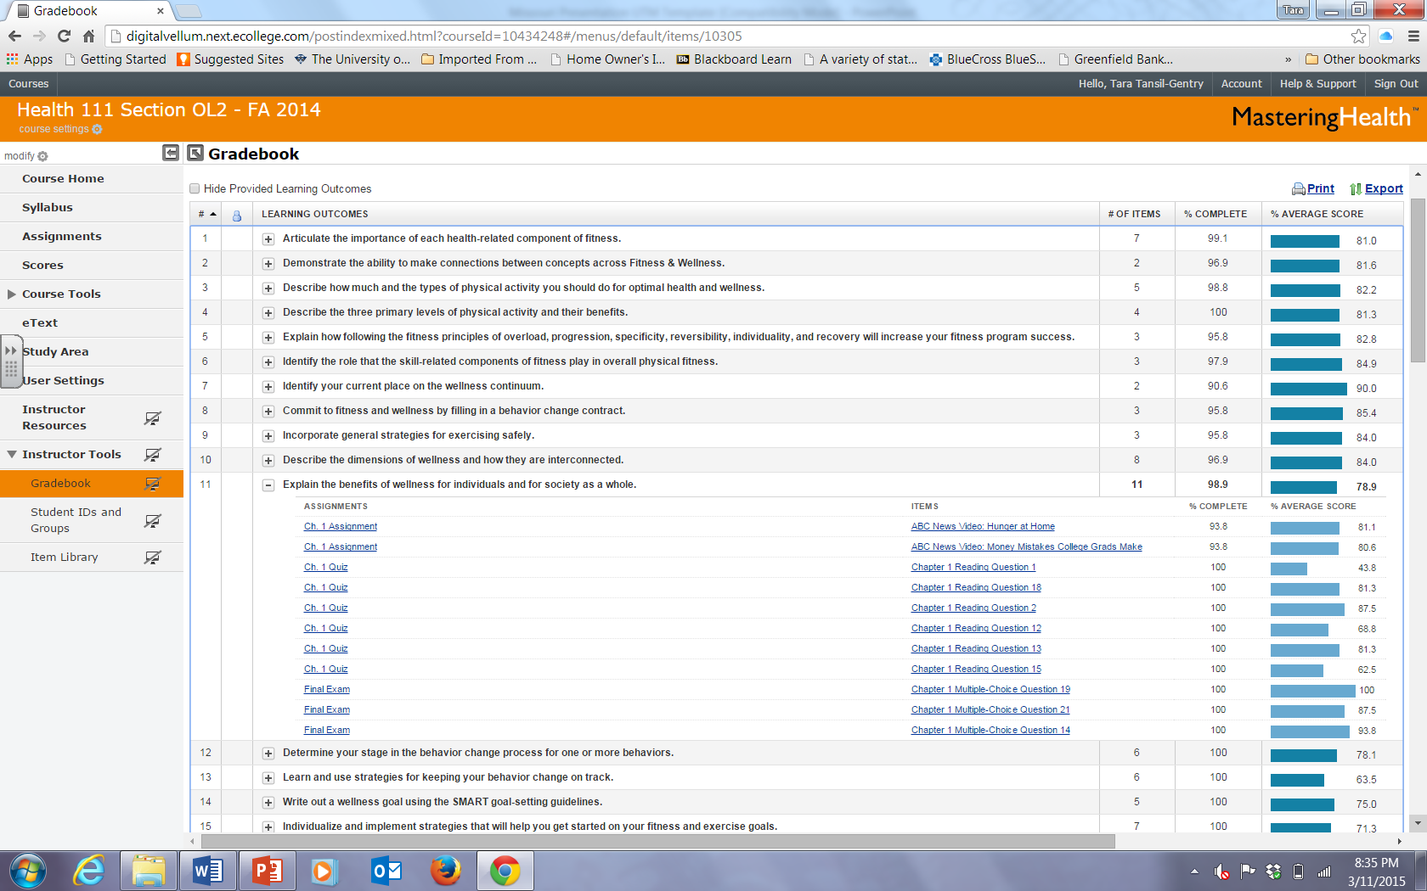

Slide 32
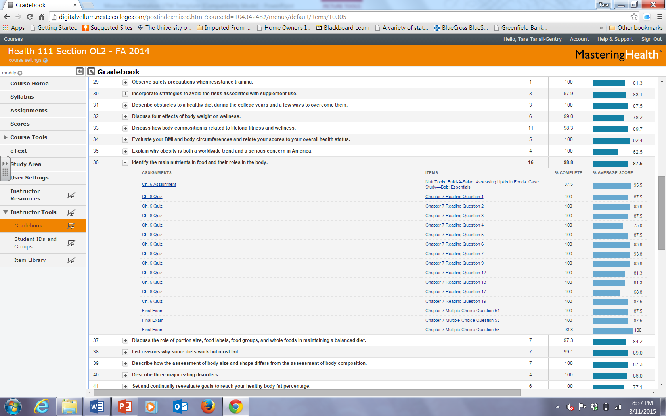

Slide 33
Pros
Standard presentation of content
Convenience of equal expectations from remote sites
Variety of formats, methods of assessment, activities to guide student learning
Ability to track learning outcomes
Appealing to all learning styles

Slide 34
Cons
Individual Instructor course design not possible
Student cost; $66 online access w/ebook versus $130 university bookstore bundle (textbook w/access code)
Possible hesitation of faculty to use technology

Slide 35
THANK YOU
ttansil@utm.edu
hspiegel@utm.edu
donalds@utm.edu

