Slide 1
The Road Ahead Blackboard Learning Solutions
Wade Fields
Customer Success Advocate

Slide 2
Wade Fields
Title:
Customer Success Advocate
Area of education:
Higher Ed/Corporate
Previous Institution:
Capella University
Short bio:
Wade has led several product upgrades and implementations including Blackboard Learn, Capella’s competency based education product FlexPath and multiple customization efforts within the Learn system. He has led efforts to better understand and improve the faculty and learner experience. Wade’s end to end experience allows him to understand faculty and learner perspective as well as technical support and academic administration.

Slide 3
Statements regarding our product development initiatives, including new products and future product upgrades, updates or enhancements represent our current intentions, but may be modified, delayed or abandoned without prior notice and there is no assurance that such offering, upgrades, updates or functionality will become available unless and until they have been made generally available to our customers.

Slide 4
A focus on the learner
Connected and tightly integrated workflows
The New Learning Experience
A delightful new user experience
An accessible and always-on environment
Integrated data and analytics
Notes:
This presentation ASSUMES that the NLE has been properly set up, defined, and introduced. If not, add that to the beginning of this roadmap deck
The New Learning Experience how we describe our design approach—a philosophy and guiding principle for the work we’re doing across all of our teaching and learning solutions.
First is a Focus on the Learner – no matter what we’re working on, making sure we put the learner first. This means understanding their needs through in-depth ethnographic study and applying what we learn to our learning solutions.
Connected and tightly integrated workflows – finding the simplest way to accomplish a task and removing experiential barriers when more than one Blackboard product are used together.
A delightful new user experience – an experience that is not only simpler, easier and quicker, but also fun to use.
An accessible and always-on environment – learning solutions are mission critical for institutions of learning. More and more these systems can’t be down for upgrades, changes, or system problems, so we’re investing in newer technologies that are more resilient when problems arise and require little or no downtime for upgrades.
And Integrated data and analytics – bringing meaningful and actionable information to educators and learners when and where they need it.

Slide 5
Today’s session
Blackboard Learn: 9.1 & The Ultra Experience
Blackboard Collaborate
Bb Student & Blackboard’s Mobile App Strategy

Slide 6
Listening to your feedback
Notes:
that our Blackboard Learn roadmap for the Ultra experience AND Blackboard Learn 9.1 have evolved as a direct result of your feedback since BbWorld 2015. You’ll see that we’ve been listening to what you’ve said you need to drive the Ultra experience at your institution, as well as what you’re looking for today on a MH or SH platform. You are going to be excited to see what we’ve got coming up for you.

Slide 7
Blackboard Learn: 9.1 and the New Ultra experience

Slide 8
Blackboard Learn 9.1

Slide 9
The Power of Learn 9.1
Flexible hosting options
SaaS, Managed Hosting and On-Premise deployment to best fit your needs
Functionality to support the full spectrum of educators
Full-featured Original Course View with unmatched depth and breadth of functionality
Integration with our latest solutions
Fully integrated with Bb Student and the new Collaborate
Embedded learning analytics
Understand and act on student, program, institution and system data
Ongoing innovation and support
Improvements and enhancements for students, instructors, and administrators
Notes:
Flexible hosting options
We understand that different institutions has different needs for hosting their learning environment. Because of this, we’re the only vendor who provides SaaS, Managed Hosting, and On-Premise deployment, providing unparalleled choice.
Deep functionality
Institutions and programs have a broad spectrum of pedagogical needs for a diverse educator population. Learn 9.1 has the broadest array of functionality to meet the most number of educational models and pedagogical needs.
Integration
Many of our customers and users are using the new Collaborate and BbStudent, and we’re thrilled to be able to offer these innovative and elegantly designed products as part of Learn 9.1.
Analytics
Institutions and programs need information to improve their effectiveness, efficiency, and student outcomes and experiences. Embedded analytics in Learn 9.1 supports schools to get the most out of their educational programs.
Ongoing Development & Support
Blackboard is fully committed to Learn 9.1, with long support windows, a consistent release calendar, and continued investment in quality, usability, and innovation.

Slide 10
Continued commitment to 9.1
Q3 ‘15
Q4 ‘15
Q1 ‘16
Q2 ‘16
Q3 ‘16
Q4 ‘16
9.1 Oct 2014
CU
CU
CU
CU
CU
9.1 Q4 2015
CU
CU
CU
Major release every 6 months
9.1 Q2 2016
CU
More Cumulative Updates (1 per mo.)
9.1 Q4 2016

Slide 11
9.1 Q4 2015 Release Available now

Slide 12
Quality counts! What we hear from you…
“Bug free tools that work as advertised and are easy to use are much more of a need right now than new features.”
“I just want a system that works right all the time.”
“I feel like bug fixes have been coming out more frequently, and the way they are handled is very consistent, but I'd like to see more work done in this area.”
IT Leader 2-year private college
Faculty member 4-year public college
Technology support staff 4-year public college

Slide 13
Quality and maintenance Q4 2015 release
Hundreds of issues fixed in the most important areas!
Notes:
Based on our internal measurement, and the feedback of many customers, we believe the 9.1 October 2014 release is very stable
Focus on quality
We know from talking with many of you that quality is the highest priority for most of you. Because of this, we’ve really emphasized fixing issues and increasing QA testing to ensure higher quality releases, resulting in fewer bugs and bumps in the road for you.
More staff aligned to this goal
But of course there’s always room for improvement, so I’m happy to share that we recently decided to hire more staff to work specifically on 9.1 quality. We think you’ll really appreciate this in our future releases.
More CUs / fixes in major releases
Another benefit of adding additional staff is increasing our capacity to fix and release Cumulative Updates more regularly and frequently, ensuring that if some bugs do slip through the cracks, we’ll be able to fix them as fast as possible.

Slide 14
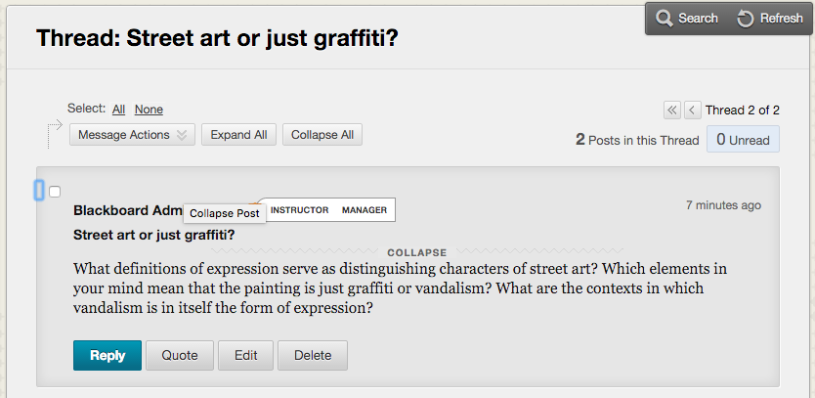
Workflow improvements & usability Q4 2015 Release
Notes:
“Quality” sometimes means fixing bugs, and sometimes means something more subtle, like the ease of navigating Learn, or how many clicks it takes to complete an action.
Improve the workflow of important areas
So in addition to fixing bugs, we’re also working on improving the way our current features are designed to make things more efficient for your educators and students.
Example: discussions thread to thread navigation
A great example in the Q4 2015 release is an improvement to discussion boards. We recently made some improvements to the overall design of discussions, but we also left out an easy way for users to go from one thread to the next quickly. This is a small thing, but small things matter when you’re looking to complete tasks more quickly.

Slide 15
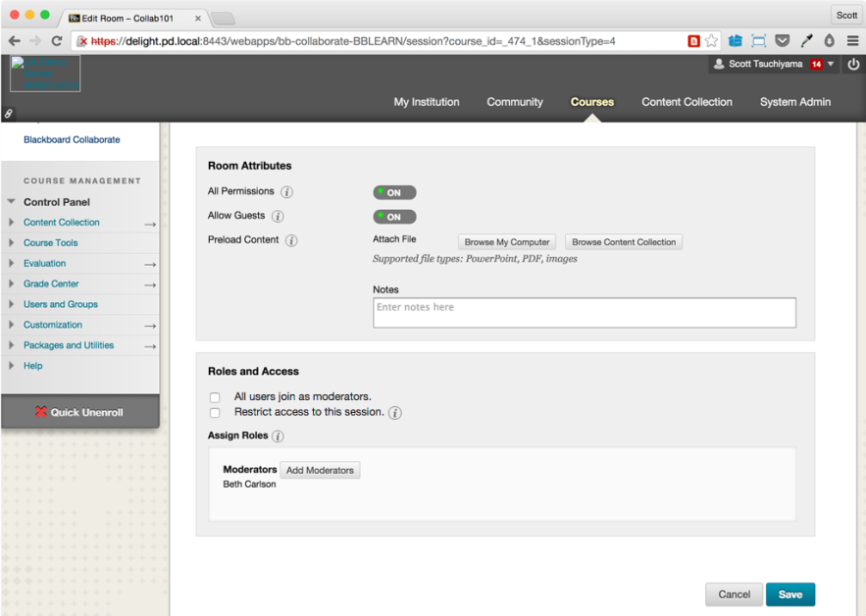
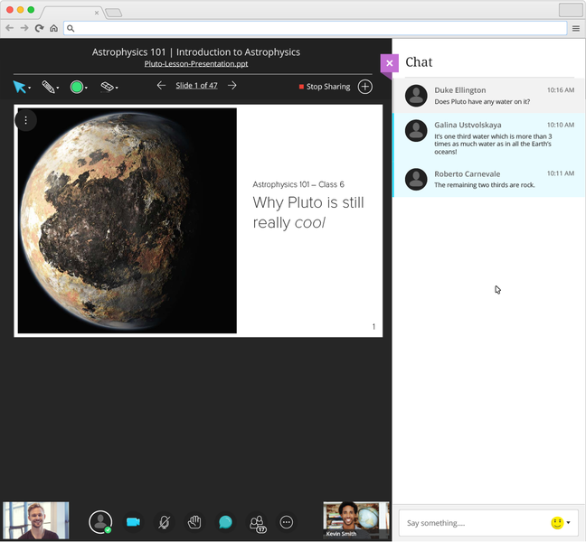
Collaborate Ultra Experience – Learn 9.1 integration Available now

Slide 16
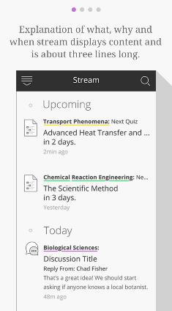
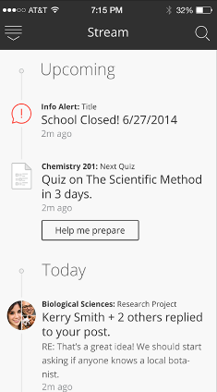
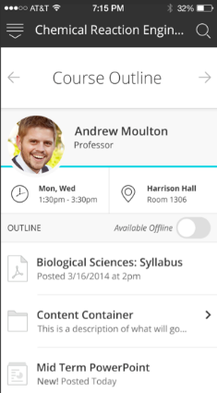
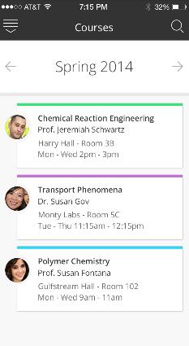
Bb Student App – Learn 9.1 integration
Available now
First Time User Experience
Stream: What’s New/Due
Course Outline
Course Timeline
Notes:
So, now, let me tell you a little bit about Bb Student, Blackboard’s first persona-based native mobile app.
Bb Student is available now for the phone in the Apple, Google and Windows app stores, and for the tablet in the Windows tablet app store.
I’m telling you this as a prepare to show you a live demo…and we all know how live demos can go…at least during July, I know there will be no text message about a lack of money in their lunch account…my district doesn’t use ParentLink ☺ (make sure Eanes ISD isn’t there…)
In my short demonstration of Bb Student, I want to focus on a few simple things:
The modern, predictable, delightful design: I want to simply move through the application without narrative or many stops to show you how the application looks & feels
The Stream: I want to highlight the importance of the curated home page stream – students these days need a clear “instagram-like” stream of what’s new & due. The majority of the time students spend in Bb Student will be spent on this activity stream, the home screen. It represents a “smart view” of prioritized events and actions, and pushes content to the student. We’ll do the heavy lifting help students can prioritize their work and spend their time on the thing that matters the most, learning.
Course Timeline. The course timeline provides students with a visual representation of their courses - past, present, and future. Courses are grouped by term and year with relevant course information using simple repetitive design patterns to create semantic connections between courses across the learning environment. Display course information including instructor name, course title, location, and hours.

Slide 17
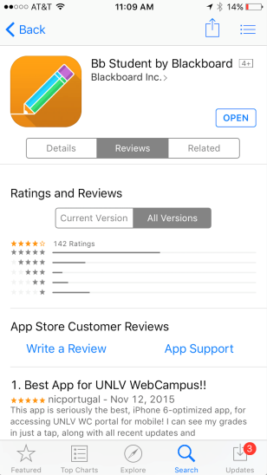
Students love Bb Student for Learn 9.1
“I’ve been using apps by Blackboard for a long time now, but I have to say the most recent update is amazing!”
Uoflstudent24
“This app makes my school routine so much easier.”
“…it almost makes it fun to check my class assignments”
CdPeralta
The Nightly Pacifist

Slide 18
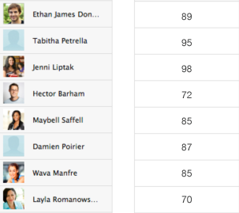
Simpler SIS Grade Exchange Q4 2015 release
HR/ERP
Grades Column
Provisioning
Library
Timetable
Grades approval, release Optional read-only after post
SIS
Grades
Exchange
Notes:
Managing grade information is complex and time consuming. While the SIS is the system of record, Blackboard Learn is often where assessments take place and grades are collected. Posting grades to the SIS from Blackboard Learn is a huge efficiency for faculty members and administrators.
New Grade Center functionality will accept gradebook column information from the SIS and also manage the approval, posting, release, and locking of gradebook data in the Grade Center. The exchange of information can be through flat files, LIS SOAP web services, or REST web services, offering tremendous flexibility for institutions.
Because of widely differing SIS solutions and institutional policies, Blackboard will be assisting by offering fixed-price implementation services for this grades exchange.

Slide 19
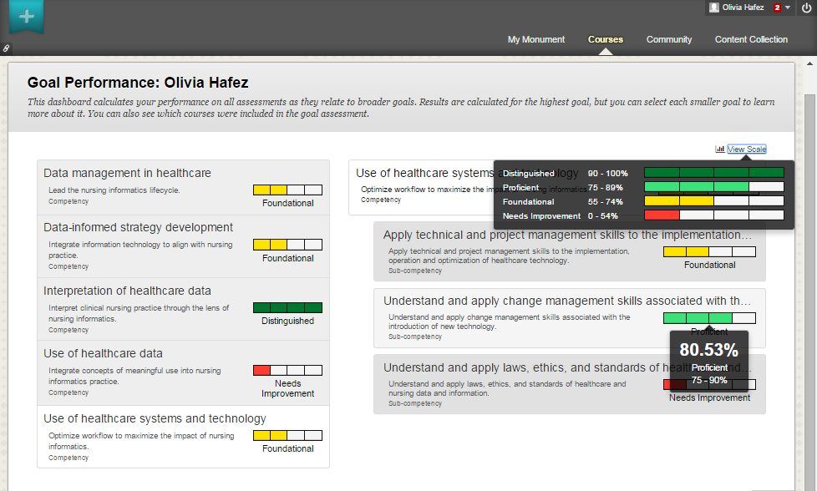
Competency based education Q4 2015 release
Notes:
We know that many institutions are just starting, or have been delivering competency-based education programs. Through Badging, Standards and Goal Alignment, Outcomes Assessment, amongst others, Blackboard has the foundational workflows and data capabilities needed to support many competency based programs. What we are developing are additional end user interfaces and reports to get at this data and make meaning out of them.
For example, a learner’s dashboard uses existing alignments and grading tools to create a view that allows the learner (and advisor) to understand how s/he is performing against the stated learning outcomes of the program across all courses—which is what we see here including aggregation up the competency model’s hierarchy. Instructors can also see how all students are performing against the defined course learning outcomes.

Slide 20
What’s Next for Learn 9.1?

Slide 21
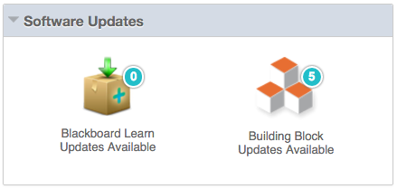
Quality & maintenance: Cumulative Updates & Building Blocks In development
“Fix the dependency checking to properly identify cumulative updates and actually make it impossible to deploy things in the wrong order ever again.”
Technology Support Staff
U.S. public university
Notes:
Speak to example bug fixes for Q2:
Email – replying to a system-sent email
Spell checker performance fix – fix the slow down when mutliple languages enabled

Slide 22
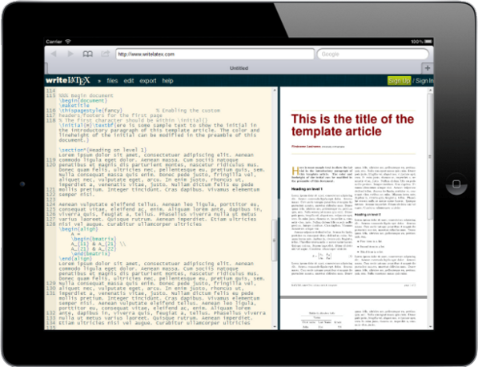
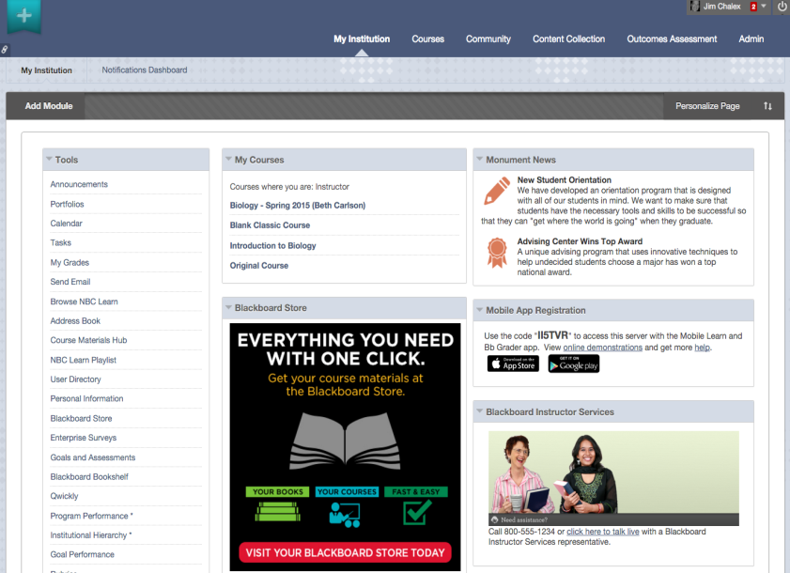
Responsive design for Learn 9.1 In development
Conceptual mock-up subject to change without notice

Slide 23
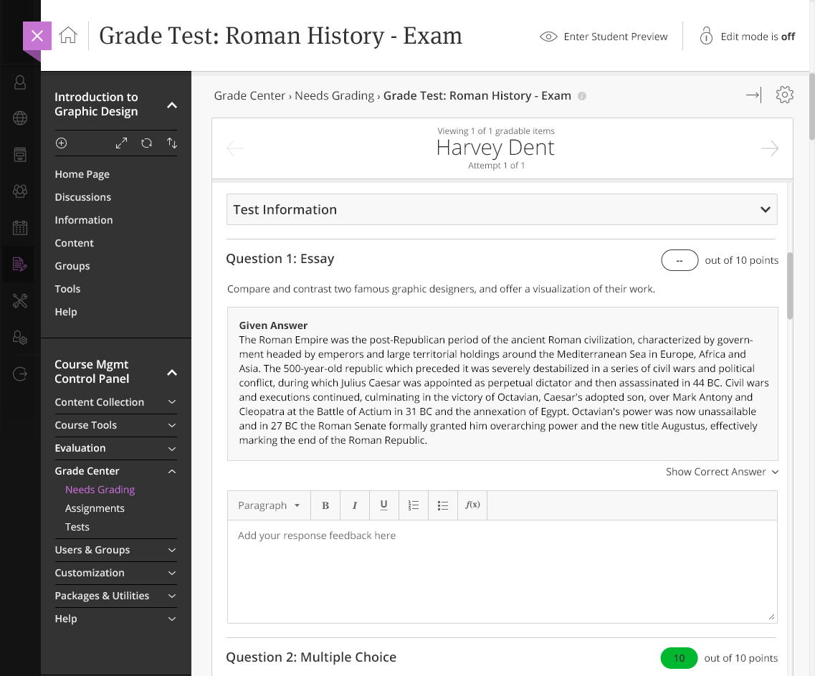
New theme for Learn 9.1 In development
New, modern system and course theme for Learn 9.1 (inspired by the Ultra experience)
Will work for all deployment types (Self-hosted, Managed Hosting, and SaaS)
Conceptual mock-up subject to change without notice

Slide 24
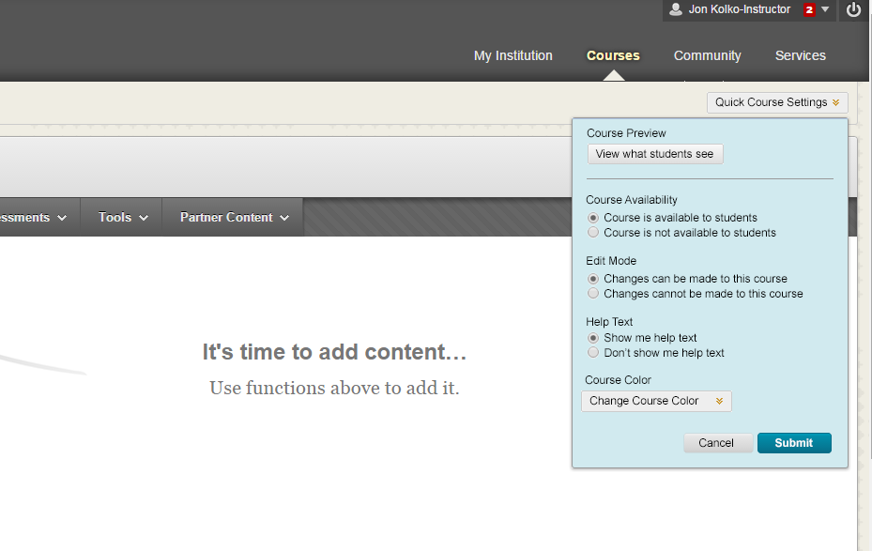
Workflow improvements & usability In research
Conceptual mock-up subject to change without notice
Notes:
One more example of these workflow and usability enhancements we’re currently planning:
Bringing the most commonly used course settings up to the front for instructors, making it easier to make common changes to the course such as making it available and unavailable, without having to click through the various levels of the Control Panel.

Slide 25
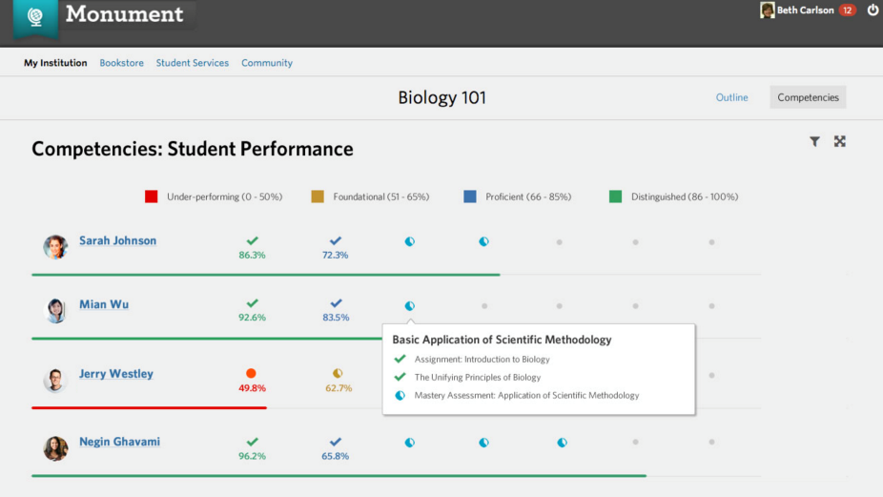
More for competency-based education: Dashboards In research
Enhanced course dashboard
Improved program dashboard
Conceptual mock-up subject to change without notice
Notes:
One more example of these workflow and usability enhancements we’re currently planning:
Bringing the most commonly used course settings up to the front for instructors, making it easier to make common changes to the course such as making it available and unavailable, without having to click through the various levels of the Control Panel.

Slide 26
Blackboard Learn Ultra Experience

Slide 27
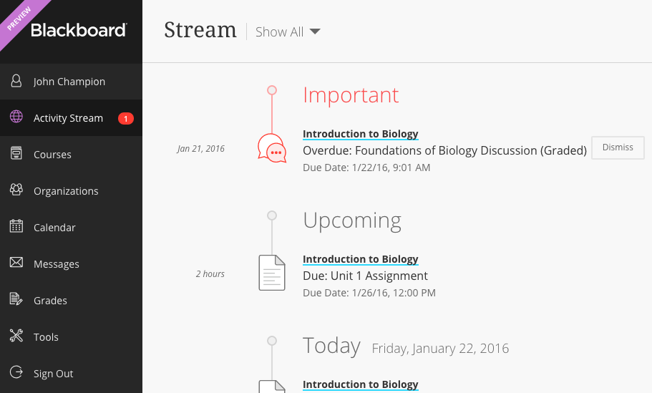
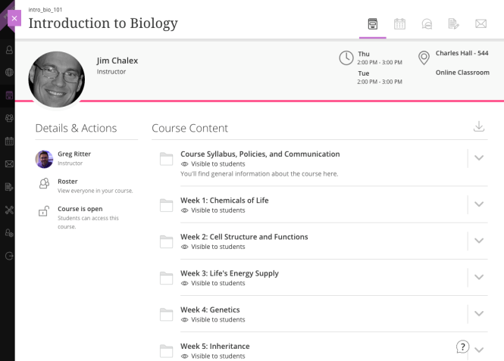
Learn & the Ultra Experience Why Ultra?
Modern
Notes:
We think the Original Learn experience is good, but there were some changes we wanted to do that went beyond incremental steps. And there were several drivers for this change.
Modern UI
A fact of life is that most of your educators and students spend more time on other websites OUTSIDE your learning environment. Because of this, we felt it was important to come up with an aesthetic design that was highly modern and recognizable as such by students and instructors. This modern design instills confidence and engagement in users – this is a great place to learn and interact with others!
Easy to use
Ultra has an aesthetically beautiful new look, but it’s also important to remember that just because it’s beautiful doesn’t mean it’s efficient. Happily, we’ve also spent a lot of time obsessing over the details of navigation, page layout, and usability in general to achieve what is a demonstrably easier to use interface. This means that educators and students can get more done in a shorter amount of time!
More devices
We’ve designed the Ultra experience to work wonderfully on PCs and laptops, but we also knew that because of the growth in use of tablets and smartphones, we wanted to bring the power of Learn to these other devices. And this is just what we’ve done with the Ultra experience, bringing greater freedom to students and instructors to use Learn where they want, and when they want.
Student-centric
Also, in keeping with our focus on the learner, overcoming anxiety, and creating an engaging experience, we wanted to make sure that the Ultra design had students in mind from the start. This also means that by making it easier for instructors to design elegant courses, we’re ultimately making the student experience better in the process!

Slide 28
Learn & the Ultra Experience Why Ultra?
Modern
Easy to use
Notes:
We think the Original Learn experience is good, but there were some changes we wanted to do that went beyond incremental steps. And there were several drivers for this change.
Modern UI
A fact of life is that most of your educators and students spend more time on other websites OUTSIDE your learning environment. Because of this, we felt it was important to come up with an aesthetic design that was highly modern and recognizable as such by students and instructors. This modern design instills confidence and engagement in users – this is a great place to learn and interact with others!
Easy to use
Ultra has an aesthetically beautiful new look, but it’s also important to remember that just because it’s beautiful doesn’t mean it’s efficient. Happily, we’ve also spent a lot of time obsessing over the details of navigation, page layout, and usability in general to achieve what is a demonstrably easier to use interface. This means that educators and students can get more done in a shorter amount of time!
More devices
We’ve designed the Ultra experience to work wonderfully on PCs and laptops, but we also knew that because of the growth in use of tablets and smartphones, we wanted to bring the power of Learn to these other devices. And this is just what we’ve done with the Ultra experience, bringing greater freedom to students and instructors to use Learn where they want, and when they want.
Student-centric
Also, in keeping with our focus on the learner, overcoming anxiety, and creating an engaging experience, we wanted to make sure that the Ultra design had students in mind from the start. This also means that by making it easier for instructors to design elegant courses, we’re ultimately making the student experience better in the process!

Slide 29
Learn & the Ultra Experience Why Ultra?
Modern
Easy to use
Responsive
Notes:
We think the Original Learn experience is good, but there were some changes we wanted to do that went beyond incremental steps. And there were several drivers for this change.
Modern UI
A fact of life is that most of your educators and students spend more time on other websites OUTSIDE your learning environment. Because of this, we felt it was important to come up with an aesthetic design that was highly modern and recognizable as such by students and instructors. This modern design instills confidence and engagement in users – this is a great place to learn and interact with others!
Easy to use
Ultra has an aesthetically beautiful new look, but it’s also important to remember that just because it’s beautiful doesn’t mean it’s efficient. Happily, we’ve also spent a lot of time obsessing over the details of navigation, page layout, and usability in general to achieve what is a demonstrably easier to use interface. This means that educators and students can get more done in a shorter amount of time!
More devices
We’ve designed the Ultra experience to work wonderfully on PCs and laptops, but we also knew that because of the growth in use of tablets and smartphones, we wanted to bring the power of Learn to these other devices. And this is just what we’ve done with the Ultra experience, bringing greater freedom to students and instructors to use Learn where they want, and when they want.
Student-centric
Also, in keeping with our focus on the learner, overcoming anxiety, and creating an engaging experience, we wanted to make sure that the Ultra design had students in mind from the start. This also means that by making it easier for instructors to design elegant courses, we’re ultimately making the student experience better in the process!

Slide 30
Learn & the Ultra Experience Why Ultra?
Modern
Easy to use
Responsive
Innovative
Notes:
We think the Original Learn experience is good, but there were some changes we wanted to do that went beyond incremental steps. And there were several drivers for this change.
Modern UI
A fact of life is that most of your educators and students spend more time on other websites OUTSIDE your learning environment. Because of this, we felt it was important to come up with an aesthetic design that was highly modern and recognizable as such by students and instructors. This modern design instills confidence and engagement in users – this is a great place to learn and interact with others!
Easy to use
Ultra has an aesthetically beautiful new look, but it’s also important to remember that just because it’s beautiful doesn’t mean it’s efficient. Happily, we’ve also spent a lot of time obsessing over the details of navigation, page layout, and usability in general to achieve what is a demonstrably easier to use interface. This means that educators and students can get more done in a shorter amount of time!
More devices
We’ve designed the Ultra experience to work wonderfully on PCs and laptops, but we also knew that because of the growth in use of tablets and smartphones, we wanted to bring the power of Learn to these other devices. And this is just what we’ve done with the Ultra experience, bringing greater freedom to students and instructors to use Learn where they want, and when they want.
Student-centric
Also, in keeping with our focus on the learner, overcoming anxiety, and creating an engaging experience, we wanted to make sure that the Ultra design had students in mind from the start. This also means that by making it easier for instructors to design elegant courses, we’re ultimately making the student experience better in the process!

Slide 31
A range of different instructors with different needs
Notes:
CANVAS COMPETITIVE DIFFERENTIATORS; VAL showed quotes from instrutors talking about how faculty memebrs using Canvas have been asking for years for simple enhancements to features like Discussions and the Grade Center. ONLY Blackboard supports the entire spectrum of instturors…..n

Slide 32
A range of different instructors with different needs
Getting Started
Teaches mostly F2F classes
Views the LMS as a way to provide students with access to information & materials
Notes:
CANVAS COMPETITIVE DIFFERENTIATORS; VAL showed quotes from instrutors talking about how faculty memebrs using Canvas have been asking for years for simple enhancements to features like Discussions and the Grade Center. ONLY Blackboard supports the entire spectrum of instturors…..n

Slide 33
A range of different instructors with different needs
Getting Started
Teaches mostly F2F classes
Views the LMS as a way to provide students with access to information & materials
Middle of the Road
Teaches a mix of F2F and blended classes
Uses the LMS to share content and engage students
Notes:
CANVAS COMPETITIVE DIFFERENTIATORS; VAL showed quotes from instrutors talking about how faculty memebrs using Canvas have been asking for years for simple enhancements to features like Discussions and the Grade Center. ONLY Blackboard supports the entire spectrum of instturors…..n

Slide 34
A range of different instructors with different needs
Getting Started
Teaches mostly F2F classes
Views the LMS as a way to provide students with access to information & materials
Middle of the Road
Teaches a mix of F2F and blended classes
Uses the LMS to share content and engage students
Power User
Teaches all types of courses: F2F, blended, and fully online
Must have the LMS for content distribution, engagement and assessment
Notes:
CANVAS COMPETITIVE DIFFERENTIATORS; VAL showed quotes from instrutors talking about how faculty memebrs using Canvas have been asking for years for simple enhancements to features like Discussions and the Grade Center. ONLY Blackboard supports the entire spectrum of instturors…..n

Slide 35
A range of different instructors with different needs
Getting Started
Teaches mostly F2F classes
Views the LMS as a way to provide students with access to information & materials
Middle of the Road
Teaches a mix of F2F and blended classes
Uses the LMS to share content and engage students
Power User
Teaches all types of courses: F2F, blended, and fully online
Must have the LMS for content distribution, engagement and assessment
Institutions support a wide range of instructors and comfort levels as it pertains to technology, in particular the LMS. No two courses and instructors are alike, and there shouldn’t be a one size fits all structure that instructors are forced into
Notes:
CANVAS COMPETITIVE DIFFERENTIATORS; VAL showed quotes from instrutors talking about how faculty memebrs using Canvas have been asking for years for simple enhancements to features like Discussions and the Grade Center. ONLY Blackboard supports the entire spectrum of instturors…..n

Slide 36
Dual Course Mode: Two course types support different needs
Getting Started
Middle of the Road
Power User
Notes:
CANVAS COMPETITIVE DIFFERENTIATORS; VAL showed quotes from instrutors talking about how faculty memebrs using Canvas have been asking for years for simple enhancements to features like Discussions and the Grade Center. ONLY Blackboard supports the entire spectrum of instturors…..n

Slide 37
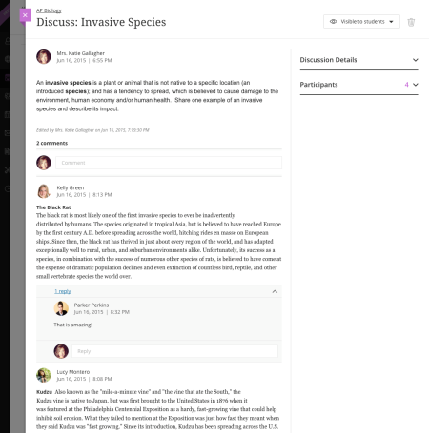
Dual Course Mode: Two course types support different needs
Getting Started
Middle of the Road
Power User
Ultra Course
Great for many instructors! Essential workflows in a brand new, modern, fully responsive view
Notes:
CANVAS COMPETITIVE DIFFERENTIATORS; VAL showed quotes from instrutors talking about how faculty memebrs using Canvas have been asking for years for simple enhancements to features like Discussions and the Grade Center. ONLY Blackboard supports the entire spectrum of instturors…..n

Slide 38
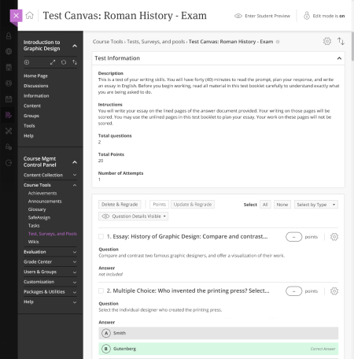
Dual Course Mode: Two course types support different needs
Getting Started
Middle of the Road
Power User
Ultra Course
Great for many instructors! Essential workflows in a brand new, modern, fully responsive view
Original Course
Great for long-time users, and those with more extensive course needs! You get all of the original workflows and capabilities
Notes:
CANVAS COMPETITIVE DIFFERENTIATORS; VAL showed quotes from instrutors talking about how faculty memebrs using Canvas have been asking for years for simple enhancements to features like Discussions and the Grade Center. ONLY Blackboard supports the entire spectrum of instturors…..n

Slide 39
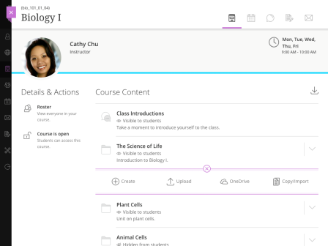
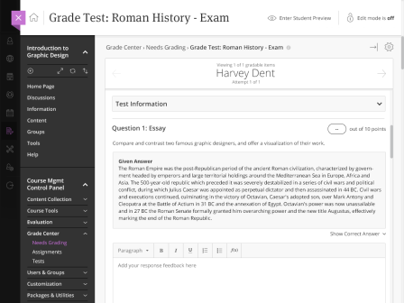
Institution/admins control who gets what course type In development
Specific instructors
Ultra
Department(s) or program(s)
or
Original
School(s) or Institution

Slide 40
Transition to the Ultra Experience Two milestones
1. Transition to SaaS deployment with the Original experience
Notes:
We think the Original Learn experience is good, but there were some changes we wanted to do that went beyond incremental steps. And there were several drivers for this change.
Modern UI
A fact of life is that most of your educators and students spend more time on other websites OUTSIDE your learning environment. Because of this, we felt it was important to come up with an aesthetic design that was highly modern and recognizable as such by students and instructors. This modern design instills confidence and engagement in users – this is a great place to learn and interact with others!
Easy to use
Ultra has an aesthetically beautiful new look, but it’s also important to remember that just because it’s beautiful doesn’t mean it’s efficient. Happily, we’ve also spent a lot of time obsessing over the details of navigation, page layout, and usability in general to achieve what is a demonstrably easier to use interface. This means that educators and students can get more done in a shorter amount of time!
More devices
We’ve designed the Ultra experience to work wonderfully on PCs and laptops, but we also knew that because of the growth in use of tablets and smartphones, we wanted to bring the power of Learn to these other devices. And this is just what we’ve done with the Ultra experience, bringing greater freedom to students and instructors to use Learn where they want, and when they want.
Student-centric
Also, in keeping with our focus on the learner, overcoming anxiety, and creating an engaging experience, we wanted to make sure that the Ultra design had students in mind from the start. This also means that by making it easier for instructors to design elegant courses, we’re ultimately making the student experience better in the process!

Slide 41
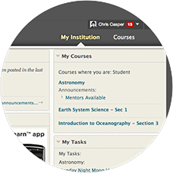
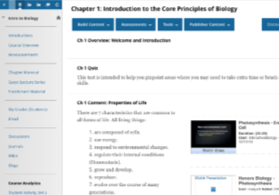
Transition to the Ultra Experience Two milestones
1. Transition to SaaS deployment with the Original experience
No change to the user interface
Notes:
We think the Original Learn experience is good, but there were some changes we wanted to do that went beyond incremental steps. And there were several drivers for this change.
Modern UI
A fact of life is that most of your educators and students spend more time on other websites OUTSIDE your learning environment. Because of this, we felt it was important to come up with an aesthetic design that was highly modern and recognizable as such by students and instructors. This modern design instills confidence and engagement in users – this is a great place to learn and interact with others!
Easy to use
Ultra has an aesthetically beautiful new look, but it’s also important to remember that just because it’s beautiful doesn’t mean it’s efficient. Happily, we’ve also spent a lot of time obsessing over the details of navigation, page layout, and usability in general to achieve what is a demonstrably easier to use interface. This means that educators and students can get more done in a shorter amount of time!
More devices
We’ve designed the Ultra experience to work wonderfully on PCs and laptops, but we also knew that because of the growth in use of tablets and smartphones, we wanted to bring the power of Learn to these other devices. And this is just what we’ve done with the Ultra experience, bringing greater freedom to students and instructors to use Learn where they want, and when they want.
Student-centric
Also, in keeping with our focus on the learner, overcoming anxiety, and creating an engaging experience, we wanted to make sure that the Ultra design had students in mind from the start. This also means that by making it easier for instructors to design elegant courses, we’re ultimately making the student experience better in the process!

Slide 42
Transition to the Ultra Experience Two milestones
1. Transition to SaaS deployment with the Original experience
2. Enable the Ultra experience
No change to the user interface
Notes:
We think the Original Learn experience is good, but there were some changes we wanted to do that went beyond incremental steps. And there were several drivers for this change.
Modern UI
A fact of life is that most of your educators and students spend more time on other websites OUTSIDE your learning environment. Because of this, we felt it was important to come up with an aesthetic design that was highly modern and recognizable as such by students and instructors. This modern design instills confidence and engagement in users – this is a great place to learn and interact with others!
Easy to use
Ultra has an aesthetically beautiful new look, but it’s also important to remember that just because it’s beautiful doesn’t mean it’s efficient. Happily, we’ve also spent a lot of time obsessing over the details of navigation, page layout, and usability in general to achieve what is a demonstrably easier to use interface. This means that educators and students can get more done in a shorter amount of time!
More devices
We’ve designed the Ultra experience to work wonderfully on PCs and laptops, but we also knew that because of the growth in use of tablets and smartphones, we wanted to bring the power of Learn to these other devices. And this is just what we’ve done with the Ultra experience, bringing greater freedom to students and instructors to use Learn where they want, and when they want.
Student-centric
Also, in keeping with our focus on the learner, overcoming anxiety, and creating an engaging experience, we wanted to make sure that the Ultra design had students in mind from the start. This also means that by making it easier for instructors to design elegant courses, we’re ultimately making the student experience better in the process!

Slide 43
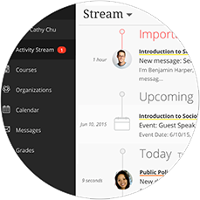
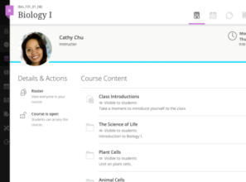
Transition to the Ultra Experience Two milestones
1. Transition to SaaS deployment with the Original experience
2. Enable the Ultra experience
No change to the user interface
New navigation, same Original Course View, and optional Ultra Course View
Notes:
We think the Original Learn experience is good, but there were some changes we wanted to do that went beyond incremental steps. And there were several drivers for this change.
Modern UI
A fact of life is that most of your educators and students spend more time on other websites OUTSIDE your learning environment. Because of this, we felt it was important to come up with an aesthetic design that was highly modern and recognizable as such by students and instructors. This modern design instills confidence and engagement in users – this is a great place to learn and interact with others!
Easy to use
Ultra has an aesthetically beautiful new look, but it’s also important to remember that just because it’s beautiful doesn’t mean it’s efficient. Happily, we’ve also spent a lot of time obsessing over the details of navigation, page layout, and usability in general to achieve what is a demonstrably easier to use interface. This means that educators and students can get more done in a shorter amount of time!
More devices
We’ve designed the Ultra experience to work wonderfully on PCs and laptops, but we also knew that because of the growth in use of tablets and smartphones, we wanted to bring the power of Learn to these other devices. And this is just what we’ve done with the Ultra experience, bringing greater freedom to students and instructors to use Learn where they want, and when they want.
Student-centric
Also, in keeping with our focus on the learner, overcoming anxiety, and creating an engaging experience, we wanted to make sure that the Ultra design had students in mind from the start. This also means that by making it easier for instructors to design elegant courses, we’re ultimately making the student experience better in the process!

Slide 44
Blackboard Learn Ultra Experience quick summary
Available Now (Technical Preview)
Announcements
Notifications / Stream
Roster
Course Content
OneDrive Integration
Calendar
Discussions
Messages
Assignments
Grades
Basic Profile
Analytics & Action
Course Copy & Diagnostics
Export/Archive Course
Notes:
So that should have given you a taste for the Ultra experience. Here’s a high-level summary of the major areas we’ve put into the first release of Ultra.
Now, because we’ve made Ultra available as part of our SaaS deployment first, we’ll be able to add more workflows and capabilities to Ultra on a regular basis.
In this next section, I’m going to walk you through some of the big areas that are either being designed or developed right now, and will be released soon.

Slide 45
Blackboard Learn Ultra Experience: What’s next
Notes:
What I just showed you in Ultra provides an elegant way for many instructors – especially those who are teaching face-to-face, and some blended – to consider adopting the new experience.
But we also understand that we have more to add to the Ultra experience to support these more straightforward courses, as well as more disciplines and modalities, especially STEM disciplines and fully online courses.
The next section will walk you through what’s in design or development now, and that you will see released on a regular basis in the coming months.

Slide 46
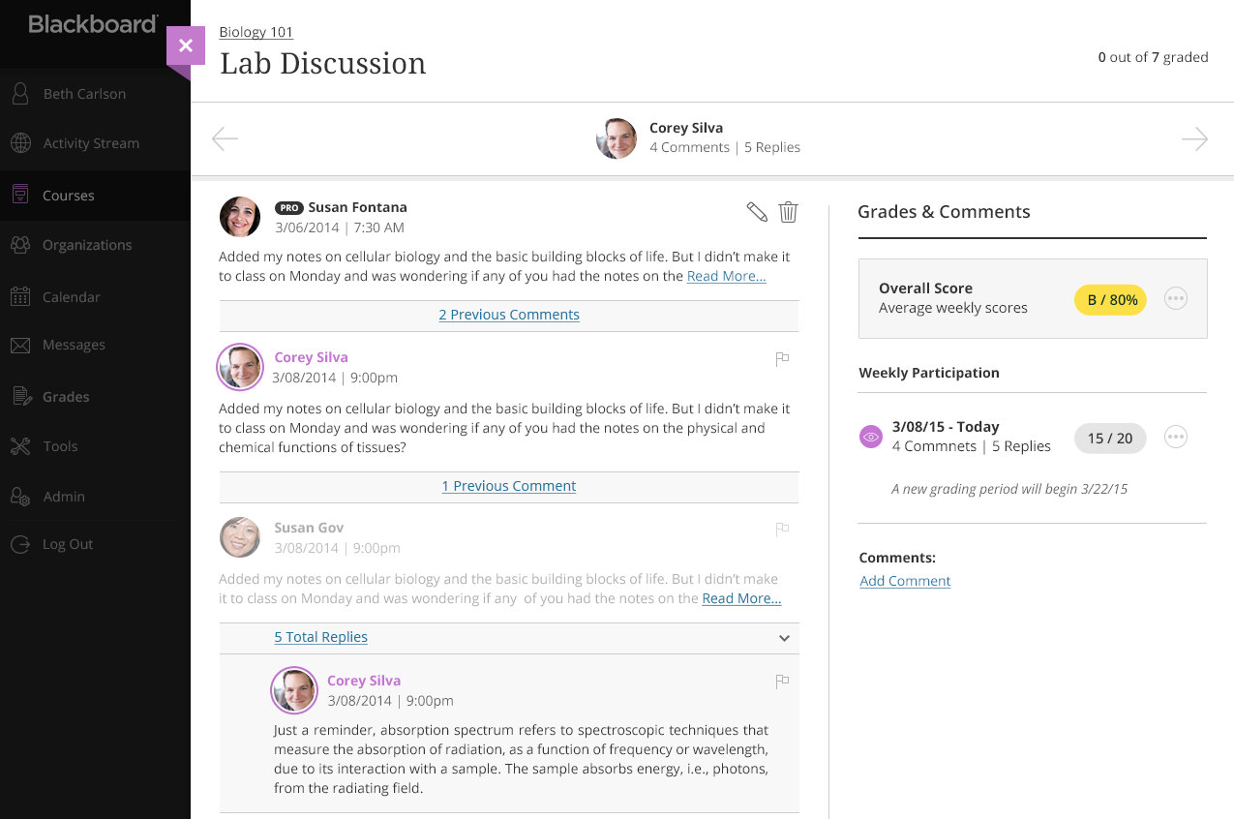
Assessment and communication (discussion grading) In development
Conceptual mock-up subject to change without notice
Notes:
As you’ve seen, we have a great discussion experience in Ultra now, but we know that some instructors use discussions to assess their students’ understanding of the material, and written and critical thinking skills.
In the design of graded discussions, we’ve paid special attention to the grading workflow for instructors, making it easy to see a single students’ contribution in the context of the overall discussion.

Slide 47
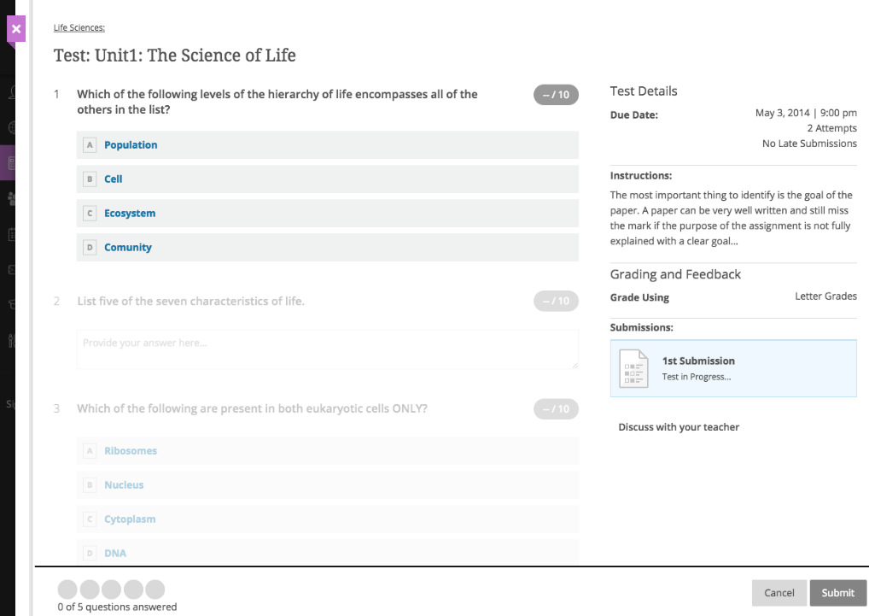
Assess student learning (tests) In development
Conceptual mock-up subject to change without notice
Notes:
Tests are a mainstay of an online course experience to support instructors’ need to assess student learning, especially for STEM disciplines.
We’ll be starting with the most important question types, and working hard to create an experience that provides both instructors and students with confidence and reliability.

Slide 48
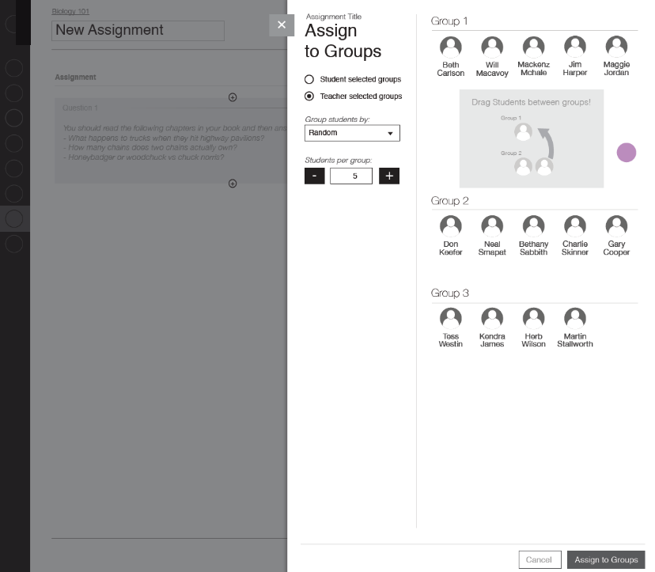
Course organization (groups) In development
Conceptual mock-up subject to change without notice
Notes:
Organizing students into smaller groups serves many important educational purposes, like building collaboration skills and for course administration purposes.
We’re working to make groups even easier to use than in original courses, and also allowing students to create their own groups for informal purposes.

Slide 49
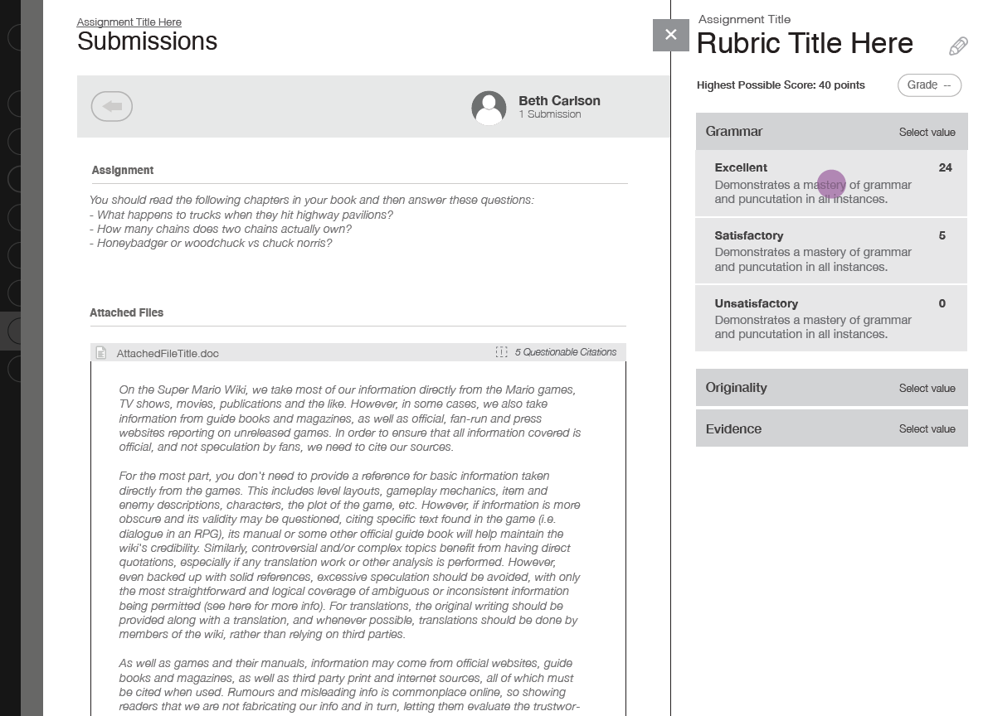
Assessment and engagement (rubrics) In development
Conceptual mock-up subject to change without notice
Notes:
Related to discussion grading and other authentic assessment is our new design of grading rubrics. Rubrics provide students with clear criteria of assessment, giving them a greater opportunity to have their work align more closely to the definition of mastery.
Rubrics will be applied to Assignments, Discussions, Test Essay questions, and other places in the course experience.

Slide 50
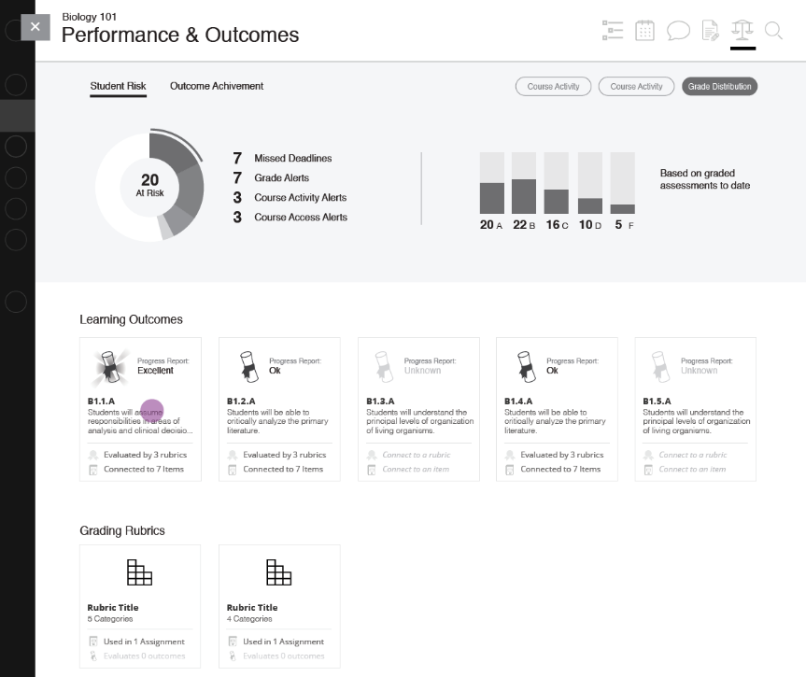
Retention and engagement (learning outcomes) In research
Conceptual mock-up subject to change without notice
Notes:
Understanding how students are performing, and if students are demonstrating behavior that indicates risk, helps students and instructors stay on track for course and degree completion.
We be starting from our work in the Retention center and Learning Outcomes in Original Learn, and building upon it to provide even more flexibility and insight into how students are performing, and discovering issues before they become insurmountable.

Slide 51
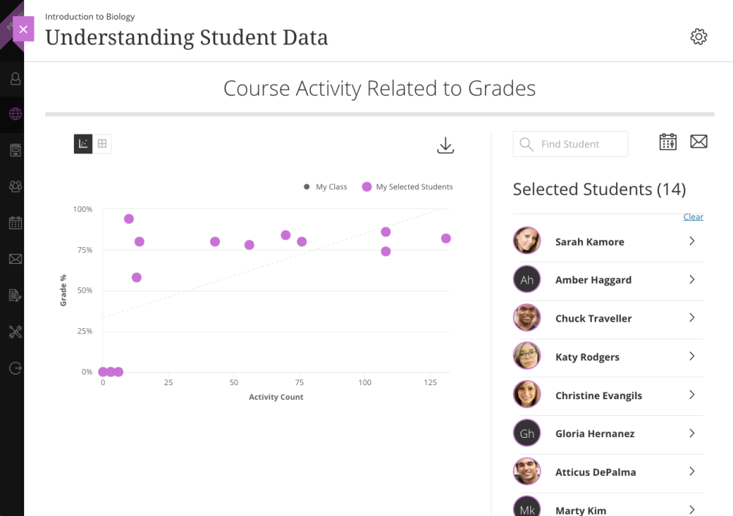
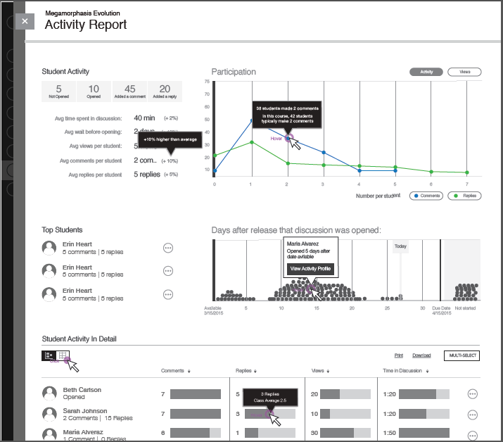
Learner risk & activity analytics Available now & In development
Conceptual mock-up subject to change without notice
Notes:
Understanding how students are performing, and if students are demonstrating behavior that indicates risk, helps students and instructors stay on track for course and degree completion.
We be starting from our work in the Retention center and Learning Outcomes in Original Learn, and building upon it to provide even more flexibility and insight into how students are performing, and discovering issues before they become insurmountable.

Slide 52
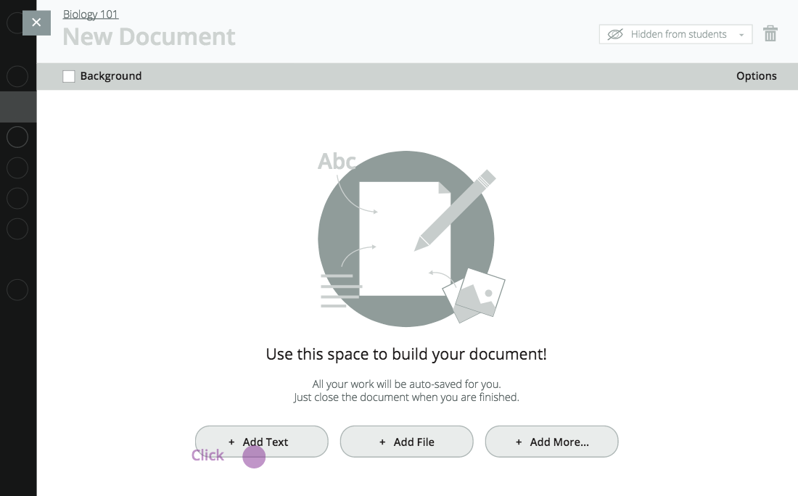
Course design (rich pages & media) In development
Conceptual mock-up subject to change without notice
Notes:
Learn Ultra has the ability to quickly add files now, but we also understand the importance of providing a rich interface for building pages within the course itself.
Because we’re building Ultra to be responsive – adjusting to the screen size and supporting multiple devices – we are taking pains to provide a rich editing experience that also retains its responsive character.
That’s where our rich page editor will come in, making it easy to create your own pages in Ultra that will make it easy to design beautiful and responsive pages.

Slide 53
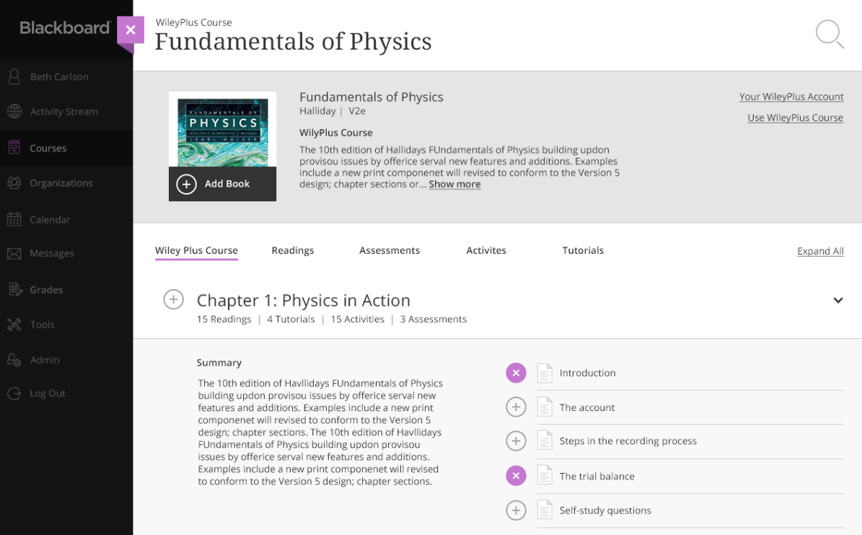
Integration framework (publishers, LTI, REST APIs) In development
Conceptual mock-up subject to change without notice
Notes:
Publishers and other content providers create world-class content that can augment a course experience, be a time-saver for instructors, and provide easier access to content to students.
It’s important, however, to design a seamless integration between the Ultra interface and the ability to select and experience content in an Ultra course.
Using our new integration framework, based on our REST APIs, Blackboard is collaborating with leading publishers and content providers to create a great new content discovery experience in Ultra courses.

Slide 54
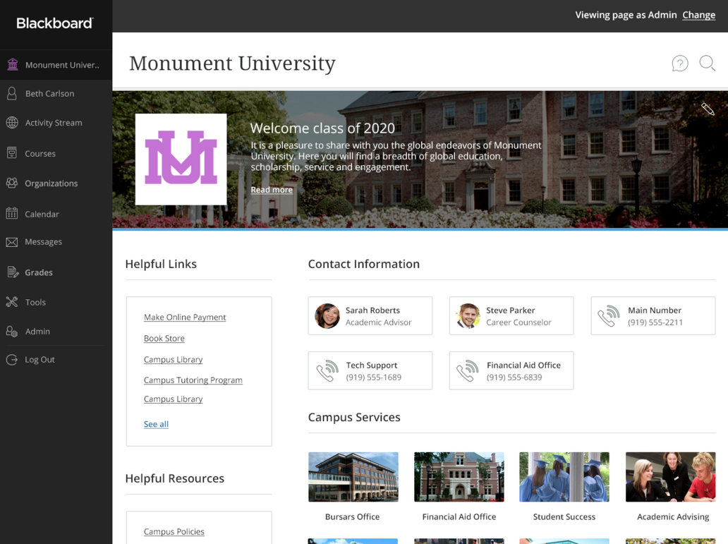
Institution page (new tabs & modules) In research
Conceptual mock-up subject to change without notice

Slide 55
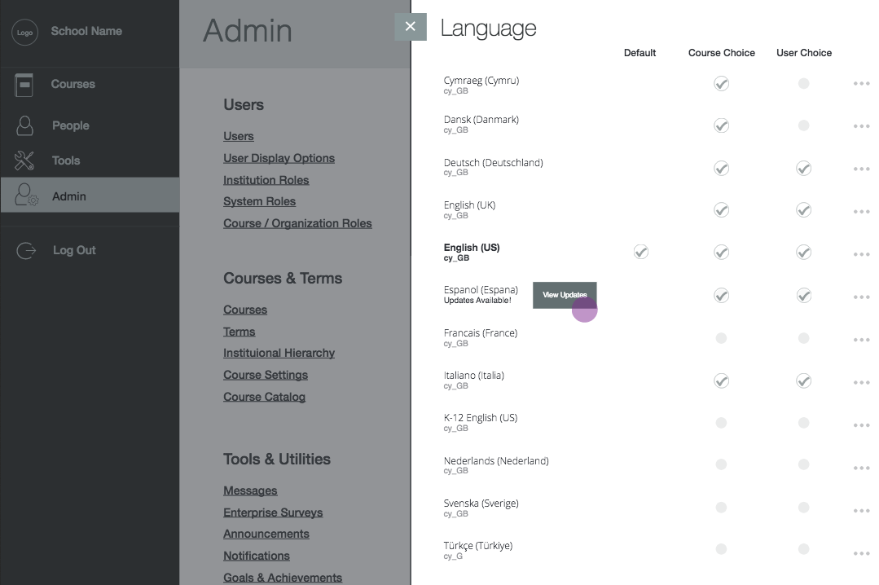
Worldwide use (locale & language selection) In research
Conceptual mock-up subject to change without notice
Notes:
A localized experience is important. Language is the way we see the world and see each other. The experience of numbers, dates, and interactions are contextual, and these perspectives can make the difference between something being understood and not understood.
With the initial release of Blackboard Learn with Ultra Course View, we’re introducing time zone support. Now, users will see due dates and message post dates based on the time zone settings of their devices. When an educator lives in one place and her students live in others, the students will all see times that are relevant to them.
Next, we’re working on bringing our 22 supported languages to the Ultra Course View. But besides that, we’ll also be giving administrators and individuals more control over behaviors of date, time, and number formatting.
We’re also simplifying the way that individual institutions change the language in their Blackboard Learn instances. Before, the task was time-consuming, and any update to the software required starting all over again with the string modification process. In the new Blackboard Learn, software updates won’t affect modified text, and administrators will receive notifications when there are new text strings so they can update them to the preferred terminology of the institution.

Slide 56
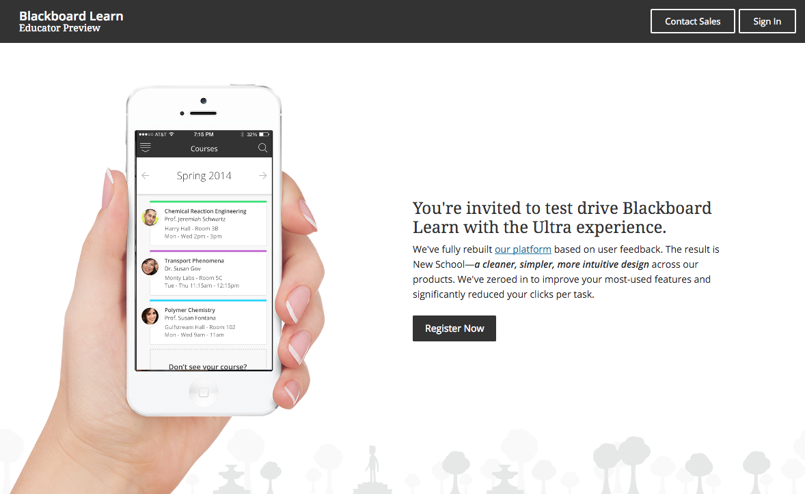
Educator preview In development
Conceptual mock-up subject to change without notice
Notes:
Tests are a mainstay of an online course experience to support instructors’ need to assess student learning, especially for STEM disciplines.
We’ll be starting with the most important question types, and working hard to create an experience that provides both instructors and students with confidence and reliability.

Slide 57
Blackboard Learn Ultra Experience Roadmap Selected highlights
Available Now (Technical Preview)
Announcements
Notifications / Stream
Roster
Course Content
OneDrive Integration
Calendar
Discussions
Messages
Assignments
Grades
Basic Profile
Analytics & Action
Course Copy & Diagnostics
Export/Archive Course
In Development
Graded Discussions
Tests
Rubrics
Group Management
Rich Pages
Integration Framework (Publishers, LTI, REST APIs)
Learner Risk & Activity Analysis
Educator Preview
In Research
Institution Page
Learning Outcomes
Locale and Language Selection

Slide 58
Blackboard Collaborate
Notes:
Let’s just get into the roadmap…

Slide 59
Blackboard Collaborate
Scalable, reliable foundation for world-class web conferencing
Designed for education
Sleek, intuitive interface/entirely browser-based
Tools to support fully inclusive learning
Blackboard Collaborate

Slide 60
Blackboard Collaborate Ultra Experience Key benefits
Highest level of quality & innovation
Enhancements and maintenance more quickly with zero downtime
HD video & audio puts you right in the center
Built with award-winning WebRTC technology providing efficient, high-definition media delivery
A world-class, inclusive user experience encourages use
Delivering a modern user experience, focused on education, for users of all abilities
Supporting asynchronous learning models
Native MP4 Recording and Playback
“Web-based” = get started immediately
No need for Java, plugins or downloading launchers
Notes:
Why do we people care…

Slide 61
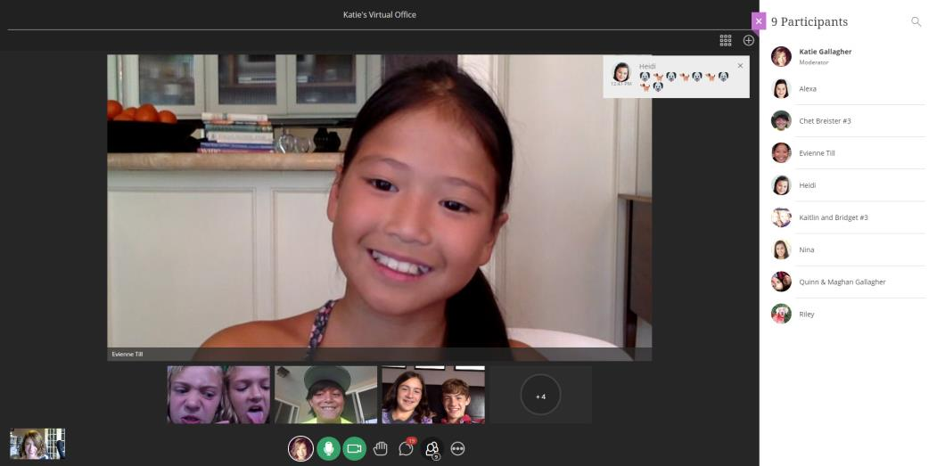
Collaborate: A delightful user experience Supporting learners in 26 languages

Slide 62
Collaborate: Inclusive web-conferencing Supporting the needs of diverse learners
Partnering with clients and accessibility experts to deliver web-conferencing experiences that conform to the highest levels of global accessibility standards and meet the needs of all users.

Slide 63
Collaborate: Current use cases
Office Hours & Parent Teacher Conferences
Group Collaboration
Teaching & Learning
Professional Development

Slide 64
Collaborate: Current use cases Features available now
High definition video & audio conference
Faster, sharper application sharing
Lecture style instruction/group collaboration (up to 100 participants)
Upload, share and annotate content (server based conversions)
Moderator controls support privacy
Group interaction (group chat, raise hand, Q&A)
One-on-One (advising, parent teacher conference, interviews, etc.)
Mobile friendly MP4 lesson recording & playback for flipped classes
Supports learners with disabilities – Screen readers and Live captioning
Chromebook access
Integrated phone conferencing dial-in for participants

Slide 65
Collaborate: Connected and integrated workflows Available now
Learn
Moodle
LTI
Set Ultra or Original experience by Course
Separate module, can configure Collab 12 and Ultra in same course
Flexible for any LTI compliant LMS
Course session View recordings
Schedule sessions View recordings
Adheres to LTI standards
Institution wide enablement option
Available to Moodle Community
Consistent with Collaborate user experiences

Slide 66
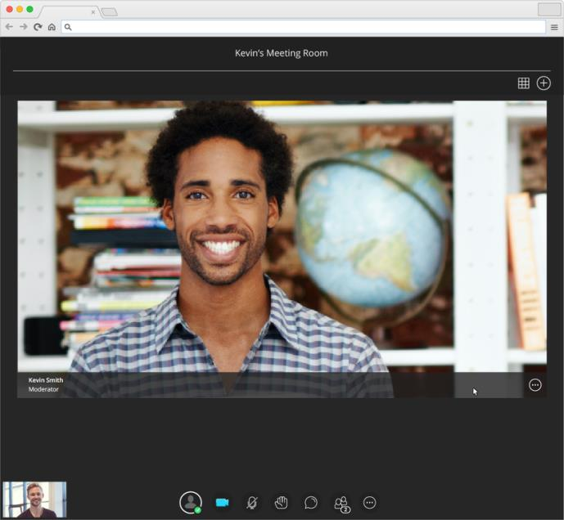
Collaborate: One-to-one and group discussion Available now

Slide 67
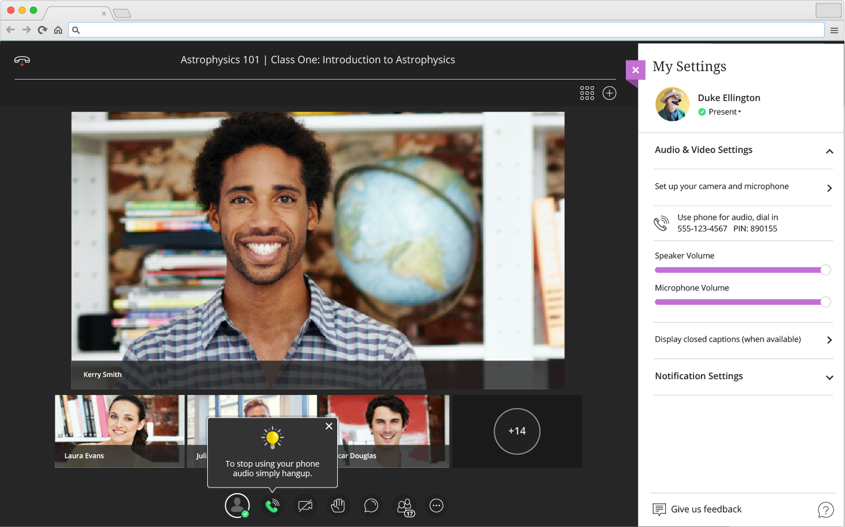
Collaborate Ultra Experience: Phone conference Available now

Slide 68
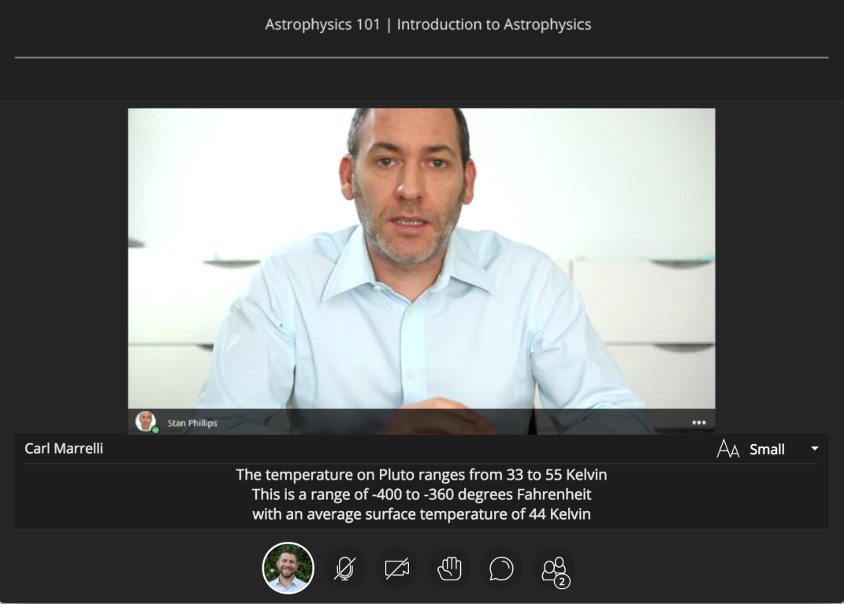
Collaborate: Live captions and accessibility standards Available now

Slide 69
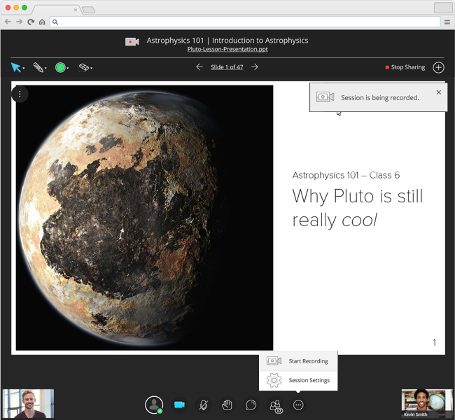
Collaborate: Flip the lesson or review w/ MP4 recording Available now

Slide 70
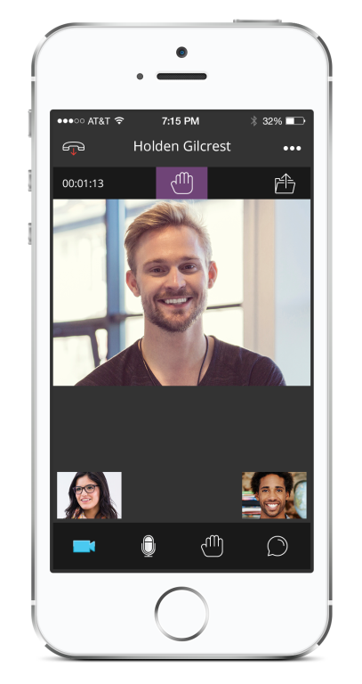
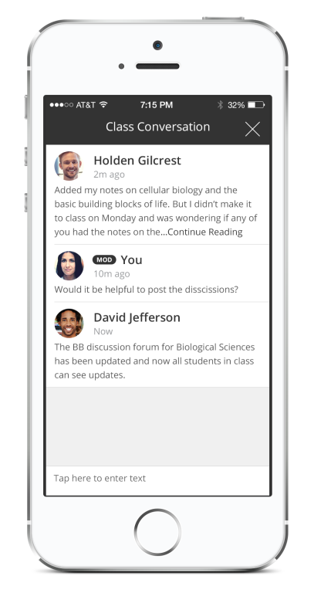
Bb Student: Mobile collaboration Available now
Students collaborate on the go with high quality audio and video and visuals
Collaborate experience integrated directly into Bb Student on Android and iOS
Collaborating in Bb Student does not require Blackboard Learn
Supports 22 languages
Conceptual mock-up subject to change without notice

Slide 71
Blackboard Collaborate Ultra Experience: What’s next

Slide 72
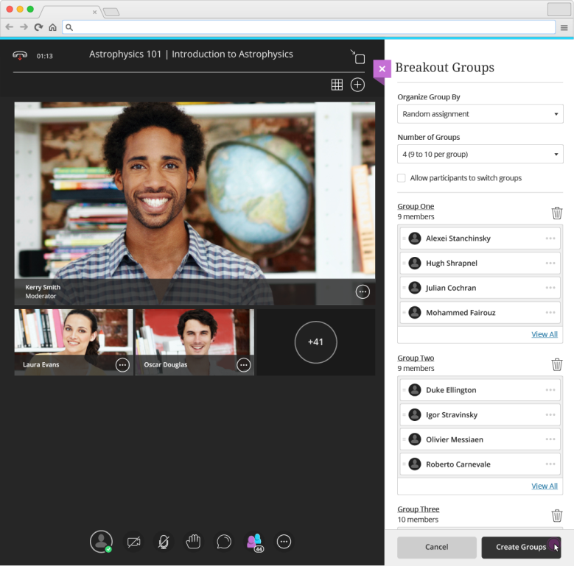
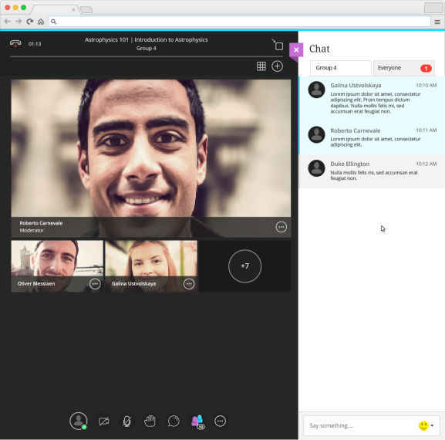
Collaborate: Breakout group learning In development
Conceptual mock-up subject to change without notice

Slide 73
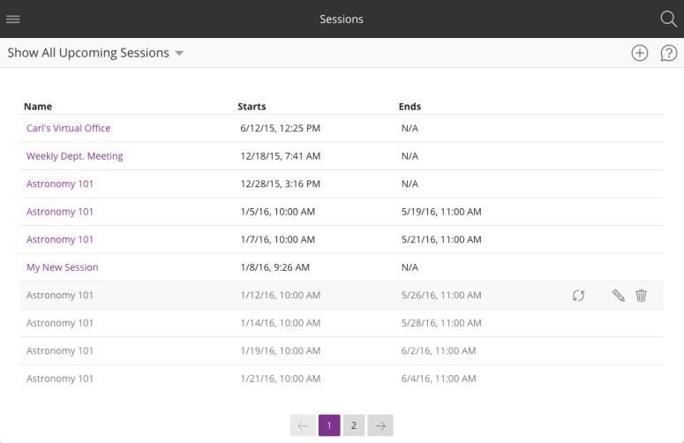
Collaborate: Redesigned Learn 9.1 integration In development
New Collaborate Building Block UI integrated in Learn courses for creating sessions and viewing recordings
Support for downloading recordings and telephony session settings
Supports using Collaborate Ultra and Original experience in same course
Conceptual mock-up subject to change without notice

Slide 74
Collaborate: Leveraging the power of Learn 9.1 In research
Course room and personal virtual office
Learn gradebook integration for Collaborate attendance
Assign Collaborate breakout groups automatically using course group assignments
Display scheduled Collaborate sessions in the course calendar
Conceptual mock-up subject to change without notice

Slide 75
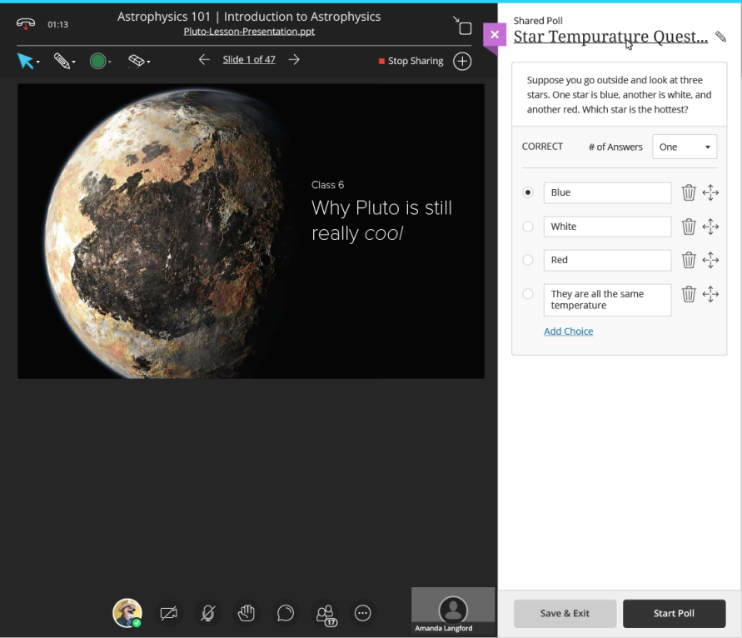
Collaborate: Real-time comprehension w/ polling In research
Conceptual mock-up subject to change without notice

Slide 76
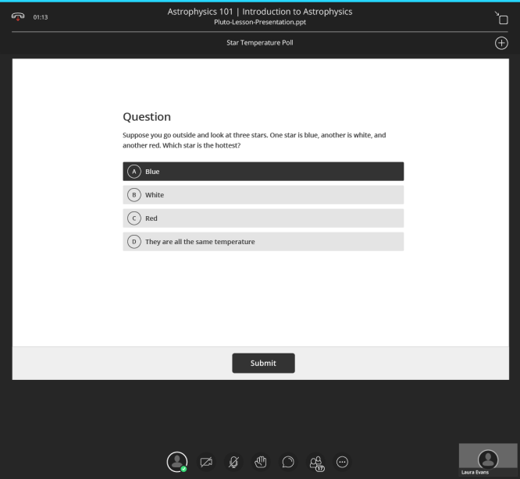
Collaborate: Real-time comprehension w/ polling In research
Student responds
Moderator views results
Conceptual mock-up subject to change without notice

Slide 77
Collaborate: Get live feedback from class In research
Conceptual mock-up subject to change without notice

Slide 78
Collaborate: Support the hearing impaired with sign language interpreter In research
Conceptual mock-up subject to change without notice

Slide 79
Collaborate: Enhanced collaborative whiteboard In research
Conceptual mock-up subject to change without notice

Slide 80
Blackboard Collaborate Ultra Experience roadmap
Available now
High quality audio, video, and app sharing
Room and Moderator Chat
Annotate whiteboard and slide content
Integrated Telephony
Integration with Learn, Moodle, LTI, APIs
Closed Captioning & WCAG 2.0 AA Support
MP4 Recordings
Mobile experience with Bb Student app
Internationalized scheduling UI
Up to 100 participants
Experience Indicators
In beta
Firefox WebRTC Support
In development
Persistent and pre-loaded content
Breakout Groups
Deeper integration with Learn 9.1
Integration with Learn Ultra Experience
Instructor mobile experience with Bb Instructor app
Up to 250 participants
In research
Polling
Advanced Collaborative Whiteboard
Live Feedback
Display Videos as Content
Private Chat
Sign Language Interpreter
Native Session Recording / Playback
Basic Edit Recordings
Up to 1,000 participants

Slide 81
Blackboard Mobile Apps
Notes:
Hello
I’m Jennifer Harris, Senior Director, Product Management for Mobile & Consumer at Blackboard, and I’m here for these last few minutes of the session to share with you how our mobile strategy benefits you and your constituents – both now and in the future. I liken my presentation on mobile to the mobile medium itself – I like to keep it to-the-point and simple!

Slide 82
One app based on who you are
Bb Instructor
Bb Student
Bb Parent
Bb Grader
Profile
Instructor Analytics
Personal Education Planner
Learn
Collaborate
ParentLink/Schoolwires
Connect
Conceptual mock-up subject to change without notice
Notes:
With mobile —
We are developing persona based mobile apps for students, instructors, and parents that brings together functionality from Learn, Collaborate, MyEdu, and other Blackboard products.
This simple point is really important – it turns our previous mobile strategy upside down!.
So where a student or instructor might previously have used Mobile Learn and Mobile Collaborate as separate apps, they’ll now use…the app for their persona.
We spent a significant amount of time conducting research with instructors, students, and parents.
And do you know what one of biggest takeaway was?
That each of the cohorts had such wildly different wants / needs / expectations that maybe a single mobile solution didn’t best serve each persona.
Students want access to content, the ability to take assignments, and to get feedback and grades from the instructor. And instructors want to tweak content, grade papers, give feedback, and see how their classes are doing
And all of these portions of functionality used to be part single persona discrete product lines. With mobile we are going to be tying all those workflows together.
So for:
Instructors that means you will have functionality from: Bb Grader, Learn, Analytics, and Collaborate
For Students that means you will have functionality from: Learn, Collaborate, MyEdu, a personal education planner we are building, and Connect
And for Parents functionality for: Connect, Parent Link/Schoolwires

Slide 83
Bb Student Available now
Activity Stream
Course Outline
Course Timeline
Conceptual mock-up subject to change without notice
Notes:
So, now, let me tell you a little bit about Bb Student
Bb Student is Blackboards first persona based application and really is the center piece of the New Learning Experience on mobile — and its probably the clearest proof point to show how we are helping learners. Our is intent is simple.
To provide students with a delightful mobile experience that helps them succeed in their academic journey.
The name calls it out — Bb Student. This is an application for students. Immediately students understand. This is an app for me.
Next I’m going to give a quick demo of Bb Student. Bb Student is available on iOS/Android/Windows phone and Windows tablet to our clients in the US. Later in Q3 we will expand the reach to our clients and students outside of the US.
In my short demonstration of Bb Student, I want to focus on a few simple things:
The modern, predictable, delightful design: I want to simply move through the application without narrative or many stops to show you how the application looks & feels
The Stream: I want to highlight the importance of the curated home page stream – students these days need a clear “instagram-like” stream of what’s new & due. The majority of the time students spend in Bb Student will be spent on this activity stream, the home screen. It represents a “smart view” of prioritized events and actions, and pushes content to the student. We’ll do the heavy lifting help students can prioritize their work and spend their time on the thing that matters the most, learning.
Course Timeline. The course timeline provides students with a visual representation of their courses - past, present, and future. Courses are grouped by term and year with relevant course information using simple repetitive design patterns to create semantic connections between courses across the learning environment. Display course information including instructor name, course title, location, and hours.

Slide 84
Connected workflows Available now
Assignments & Tests
Grades
Due Dates
Conceptual mock-up subject to change without notice

Slide 85
Communication tools
Collaborate
Ultra experience
Push Notifications
(coming in 2016)
Discussions
(coming in 2016)
Conceptual mock-up subject to change without notice

Slide 86
Bb Student App Key benefits
Learner-focused, one app
Designed specifically for learners to help them react quickly to their changing course needs, while learning to plan for the future. Brings together multiple capabilities in to a single cohesive app (learn, collab, profile, etc.).
World-class user experience
Delivers a simple, modern user experience, focused on quick task completion, and predictable and delightful interactions.
Consistent blackboard story
Debuts an experience language that will be consistent throughout all Blackboard products, giving users a sense of familiarity and helping them transfer their experiential knowledge from one system to another.
Authentically mobile
Leverages the mobile device’s access to camera, push notification, and more to provide rich, contextual features that move beyond the desktop and live with the learner on the go.
Notes:
To recap…

Slide 87
Bb Student
Available now:
85 Markets – North America/ LAC / Europe/ APAC
22 Supported Languages
iOS / Android / Windows Phone & Tablet
Supports Learn 9.1 (SH/MH), Learn SaaS, Learn SaaS w/ Ultra Experience
Requirements*:
Learn 9.1 SP14+ or Learn SaaS
Latest Mobile B2
Mobile License or Solution w/ Mobile
*iOS and Android only; Collaborate Ultra clients and users only need to download the app

Slide 88
Bb Student ratings/feedback
iOS
Android / Windows
“Just downloaded this app five minutes ago and I am IMPRESSED. I have hated the web page because of previous college struggles with it years ago. Now that it is primarily used for my program, this helps immensely and is good looking and simple. THANK YOU”
– A. Oppermann (Robert Morris University)
“I was a frequent user of the old backboard app, but this one is just so much better. I love the stream screen which is new with this app. It's just a lot easier to see updates from teachers, as well as checking the grades for your classes. Looks like this will be my new favorite app for school! The best part is the updated just keep making it better and better.”
– Lukeyybru
“Awesome app! I love the simplicity and the available features! Keep up the good work! 😊”
– M Belshady (University of Houston)
“Such an improvement from last version! Really like the new due date section.”
– nml13c (Florida State University)
*iOS and Android only

Slide 89
Bb Grader App Available now
Notes:
Now, let me re-cap a little bit about the in-market Bb Grader app, which will next year evolve to become Bb Instructor.
Bb Grader already has received positive feedback from the community:
“I like being able to grade from anywhere; my iPad is always around, and I don’t have to haul out my computer to do some grading.”
“I prefer the touch interface, as it suits my interaction preferences more than clicking with a mouse.”
“Because of the iPad app, I see Blackboard as a more innovative company than [D2L, Moodle, etc.]”
“I love the simplicity of going in and changing a grade. There are no extra buttons to click. I just hit 'grade' and start modifying."
And my favorite: A user who is visually impaired has been LOVING Bb Grader for the ability to provide video feedback and using Sign Language to communicate feedback to her students.
Bb Grader is:
Tablet app for teachers and instructors designed to improve faculty workflow – available now
Easily track, sort, and grade assignments across multiple courses
Offer text, audio, video feedback, creating more personalized and engaging experience
So, as I said, our intent is to next year replace Bb Grader with another persona-based application just for Instructors – Bb Instructor!

Slide 90
Bb Instructor In research: iOS and Android Tablet
Our goal is to help instructors minimize administrative tedium, improve their teaching, and support their students’ personal and professional growth
All the same key benefits as Bb Student:
End-user-focused, one app
World class experience
Consistent blackboard story
Authentically mobile
Notes:
As we approach an Instructor-based app, our early research has already told us a few things:
Get on iOS AND Android tablets; …..then phones
Help instructors “clear the brush” (of administrative tasks) so they can focus on what they love – teaching and their students
Ensure it works with current and future Bb products like 9.1 and Ultra
And ultimately we use the same 4 driving benefits as Bb Student to guide our Instructor app design…mention the points above…

Slide 91
Blackboard Mobile App roadmap
Available now
Mobile Learn
Bb Grader
Bb Student
Activity Stream
Course Timeline
Grades
Assignments & Tests
Due Dates
Collaborate Ultra - Join from Link
Google Drive / Dropbox / OneDrive
Available in NAHE/LAC/Europe/ APAC*
In beta
Bb Student
Collaborate Ultra - Join from Course
Collaborate Ultra – Activity Notifications & Document Navigation
Profile Integration
In development
Bb Student
Push Notifications
Discussions
In research
Bb Student
Collaborate Ultra – Breakout Rooms
RTL Language Support
Third-party content (PC/SCORM/LTI/App to App Launch )
Analytics & Telemetry
Bb Instructor
UPDATE: iOS, Android tablet; to replace Bb Grader
*22 Supported Languages / 85 Markets

Slide 92
Monthly Teaching & Learning update emails
What’s new each month for:
Learn (including 9.1, SaaS, and the Ultra experience)
Collaborate
Mobile apps
January 21 Edition
Sign up at: http://www.blackboard.com/blackboard-insights
Notes:
The emails are sent to our academic technologist and administrator contracts in our customer database. On customer webinars, we have invited customers to sign-up for these emails or opt back here - http://www.blackboard.com/blackboard-insights.aspx

Slide 93
Save the Date: 2016 Roadmap Webinars
Join our Product Management leaders for an update on what’s new and what’s coming for Learn, Collaborate, and our mobile apps
April
Wednesday, April 6 2:00-3:00 pm Eastern
Thursday, April 7 4:00-5:00 pm Eastern
August
Dates coming soon!
Register at: bbbb.blackboard.com/TeachingLearningRoadmap

Slide 94
Try the new Blackboard Collaborate
Try Collaborate with the Ultra experience free for 30 days
Visit: bbbb.blackboard.com/CollabTrial

Slide 95
Join the Blackboard Community
Join now: community.blackboard.com

Slide 96
Faculty Field Guide
A short interactive survey tool for faculty that, based on level of experience with Blackboard technology and immediate classroom goals, recommends select features in Blackboard Learn that you can begin using today to address specific classroom challenges, develop new skills, and become more effective as an educator.
www.blackboard.com/sites/facultyfieldguide
©2015 Blackboard Inc. – Confidential and Proprietary

Slide 97
Thank you!

