Slide 1
Enticing Students to Express Ideas: Creating Joy of Learning in the Humanities
Petra DeWitt, Ph. D.
Assistant Professor
History & Political Science

Slide 2
Primary Objectives for the Classroom
I’m an engineer, why do I have to learn history, again.
Learn history
Not dull or drab history of memorized facts
But what defined people; why people acted in certain ways; how we became Americans
Engage students; make them think
Make them more aware of what happened in the past and what is happening around them today
Turn students into active members of society

Slide 3
How to achieve these Objectives?
Appeal to as many learning styles as possible
The talkers, the introverts, the visual learners, the slow and the fast learners
Power points that combine text with maps, images, links to movie clips
Mix lecturing of facts with questions, discussion, and various forms of interaction between students
➢ Create an environment of learning where anyone can express an opinion

Slide 4
How to Entice Students to Express an Opinion?
Establish Freedom of Expression the first day
“In what year should we begin this course?”
Stipulation: must explain why
Many answers
Why do that? For 15 minutes students are engaged. They talk to each other. Establishes trust.
At the same time, explanations provide an indicator of what students already know without them taking a quiz.

Slide 5
Reinforcing Free Expression of Opinions
Placing themselves into a situation by role playing
Virginia settlers v. Powhatans
Congressmen needing to tackle a $ 1 trillion debt after the War for Independence
Leading questions that result in predictable answers
“What exactly does it mean to be in hot pursuit of the Seminole?”
“Really? Why would you say that?”
Point? Engaged; talked with each other; explanation is assessment of knowledge and comprehension of “why”

Slide 6
Creativity and Analytical Thinking through Homework
Read assigned chapter or primary document; watch movie clip or recorded lecture
Traditional Essay Style
3-4 basic facts questions
1-2 personal opinion questions
Posters
Write an analytical essay without realizing wrote an analytical essay

Slide 7
How do I know I am succeeding?
Grades continue to improve
Quality of answers is improving
Student Comments: want to watch more movie clips, but nevertheless indicate a good experience; “glad I came to class today”
Students are engaged; no one falls asleep
Peer reviews: “No one pulled out a phone.” “Positive learning environment in the class.” “Students easily interact with instructor or each other.”

Slide 9
Sample Power Point
The Trials of a Young Nation: Uniting the States and Establishing a Republic
I. The New republicanism: The Articles of Confederation
II. Bringing Order Upon the Land: The Land Ordinance of 1785 and the North West Ordinance
III. Shays’ Rebellion: Dealing with Persisting Debt Problems
Reminder:
Assignment 7 due Sunday, 10/18, 11:59 pm

Slide 10
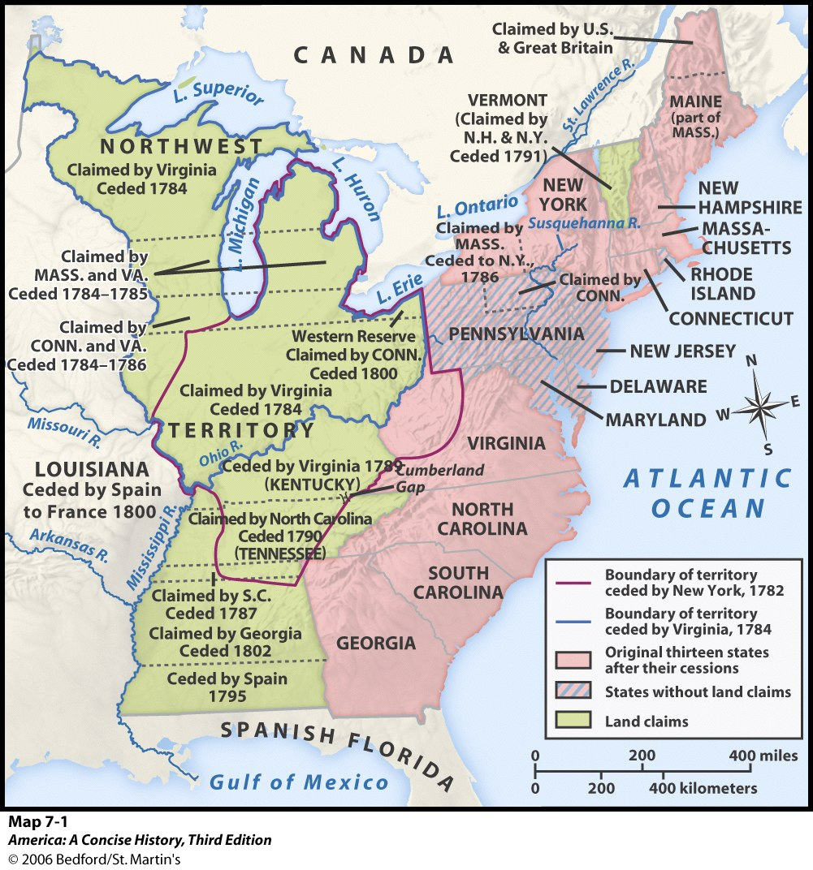

Slide 11
5,000; 60,000

Slide 12
Sample Homework Assignment
Assignment 7: Drafting the Constitution (25 points)
Why did nationalists meet in Philadelphia in the spring of 1787? What was their initial purpose?
Who attended and who did not attend? (Names and social ranks)
How did the Philadelphia convention resolve the three most controversial and divisive issues of a) the representation of large and small states, b) state power, and c) slavery? Explain for each.
What were the major arguments for and against ratification of the Constitution and why did people believe that way? Explain two examples for either side.
In your personal opinion, did the Constitution of 1787 reflect true republicanism? Did it establish a better or worse government than had existed under the Articles of Confederation?
Would you have supported or opposed its ratification? Explain your opinion with specific examples.

Slide 13
Sample Homework Assignment Answer
In your personal opinion, did the Constitution of 1787 reflect true republicanism? Was it better or worse than the Articles?
Republicanism is living in a republic rather than a monarchy or dictatorship under which people hold popular sovereignty. I believe the Constitution of 1787 reflects republicanism in the sense that it ensured the country was not ruled by a monarch, but not in the sense that everything is determined by popular sovereignty. The establishment of the Electoral College somewhat treads on the idea of popular sovereignty, since with this system, it is possible for a president to be elected without actually winning the popular vote. I think true republicanism would rely purely on popular sovereignty, which the Constitution did not establish.
I believe that the new government was much better than the government that had existed under the Articles of Confederation. The Articles of Confederation was an absolute disaster purely because it lacked the power to tax. This led to issues such as Shays Rebellion, since states had way too much power. Such disasters could have been prevented with a stronger central government. The Constitution created just that, and I think the fact that the Constitution is still in place today testifies for the success of the document.
Would you have supported or opposed its ratification? Explain your opinion with specific examples.
If I had been alive in 1787, I am not sure whether or not I would have supported the Constitution. Looking back through history, it seems obvious that this was the right way for the government to go. But from the prospective of someone living back then, the Constitution was a very big change compared to what there was previously. I think it would have scared me how drastic the changes were because that is also what Britain did in 1766 when it began to tax.

Slide 14
Poster Instructions
Read the primary documents in chapters 14 and 15 and view figure 1 on page 114 in America Firsthand
Then represent on your poster a realistic rendition of what you think actually happened during the event known as the “Boston Massacre” and why it was significant in history.
Be sure to describe context, events, locations, settings, and varying perspectives, including biases.
Use at least 200 words of text.
Remember, you are making an argument; it has to be convincing.

Slide 15
Instructions Letter Home
Imagine you are either an indentured servant, a servant from Africa, or a planter who has arrived in the Virginia colony during the late 1650s, the 1660s, or the 1670s but who has not yet written home to the old country to inform family where you are, what you are doing, and what you have experienced.
Then write a letter home that must be in the least 300 words in length but no more than 500 words.
You must tell your relatives where you are, what life is like for you and those around you.
Your experiences must be realistic based on your real-life gender and your imagined status.
The letter must address economic, social, and political developments and whether you would recommend that friends or family members also come to Virginia.

Slide 16
Instructions News Report
Imagine you are a foreign correspondent assigned by a European newspaper (British, French, Spanish, Dutch, or Hessian) to report about the end of the American War for Independence, or American Revolution (it will depend on your bias how you view or name this event)
In your final report to your newspaper in the fall of 1783 after the signing of the Treaty of Paris you are evaluating whether and why the Americans won or the British lost.
Since newspapers at that time were always biased in their political views, you too must have a clear bias, such as being supportive of Americans, supportive of the British, opposed to the British but not caring about Americans, or somewhere in between. Whatever your bias, it must be clear.
Be sure to address or evaluate the entire time span of the Revolution or War, and take into consideration the impact of the peace treaty.

Slide 17
Instructions Letter to Candidate
Take another look at your notes from week 15 and watch the posted clips related to Dred Scott v. Sanford and 1857.
Imagine you are a planter, small farmer, factory worker, or free African American living in Missouri.
Then write a letter to one of the following individuals, who were running as candidates from Missouri for the US House of Representatives in 1858: Thomas L. Anderson (Ind), Francis P. Blair (D), John B. Clark (D), John S. Phelps (D), George R. Taylor (R), Samuel Woodson (American)
In your letter you must ask the candidate how he would help deal with three particular concerns that you have about developments during the past decade.
You must explain these concerns from the perspective of your identity that you have chosen.
You can also make suggestions to the candidate how he might address these problems once elected, especially considering his party ideology.
This letter must be one page in length, single spaced, but no longer than two pages.

Slide 18
Sample Comments
I like Her use of the socratic method, that is during lectures, she guides us to the answer, instead of telling us.
This class was just a joy to have. The instructor seemed to thoroughly enjoy teaching, always had a smile, and made the material interesting.
Strengths- encouraging students to actively participate in class, engaging students in the topic
Professor DeWitt does a very good job at getting people involved during lectures and listening to peoples input on the topic allowing us in the class to debate and decide our take on the subject getting the students to more deeply understand the subject matter.

