Slide 1
BITE-SIZED STUDENT SUCCESS STRATEGIES FOR THE HIGHER ED CLASSROOM
Diane Hagni
Center for Educational Research and Teaching Innovation (CERTI)

Slide 2
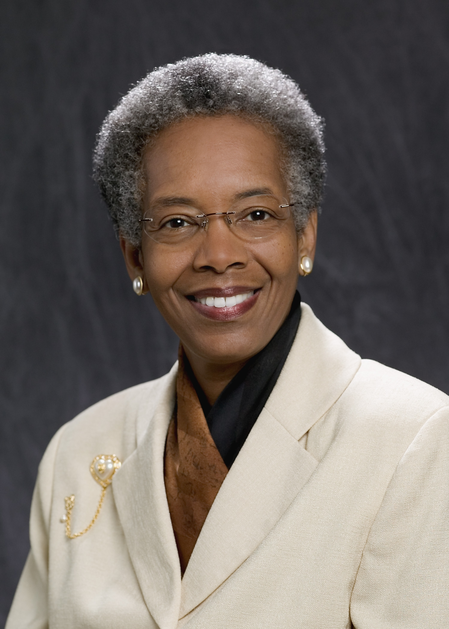
Math Assistance where Success Happens (M.A.S.H.)
“Teach Students How to Learn,” by Saundra Y. McGuire
Student Success Strategies

Slide 3
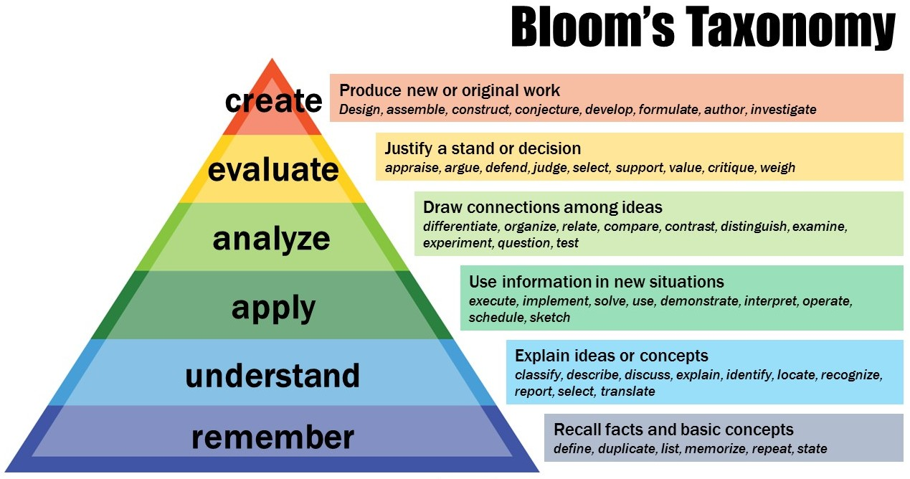
SCALING THE PYRAMID
McGuire & McGuire, 2015
At what level of Bloom’s did you have to operate to make A’s or B’s in high school?

Slide 4
SCALING THE PYRAMID
McGuire & McGuire, 2015
At what level of Bloom’s do you think you have to operate to make A’s in college?

Slide 5
READING COMPREHENSION STRATEGY
Travis is a junior psychology student whose grades were: 47, 52, 82, 86 = B in course
Preview text before reading
Develop questions
Read one paragraph at a time and paraphrase information
McGuire & McGuire, 2015

Slide 6
METACOGNITIVE PROBLEM-SOLVING STRATEGY
Dana is a first-year physics student whose grades were: 80, 54, 91, 97, 90 (final) = A in course
Start problems early – the day they are assigned
Do not flip back to see how example problems are worked; work them yourself!
Don’t give up too soon (<15 min.)
Don’t spend too much time (>30 minutes)
McGuire & McGuire, 2015

Slide 7
THE MYTH OF MULTI-TASKING
Myth of Multi-Tasking exercise
Use video or present it yourself
https://www.youtube.com/watch?v=BCeGKxz3Q8Q

Slide 8
Preview before class – Skim the chapter, note headings, boldfaced words, summaries and objectives; come up with questions you would like the lecturer to answer
Attend class – GO TO CLASS! Answer and ask questions; take meaningful notes
Review after class – As soon after class as possible, read notes, fill in gaps and note any questions.
Study – Repetition is key. Ask questions such as “why,” “how,” and “what if.”
Intense study sessions – 3-5 short sessions per day
Assess Your Learning – Periodically perform reality checks:
Am I using study methods that are effective?
Do I understand the material enough to teach others?
4 Reflect
3 Review
Preview
Attend
Review
Study
McGuire & McGuire, 2015
Assess
THE STUDY CYCLE

Slide 9
INTENSE STUDY SESSIONS
4 Reflect
3 Review
Preview
Set a Goal – decide what you want to accomplish (1-2 minutes)
Study with Focus – interact with material (30-50 minutes)
Reward Yourself – take a break, call a friend, play a short game, get a snack (10-15 minutes)
Review – go over what you just studied (5 minutes)
Attend
Review
Study
Assess
McGuire & McGuire, 2015

Slide 10
GROWTH MINDSET
Teaching students about growth mindsets vs. fixed mindsets
QR code for mindsetonline.com/testyourmindset/step1.php
TED talk (first 5 minutes) or Kahn Academy video
Infographic

Slide 11
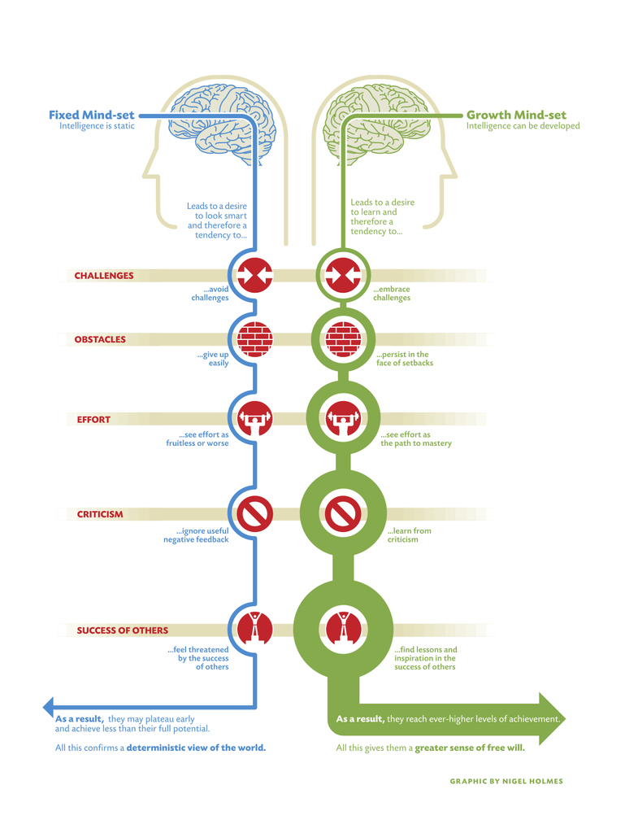

Slide 12
certi.mst.edu/teachsupport/StudentSuccessStrategies
or
tinyurl.com/mstcerti tinyurl.com/mstcerti

Slide 13
Reference
McGuire, S. Y., & McGuire, S. (2015). Teach students how to learn: Strategies you can incorporate into any course to improve student metacognition, study skills, and motivation.

Slide 14
MATH CLASS
https://www.youtube.com/watch?v=KdxEAt91D7k

