Slide 1
Teaching & Learning Technology 2016
In-class and Distance Learning
Dr. Zeshan Hyder
Mining & Nuclear Engineering
MS&T

Slide 2

What Do I have?
Introduction
Personal Experiences
Differences
Interaction/Participation
Questions, Comments/Discussion

Slide 3

Introduction
In class/on campus
Online classes
Distance Classes

Slide 4
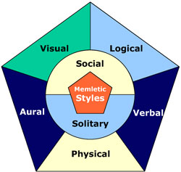
Introduction
Learning Style Categories
Students possess all learning styles,
  to a greater or lesser extent

Slide 5
Introduction
Independent Students
  Prefer inde­pendent study and self-paced instruction and would prefer to work alone rather than with other students on course projects.

Slide 6
Introduction
Dependent Learners
  Look to the teacher and to peers as a source of structure and guidance and prefer an authority figure to tell them what to do.

Slide 7
Introduction
Competitive Students
  Learn in order to perform better than their peers and to receive recognition for their academic ac­complishments.

Slide 8
Introduction
Collaborative Learners
  Acquire in­formation by sharing and cooperating with teacher and peers. They prefer lec­tures with small-group discussions and group projects.

Slide 9
Introduction
Avoidant Learners
  Are not enthusias­tic about attending class or acquiring class content. They are typically uninter­ested and are sometimes overwhelmed by class activities.

Slide 10
Introduction
Participant Learners
  Are interested in class activities and discussion and are eager to do as much class work as possi­ble. They are keenly aware of, and have a desire to meet, the teacher's expectations.

Slide 12
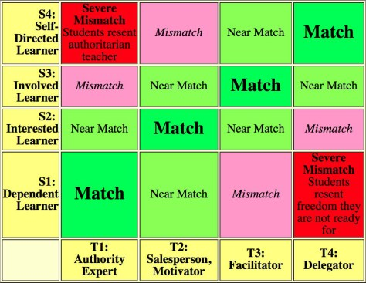

Slide 13
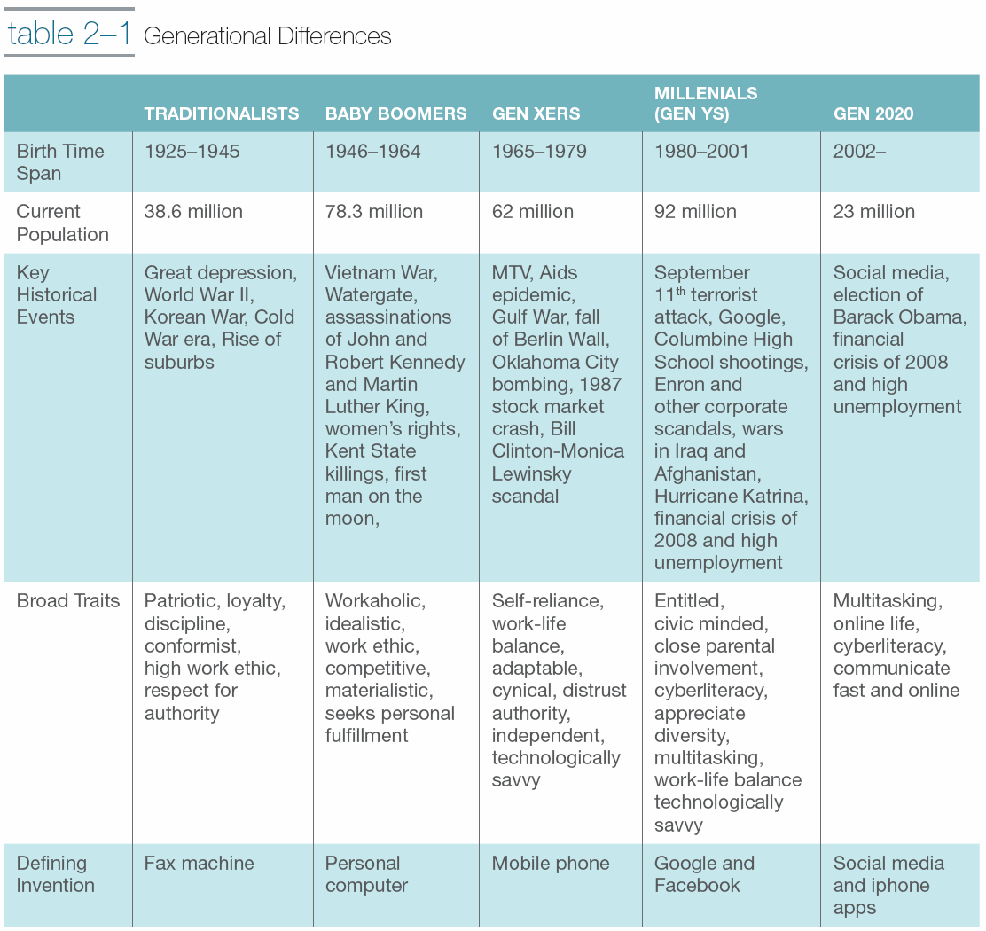

Slide 14
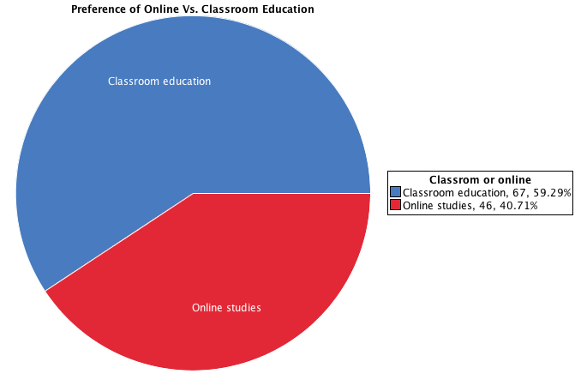

Slide 15
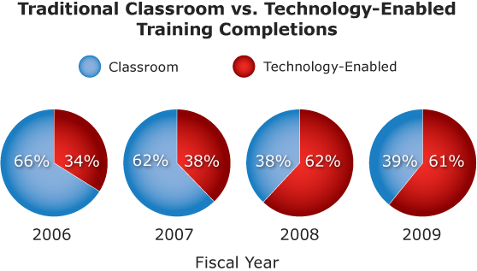

Slide 16
Differences
In class | Online
Rigid | Flexible
Immediate Feedback | Delayed Feedback
Full Interaction | Lower Interaction
Easy “Group work” | Difficult to work in Groups
Communication: face to face/online | Communication: mostly online
Synchronous | Asynchronous/Synchronous

Slide 17

Online VS Distance Education
Virtual classrooms
Synchronous and Asynchronous
Interaction (much better than online especially for synchronous)

Slide 18

Participation/Interaction
Student-Instructor
Student-Student
Student-Contents

Slide 19
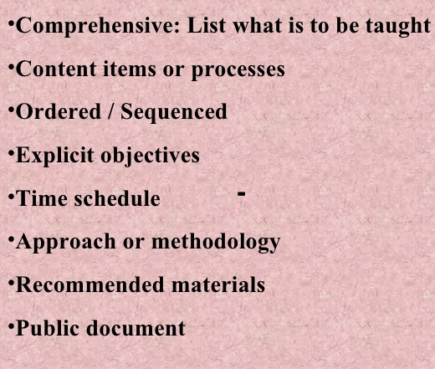
Syllabus
First interaction
Guideline
Expectations (Both)
Learning objectives and outcomes
Helps keep the track of progress

Slide 20
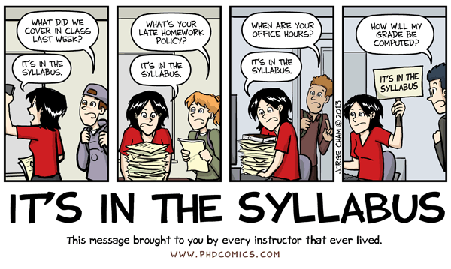
Syllabus

Slide 21

Clickers
Best for synchronous class
Immediate feedback
Break form the routine flow
Icebreaker
Can be a distraction
Timing is important
Relevance

Slide 22

Scavenger Quizzes
Best for Asynchronous class
Help students go through lecture material
Highlight important ideas
Incentive

Slide 23


Forums
Best for Student-Student interaction
Help in Generating ideas
Promotes different perspectives
Discussion of latest innovations/updates in the industry

Slide 24
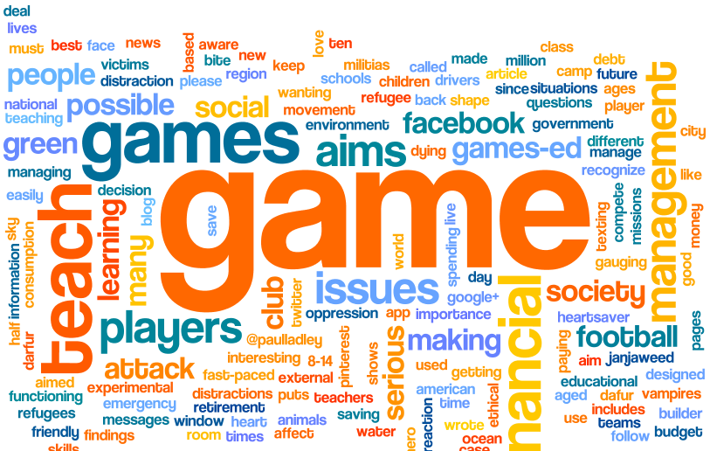
Games
Most Engaging
Best for group interactions
Innovative
Team building
Class size
Class setting
Relevance to course
Time issues
Peer Response

Slide 25
Your inputs/thoughts
Any engaging/interactive activity
Outcomes
  Expected
  Unexpected
Problems
Response

Slide 26
Questions/Comments

