Slide 1
Tools of Engagement for Online Learning
Dr. Deborah Taylor
Kansas City Kansas Community College
dtaylor@kckcc.edu

Slide 2
Notes:
Who remembers this?

Slide 3
Welcome
Quick introductions
Who, What, Where
A Little Background Information

Slide 4
Before we look at the tools and strategies, let’s define a few terms.
Engage
Engagement
Student Engagement
Online Student Engagement

Slide 5
Engage
Occupy, attract, or involve (someone’s interest or attention)
http://www.oxforddictionaries.com/us/definition/american_english/engage#engage

Slide 6
Engagement
Difficult to define - best I found was in the Oxford English Dictionary
“That which engages or induces to a course of action; an inducement, motive. Cf. (obs)”
Linda Deneen liked, “the fact of being entangled; involved or entangled conditions. Obs.”
Note both are obsolete
Notes:
Her article motived me to find my own

Slide 7
What does student engagement mean?
In education, student engagement refers to the degree of attention, curiosity, interest, optimism, and passion that students show when they are learning or being taught, which extends to the level of motivation they have to learn and progress in their education.
Student Engagement (2016, February 18). In S. Abbott (Ed.), The glossary of education reform. Retrieved from http://edglossary.org/student-engagement/

Slide 8
Student Engagement in Online Classes
Student engagement is a rendezvous between learning and the digital tools and techniques that excite students.
Linda Dennen, Educause Quarterly Review, vol. 32, no. 4, 2009
Notes:
Educause Quarterly (vol. 32, no. 4, 2009)
Linda Dennen

Slide 9
George Kuh on the engagement premise
the more students study a subject, the more they know about it,
and the more students practice and get feedback from faculty and staff members on their writing and collaborative problem solving,
the deeper they come to understand what they are learning…
Notes:
father of student engagement - George D. Kuh, “The National Survey of Student Engagement: Conceptual and Empirical Foundations,” New Directions for Institutional Research, vol. 2009, no. 141 (March 9, 2009), pp. 5–20.

Slide 10
Learning Environment Design
consider both motivational and instructional influences on learners,
Both require consideration of learner goals and capabilities together with cultural and environmental factors that affect attitudes and performance.

Slide 11
Keller’s ARCS Model for Design
Attention
Relevance
Confidence
Satisfaction
Motivational design
Adult learners – self-motivated learners

Slide 12
The ARCS Process Includes:
Knowing and identifying the elements of human motivation,
Analyzing audience characteristics to determine motivational requirements,
Identifying characteristics of instructional materials and processes that stimulate motivation,
Selecting appropriate motivational tactics, and
Applying and evaluating appropriate tactics.

Slide 14
Interest theory
For engagement to occur, the activities or tasks must be personally meaningful (Hidi, 2000).
This brings into play the importance of the instructor creating a class that can have personal meaning to the students as well as embracing the social aspects of learning.

Slide 15
Self-directed learners want to know:
what is due and when
the purpose of the activity
how it will be evaluated.
They also want some say in when they work,
expect what they need to be available when it should be, and
often want to work ahead.

Slide 16
Some of the more important design elements for a successful online course include
Start Here Folder - promotes clear navigation
Instructor Introduction - builds teaching presence
Student Introductions - builds community
Class Management Statement - spells nearly everything out for expectations both for the students AND for the instructor
Due Dates Link – allows for self-directed learning
Organization and Navigation - Content organized into folders in order to “chunk” course into manageable pieces and specific instructions included to guide student activity.
Discussion Areas - one for each main topic, one for introductions, and one for off topic discussions if desired. - Contributes to both social presence and cognitive presence and when the instructor comments, then teaching presence is there as well.
Announcements let students know that you are there and keeps them updated on class activities. (I also send as emails.)
Practice activities - establishes cognitive presence

Slide 17
Instructor Presence
Direct – use multiple means of interacting with your students
Introduction: picture and video?
Discussion: not too early nor too much
Announcements: brief and timely
Email: as needed (more on this later)
Journals: private (instructor only), directed (rubric), 1st
Feedback: timely, positive, relevant, encouraging
Indirect
Course Design
Course Navigation
Course Materials and Activities
Your course is a reflection of YOU!

Slide 18
Early Communication Builds Teaching Pressence
Send an email to students BEFORE semester starts.
Not all will see it, but those that do are greatly appreciative
Post first in the discussion area – model what you want to see
A welcome announcement telling them what to do first
About this class – quick overview for orientation

Slide 19
Mini-lectures
Podcasts – keep them short – audio only
Videos – if capturing live lectures – CHUNK THEM PLEASE!
Tutorials – Skitch (also useful for navigation issues)
Screencasts- Jing (free) Camtasia (purchase) Screencast-o-matic (free)

Slide 20
Podcasts
Audacity (FREE) software - allows you to record and edit sounds.
http://audacity.sourceforge.net/download/
Record an short talk for students to download and listen – a little music in the background spices up the podcasts.

Slide 21
Voice over PowerPoint/Lecture Capture
Articulate – Kind of expensive
Camtasia – not so pricey
Echo360 – very interesting and allows tracking of interactions (we are piloting this now)
Kaltura – not sure of price
Tegrity- not so good right now
Top Hat - ?
PowerPoint – anyone?

Slide 22
Tutorials
Can be used to explain how to access course resources.
Annotated screen shots- easy-peasy.

Slide 23
Immediate Feedback Promotes Self-regulated Learning
Feedback is a vital part of the learning process during which misconceptions are corrected. It is most effective when the feedback is both immediate and in sufficient detail for the student to initiate corrective action (Waldrop, Justen & Adams 1986).
With animations and computer models, the learner can obtain immediate feedback on his/her responses and incorrect answers can be changed as part of the acquisition of new knowledge.
Notes:
Waldrop, P. B., Justen, J. E., & Adams, T. M. (1986). A comparison of three types of feedback in a computer-assisted instruction task. Educational Technology, 26(11), 43-45.

Slide 24
Course Management Suggestions to Encourage Self-regulated Learning
Have several activities/assignments due very early, this shows your expectation for their behavior.
Use Rubrics for scoring – this gives students guidelines to monitor their performance.
Put your energy in at the beginning – correcting, adjusting, and explaining then students understand expectations and things move more smoothly the rest of the semester.

Slide 25
Please note:
There is NO ONE way to teach your course
Each course is unique
Each instructor is unique
HOWEVER
Some consistency in structure and design helps students as they move from course-to-course
Notes:
I teach several vastly different courses and while the skeleton is the same – the specifics vary quite a bit.

Slide 26
Learning
is a process not a product.
involves change in knowledge, beliefs, behaviors, or attitudes – over time and is lasting.
is not something that is done to students but rather something that students themselves do.
How Learning Works : seven research-based principles for smart teaching / Susan A. Ambrose [and others] ; foreword by Richard E. Mayer.
Notes:
How learning works : seven research-based principles for smart teaching / Susan A. Ambrose [and others] ; foreword by Richard E. Mayer.

Slide 27
Student centered learning
The responsibility to do the work is placed in the students’ hands.
Give them the tools, rules, guidelines, etc., but it is up to them to do the work.

Slide 28
Building a community
Discussion Boards
Guided Introductions
Who you are, your major, career goals, “one fun thing” and include a photo (builds community)
Post first and model what you want to see
Module (unit, weekly)
Relevant – can vary (reinforces course content)
Grading Rubric provided
*Most important interaction in my study for promoting student success
Notes:
My study showed that this had the most effect on promoting student success

Slide 29
Discussions will be different
Content heavy – i.e. science
Tell me one new thing that you learned while reading the chapter.

Slide 30
Grading Rubric for Posting (KISS)
3 points total
1 points if accepted by instructor
1 point for including page number
1 point for responding to another student's post. (Must be relevant and add to the content and not just an "I agree" type post.)
(if your post is not accepted, you will receive an email from me and your post will be deleted). (See below for requirements for acceptance.)

Slide 31
Accepted posts must fit the following criteria:
aligns with the directions
is unique (if someone has chosen your topic, you need to choose another one)
is composed of at least three sentences
has only minor grammatical and spelling errors
is accurate
is on time
must include page number

Slide 32
A Different Type of Post
Tell us how you did on the Kinsey quiz.
Were there any surprises?
Rubric is more complex – but still not as complex as many.

Slide 33
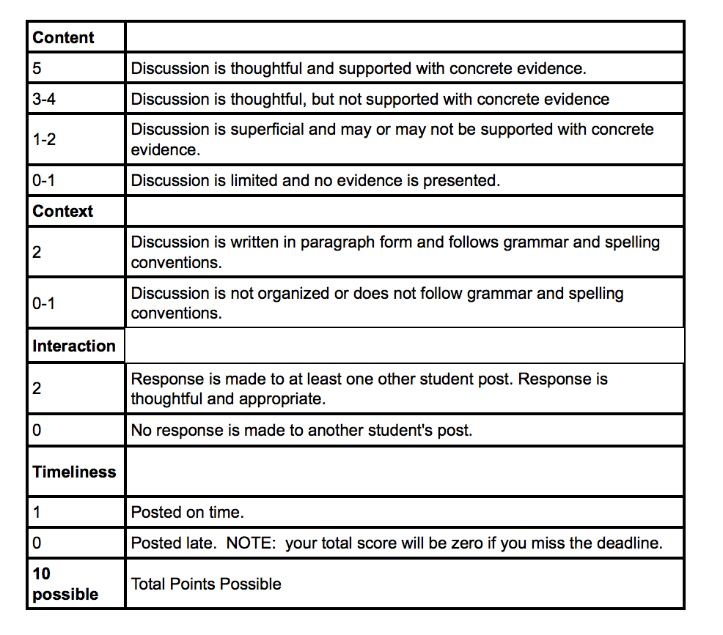

Slide 34
Other student-to-student interaction possibilities
Group work – group projects
Course wiki
Chat
Peer evaluations
Team quizzes
Peer tutoring
Notes:
Ask audience for what they use

Slide 35
7th principle of Learning
“To become self-directed learners, students must learn to monitor and adjust their approaches to learning”
Eberly Center for Teaching and Excellence at CarnegieMellon

Slide 36
Metacognition
Thinking about thinking
Higher-order thinking that enables understanding, analysis, and control of one's cognitive processes, especially when engaged in learning.
In other words, the more we can teach students to be actively thinking about thinking as they learn, the more effective their learning will be. (Kuhn, 2000)

Slide 37
Metacognition Tool –Journal
After reviewing exams
Private – Instructor only
After reviewing your results for Exam 1 tell me:
1) were you satisfied with your score?
2) what did you do to study for this exam,
3) what will you do differently for the next exam?
After last exam
3)what will you take with you from this class for your next science course?
Important to respond to 1st - see rubric
Notes:
Metacognition – students must learn to monitor and adjust their approaches to learning Eberly Center for Teaching and Excellence CarnegieMellon

Slide 38
Journal Rubric
3 points
1 point for each question
But to earn point – must answer questions 2 & 3 with specific activity
Can earn missing point(s) with a second correct post
Feedback I try to comment on first and others as needed
Notes:
The purpose is to help the to start thinking about how they study, prepare for exams, etc. The points are a carrot – do it and you get your points.

Slide 39
Exam 4 Journal Post q 2 & 3 only
For this exam I studied the powerpoints, taking notes and making flashcards, I did the homeworks and reviewed them before taking the test, I also filled out the study guide and had my roommates quiz me on it.
From this class I'm going to take away that, redoing homeworks even not for a score, works really well for me as a study method and that I excell when studying multiples days in advance a little each day instead of doing a lot only a night or a couple nights ahead of time. Thanks for the semester!

Slide 40
Another journal
I am very satisfied with my score. This is the best score I have ever gotten on a test and I am proud of myself.
To study for this test, I started studying early, I read through each chapter and took notes on them, and I reviewed the Power Point slides and homework.
The concepts that I learned in this class will definitely apply to other science classes I may take in the future. I will use my knowledge to excel in the subjects that we learned about and hopefully learn even more. I will also take away study strategies that I used in this class. With such dense information (usually a lot of information in science courses) studying can be hard, but over the weeks I learned how to study successfully. Thanks for guiding us through this course over the semester! (my emphasis)

Slide 41
Rubrics
Scoring tool
Reflects instructor’s expectations
Guidelines for students – promotes self-directed learning
Promotes consistency in grading
Reduces grading time
Reduces “why this grade?” questions
KISS
Does take time to build but worth it

Slide 42
Analytics for Metacognition
How am I doing?
Shows student how their performance stacks up against other students
Self-regulated learning
Metacognition

Slide 43
How am I doing?

Slide 44
Design Tools to Promote Engagement
Start Here Page
Folders for Chunking
Clear navigation
DUE DATE List and Link (self-directed learners want to know what is due and when)
Scavenger Hunt Quiz
Mini-tutorials – annotated screen shots (SKITCH)

Slide 45
START HERE page– every course should have one

Slide 46
Folders for Chunking and Easy Navigation

Slide 47
Chunking
Chunking refers to the strategy of breaking down information into bite-sized pieces so the brain can more easily digest new information.
Working memory can accept only 5-7 pieces of new information at a time. Information must go through working memory to be assimilated into long-term memory.
Think of this as a series of neurons (nerve cells) activating one another – neurons that fire together wire together.
http://theelearningcoach.com/elearning_design/chunking-information/

Slide 48
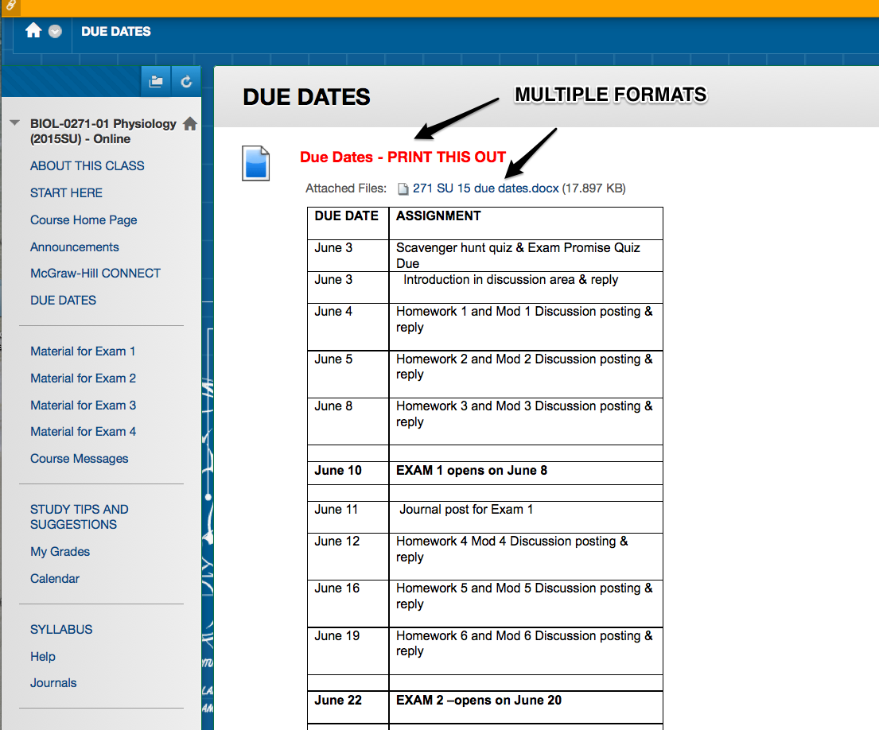

Slide 49
Scavenger Hunt Quiz
Points count towards grade – may take multiple times until full points awarded
Important course information
Not just syllabus information, but some “how to” things as well
Forces finding specific details about course
Example: Are you allowed to use your notes on test? Yes or no and then have feedback with correct answer.
Notes:
Syllabus Quiz is similar – but doesn’t sound as “fun”

Slide 50
Scavenger Hunt Quiz (can take multiple times in order to earn full credit)

Slide 51
TOOL - Skitch.com
Can be used to develop tutorials
Screen capture and annotate
Because it requires Evernote, files are easily accessed
Mobile friendly
Needs to be installed – take screenshot, annotate, pull to desktop, insert
Skitch.com screen capture with annotations (need Evernote account) I used for this presentation and also use for step-by-step instructions for students

Slide 52
Tutorial Example with SKITCH

Slide 53
Warning!
Don’t let technology get in the way of learning
If the learning curve to use the technology is too steep then cognitive overload will occur and the student won’t learn what you need them to learn for your class.

Slide 54
Practice Makes Perfect?
As a neuroscientist, practice fascinates me because it is all about establishing pathways in the brain. The ability of the brain to form and re-form routes for specific thought patterns, and for those routes to become more deeply ingrained the more we exercise those thought patterns, makes it possible for us to learn and refine a multitude of wonderful skills throughout our lives. Bill Jenkins, Ph.D.
http://www.scilearn.com/blog/deliberate-practice-develops-expertise

Slide 55
Quiz Tools
Publisher provided – some are good, but all are expensive. Helpful until instructor can develop own?
Quizlet.com
I’ve always suggested that students create their own – keeping a key so that they can check their work quickly.
Gimp.com like Adobe Photoshop, but free to make your own images

Slide 56
Interactive Tools Promote Engagement
Questions inserted into PowerPoint lectures -
Thinglink.com lets you build your own interactions
YouTube videos: search for content or build your own
Practice Quizzes: formative tools - in Quizlet.com students can build their own quizzes and find others
Interactive Homework – mostly publisher provided
Scenario Based Learning and Simulations
Some are already out there
Build your own?

Slide 57
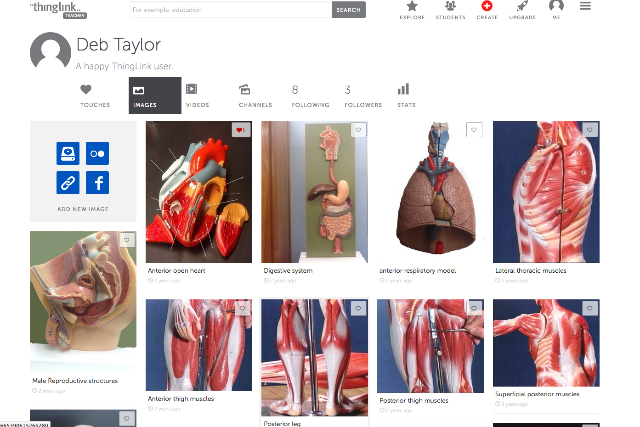

Slide 58
Learning and performance are best fostered when students engage in practice that
focuses on a specific goal or criterion for performance (again, learning objectives/outcomes),
targets an appropriate level of challenge relative to students’ current performance, and
is of sufficient quantity and frequency to meet the performance criteria.
Specifically, research shows that the amount of time someone spends in deliberate practice is what predicts continued learning in a given field, rather than time spent in more generic practice.
(Ericsson, Krampe, & Tesch-Romer, 1993)
Notes:
Ericsson, K. A., Krampe, R. T., & Tesch-Römer, C. (1993). The role of deliberate practice in the acquisition of expert performance. Psychological review, 100(3), 363.
So if you exams are multiple choice then your practice should be, but if exams are essay then practice should be essay.

Slide 59
Practice, Practice, Practice
Formative assessments (not graded, but points given for doing)
Homework over time (graded)
If multiple choice questions on test then practice should be multiple choice, but if essay tests then essay practices.
Notes:
Research has shown that learning and performance are best fostered when students engage in practice that (a) focuses on a specific goal or criterion for performance (again, learning objectives/outcomes), (b) targets an appropriate level of challenge relative to students’ current performance, and (c) is of sufficient quantity and frequency to meet the performance criteria. Specifically, research shows that the amount of time someone spends in deliberate practice is what predicts continued learning in a given field, rather than time spent in more generic practice

Slide 60
Publisher Provided (costly)
McGraw-Hill
Pearson
Wiley
Sapling Learning (still evolving)
Others?

Slide 61
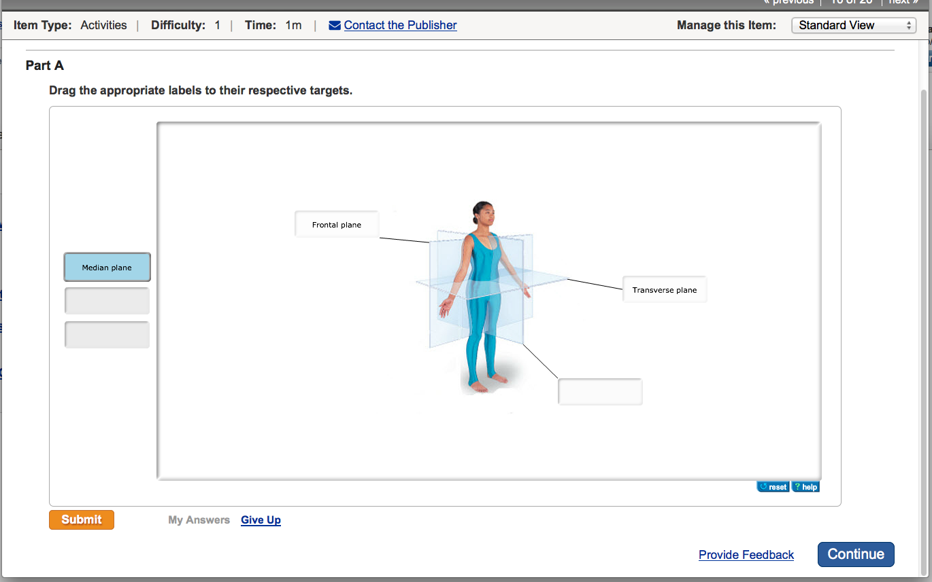

Slide 62
Build your own?
Time consuming
SoftChalk
LMS?
Test banks

Slide 63
SoftChalk

Slide 64
YouTube – Your Own

Slide 65
Or use others’ videos

Slide 66
Scenario Based Learning, Simulations, and Case Studies

Slide 67
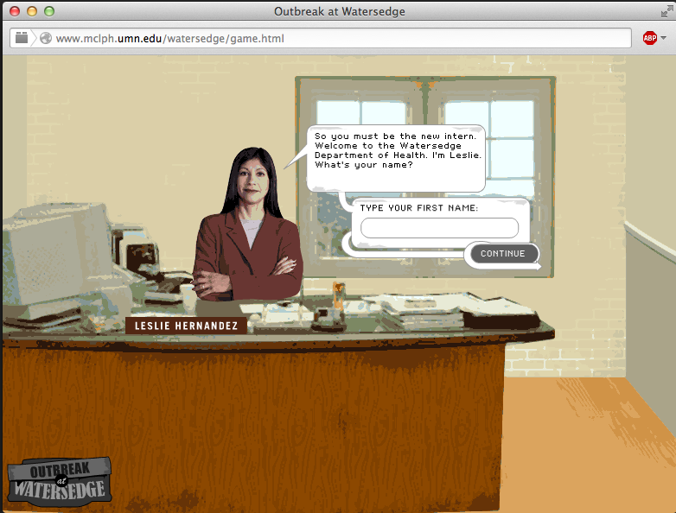

Slide 71
Notes:
Found at merlot.org resources

Slide 73
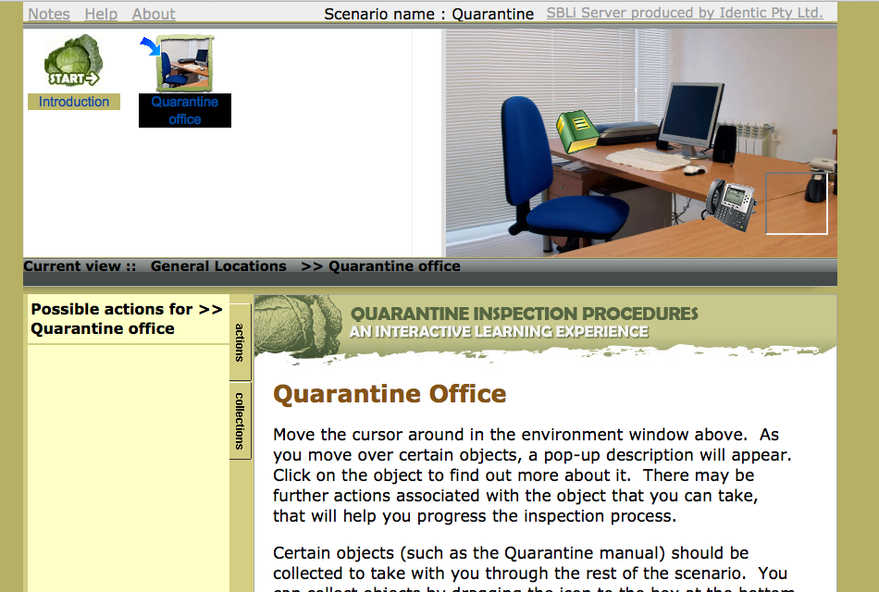

Slide 74
Find or Build?
Finding – sometimes they are good, sometimes not.
Building –
Articulate Storyline - $$$ (Windows only)
SBL Interactive http://www.sblinteractive.org
free- somewhat steep learning curve (Windows only)

Slide 75
In conclusion
It is possible to build an engaging course.
Yes, it takes work and it takes time as well as a great deal of planning, however it is worth it when you see your students succeed.
Any Questions?

Slide 76
Thank you!

Slide 77
Resources and References
http://elearninginfographics.com/engaging-students-in-elearning-infographic/
http://www.cmu.edu/teaching/principles/learning.html
http://www.hhmi.org/biointeractive/cardiology-virtual-lab
http://www.Saplinglearning.com
http://shop.mheducation.com/search.html?searchQuery=Ph.I.L.S
http://www.mclph.umn.edu/watersedge/game.html
http://www.Skitch.com
http://www.Thinglink.com
How Learning Works : seven research-based principles for smart teaching / Susan A. Ambrose [and others] ; foreword by Richard E. Mayer.
https://coi.athabascau.ca/

Slide 78
http://www.scilearn.com/blog/teaching-metacognition-thinking-about-thinking
http://www.scilearn.com/blog/deliberate-practice-develops-expertise
http://mvdspuy.blogspot.com
https://coi.athabascau.ca/coi-model/an-interactive-coi-model/
http://www.sblinteractive.org/
Dennen, L.,(2009)http://er.educause.edu/articles/2010/3/what--is-student-engagement-anyway
Keller’s ARCS model for deign https://www.arcsmodel.com

Slide 79
Taylor, Deborah L., (2014).Interactions in Online Courses and Student Academic Success . University of Kansas, ProQuest Dissertations Publishing, 2014. 3671767.
Ericsson, K. A., Krampe, R. T., & Tesch-Römer, C. (1993). The role of deliberate practice in the acquisition of expert performance. Psychological review, 100(3), 363.
http://www.cmu.edu/teaching/principles/learning.html
http://theelearningcoach.com/elearning_design/chunking-information/

