Slide 1
eLearning @ S&T
Margaret Cline, CIO
Meg Brady, Director, Educational Technology
March 12, 2010

Slide 2
Missouri S&T Opportunities
Improve student learning experience and outcomes
Meet students’ technology expectations
Use technology to facilitate “active-learning”
Provide students with options (either/or options in online courses and face-to-face)
Increase enrollments through new online programs
Decrease the need for physical classrooms

Slide 3
Expanded Opportunities: Faculty
Institutional support and recognition for those already ‘blending’
Collaborative improvement of curriculum while preserving individual value of expertise and creativity
Quantitative and qualitative measures of learning outcomes (integrated into course design)
Scholarship of teaching opportunities
Rich resources and support services for both pedagogy and technology

Slide 4
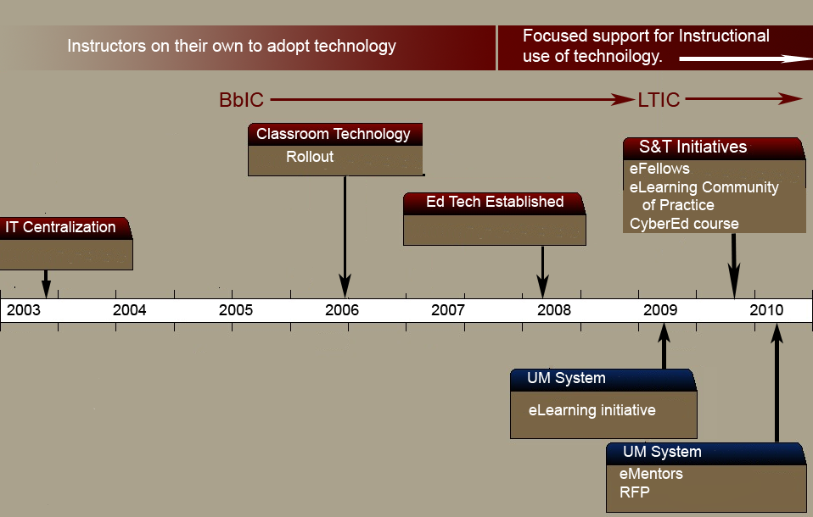
Educational Technology Timeline

Slide 5
S&T Present
Create inventory of current blended/online offerings (formal and informal)
Propose campus eLearning strategy
  Courses/programs
  Institutional processes (admissions, registrations)
  Institutional policies
    Accreditation, P&T, incentives/rewards, intellectual property, etc.

Slide 6
S&T Future
Balance/refine support models for eLearning activities (programs, staffing, partnerships)
Identify target programs for fully online design/delivery
Continue transformation to blended design/delivery

Slide 7
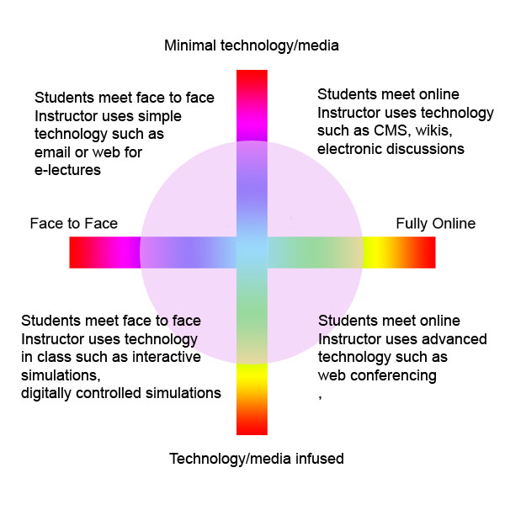

Slide 8
Why Blended Learning?
New approaches to teaching
Enhance student learning
Maximize institutional resources
Access; convenience; retention
Stepwise approach to fully online

Slide 9
EdTech and
You

Slide 10
Most of the courses I teach now are…
Traditional F2F (0% online)
Web-enabled (1-29% online)
Blended (30-79% online)
Fully online (80-100% online)
Based on the definition of Online Learning from Allen, I. Elaine and Jeff Seaman. (2008) Staying the Course, Online Education in the United States, 2008. The Sloan Consortium.

Slide 11
I believe…
Traditional lecture, face-to-face, is the best design/delivery strategy for all my courses
Blended is the best design/delivery strategy for one or more of my courses
Fully online is a potential for one or more of my courses
My department should offer a fully online degree/certificate program

Slide 12
The #1 barrier for me to adopt new pedagogy/technology is…
Time available to redesign and develop course materials
Lack of support resources (consultations, training, hot line, self-help materials)
Lack of appropriate tools (cameras, software, tablet PC, etc.)
Other

Slide 13
eFellows Program
A competitive program to provide year-long support for faculty to develop courses using best practices for online learning. Program establishes faculty cohorts for peer support and development
Pilot year begins Spring 2010 for 3 faculty to transform foundational engineering courses to blended design/delivery for Fall 2010
CyberEd course for faculty development
Consultative support services

Slide 14
eLearning Community of Practice
Open to faculty interested in learning more about blended/online practices
Participating faculty are invited to join the eFellows in the CyberEd course, and to apply principles and tools to their courses
EdTech consultation services are also available
Email Angie Hammons hammonsa@mst.edu if interested

Slide 15
Which of the following best describes your use of Blackboard?
I don’t use Blackboard in my classes
I post course syllabus and grades
I use many Bb features like discussion boards, online assignments, quizzes/exams, etc.

Slide 16
Which describes your use of Web 2.0 and social networking tools?
I use wikis, blogs, Facebook, and/or other web 2.0 tools for my personal interests
I use wikis, blogs, Facebook, and/or other tools for my research interests
I use wikis, blogs, etc. as part of the instructional technology tools in my courses
What’s a wiki?

Slide 17
Tools
Blackboard (CyberEd course)
  Discussion board
  Blogs, wikis, etc
  Wimba
Google Apps for collaboration
  http://it.mst.edu/googleapps.html
  https://sites.google.com/a/mst.edu/cyberedmultimediaresources/

Slide 18
Tools
Respondus – test making software; both printed and online
Video editing
  Camtasia, ping, etc.
Publisher content and online tools
YouTube.edu, OpenCourseWare, etc.
Others

Slide 19
Thank You for attending the
3rd Annual S&T TLT Conference
Questions?
Discussion?

