Slide 1
id@
Instructional Videos With Purpose: Compensate, Support and Challenge Students’ Learning
Dan Cernusca, Ph.D.
Instructional Design Specialist
Daniel Forciniti, Ph.D.
Professor of Chemical & Biological Engineering
Missouri University of Science and Technology
TLT Conference - Rolla, March 2010

Slide 2
id@
It started with…
Instructor’s desire to enhance students’ academic experience & performance.
TRUST
Instructor
Instructional Designer

Slide 3
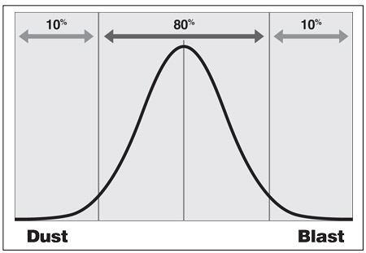
Identify Needs To Address
id@
Major Worked
Examples
Prior
Knowledge/Skills
Open-ended
Applications
Compensate
Challenge
Support

Slide 4
id@
Why Instructional Videos?
Multimodal instructional environment
(text/audio/video);
Able to convey instructor’s perspectives
in a focused manner;
User-friendly video software available;

Slide 5
id@
Startup Production Strategy
How?
decide on the focal topic;
select the material to include;
create a protocol to present the selected material;
record the audio associated with the selected material;

Slide 6
id@
Startup Production Strategy
How?
convert the material in images;
integrate images and audio
(Camtasia Studio 6);
include animated pointers & highlights to guide the viewer;
set the length of the video between 7 and 10 minutes;

Slide 7
id@
Startup Production Strategy
Why image-based videos?
gives the instructor the ownership of the material of the video;
allows for split of responsibilities yet keeps a nice flow of the teamwork;
gives flexibility on the recording of the audio ;
decreases the size of the final output;

Slide 8
id@
Startup Production Strategy
Why image-based videos?
allows for a mix of various materials into the same video

Slide 9
id@
Startup Production Strategy
Why image-based videos?
allows instructor to maintain focus on those parts of the image that are important;
allows for animation to became effective guide of students’ attention

Slide 10
id@

Slide 11
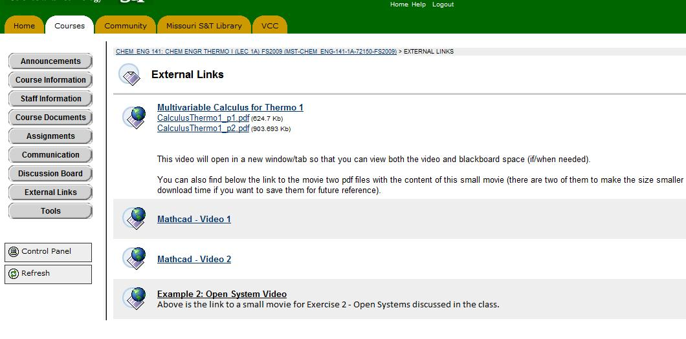
id@
Video is Done…Now What?
You can easily make it available in Blackboard;

Slide 12
id@
Video is Done…Now What?
…but it will be more effective if:
you create a task that requires students to use the video;
when appropriate provide a text/slides version of the content;
get students’ perceptions on these videos at midterm and end of the semester ;

Slide 13
id@
The end of the video can include a
transfer task…

Slide 14
id@
What we have so far?
Three short compensatory videos
one related to calculus;
created from scratch, outside the classroom, mostly with handwritten materials
two related to Mathcad;
audio for the first one recorded in the course combined with screenshots;
audio for the second one recorded mostly outside the class;

Slide 15
id@
What we have so far?
One supporting video
a major worked example introduced in the classroom;
audio recorded in classroom for reference;
final audio recorded outside the classroom;
slides converted to images and overlapped on the audio;

Slide 16
id@
Here they are!
…at least at the time of this presentation
Calculus Video
Mathcad Video
Worked Example

Slide 17
id@
Why it worked out?
The instructional designer added value in selecting the topic and in using of the videos but…
The instructor had full ownership of the content and focus of these videos;
Significant time was saved by using an effective and productive division of labor;

Slide 18
id@
Contact Information
Dan Cernusca, Ph.D.
207 Norwood Hall (CERTI office)
(573) 341 4632
dcernusca@mst.edu

