Slide 1
Extending the Active Teaching Environment Beyond the Classroom Using Wikis
Dr. John P. Hogan
Missouri S&T Geology and Geophysics
jhogan@mst.edu
Notes:
March 11th 2010 Missouri S&T EdTech Conference

Slide 2
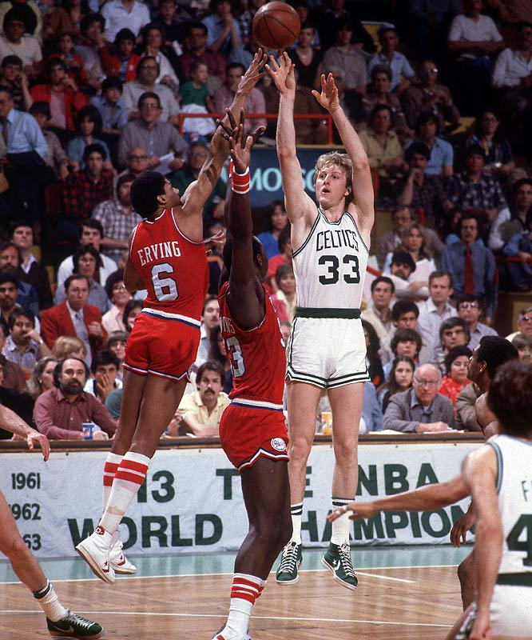
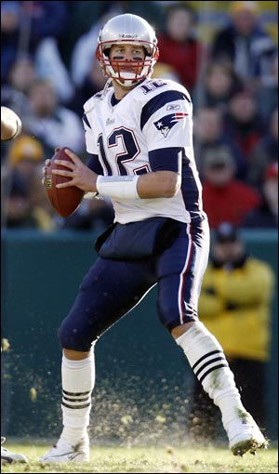
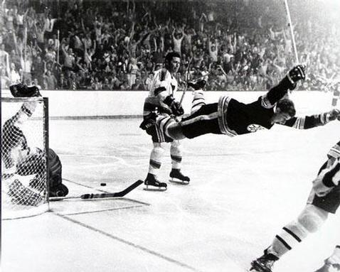
SUCCESS
Notes:
Boston has a rich sports history of successful athletes. There success reflects to a large extent their willingness to practice the fundamentals of the game for many, many, hours. I read Ted Williams biography when I was a kid – focused on hitting. I had a huge poster of Bobby Orr poster with his game winning shot in my room. Bhhiiirrrdddd! And my Mom is a Patriots fan…

Slide 3
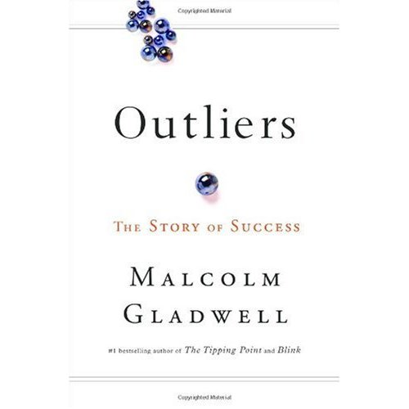
Five P’s for Success
10,000 Hour Rule
Malcom Gladwell points out in his book that one of the important keys to success in any field is the 10,000-Hour Rule, which is simply a matter of practicing a specific task for at least 10,000 hours (20 hours of practice time a week for 10 years).
Notes:
Gladwell’s book looks at a number of factors that have helped create highly successful individuals – one of these factors is commonly referred to as the 10,000 hour rule. I know this rule as the part of the five P’s for success, Patience, Persistence, Practice, Practice, Practice! All of Gladwell’s books are enjoyable reads…they should give a copy of this book to every S&T student.

Slide 4
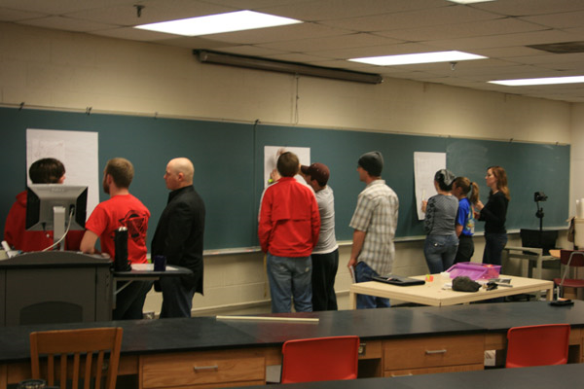
Active Teaching Provides Practice!
Practice!
Practice!
Notes:
Active Teaching helps students become academically successful by creating opportunities to practice the fundamental skills and knowledge essential to mastering and retaining the course material. Shown here is a Gallery Walk in action. I will present the fundamentals of the Gallery Walk in the next few slides.

Slide 5
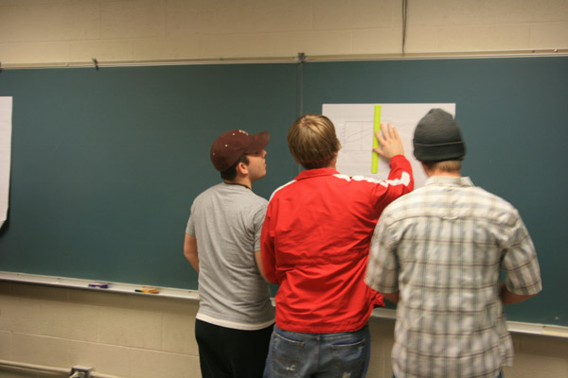
“Gallery Walks”
Notes:
Additional advantages of the Gallery Walk: 1) Assessment – do students really understand how to utilize and apply the material you have been covering in lecture? You will know right away as you look over their shoulders and see how thery approach the problem. 2) Provides variety in the classroom –variety is the spice of life. 3) Encourages cooperative learning and problem solving. 4) Requires peer evaluation of material presented by other groups. Click on the link for more information on Gallery Walks.

Slide 6
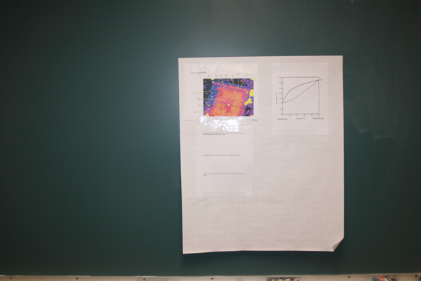
Gallery Walks are comprised of a series of problems that students work on in groups
Notes:
The problems require students to use material I have been covering in previous lectures and homework assignments. They range from straightforward problems to more challenging applications commonly involving material from my research. They can be similar to homework problems or those that mat appear on an exam….this way I can actually see if they understand the material being covered or not…

Slide 7
Students Move From
One Problem to the Next
Notes:
Students move every five minutes or so from one problem to the next until they come back to where they started. In this way they will have seen every problem posed to the class and have gotten a flavor of what they need to know. This also provides variety and renews discussion – in case your problem was too easy or too hard.

Slide 8
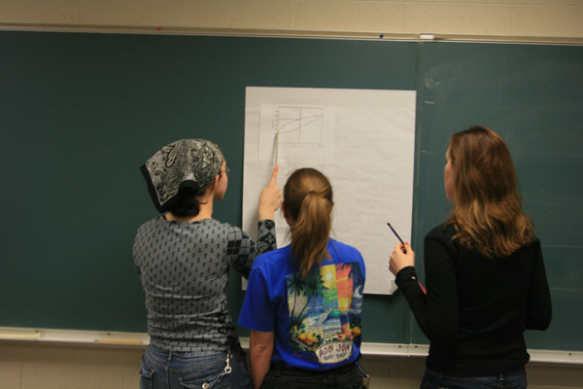
Collaborative Learning &
Peer Evaluation
Notes:
In addition to working together to contribute new knowledge towards solving the problem, each group needs to evaluate the contributions made by previous groups. They must decide if the material presented is correct and if it helps solve the problem. Then they make their own contribution.

Slide 9
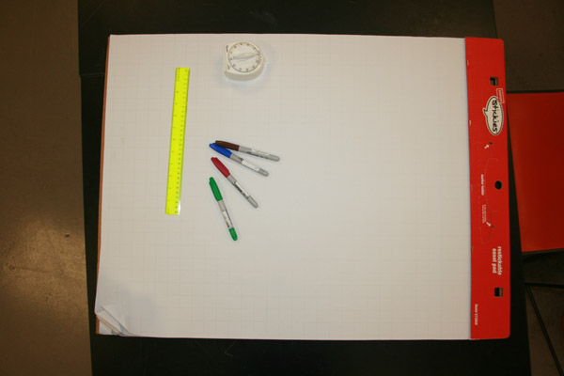
Simple Material Requirements
Notes:
The materials needed for a gallery walk are very simple and relatively inexpensive.

Slide 10
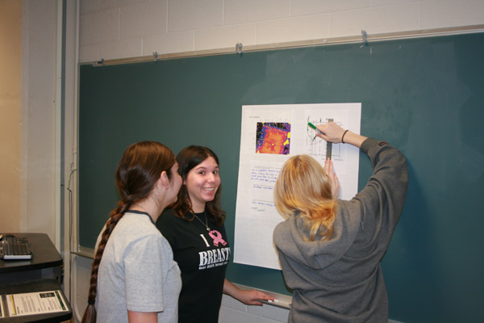
Gallery Walks Are Appreciated!
Notes:
Many students have commented on how much they enjoyed the gallery walk and really felt like they were learning the material.

Slide 11
Notes:
But what do you do when the class is over? How can we capture the learning environment and extend it to provide opportunity for reflection and retention? The value of this exercise seem to evaporate with students exiting the classroom. A course wiki present a possible solution. When the groups come back to the problem they first started with…I assign them ownership of that problem. In the past they would summarize the answer and then present that to the class – never enough time. Now they take the problem with them and will post the summary on the course wiki creating a semipermanent record that everyone in the class can use to study the problems and the possible answers.

Slide 12
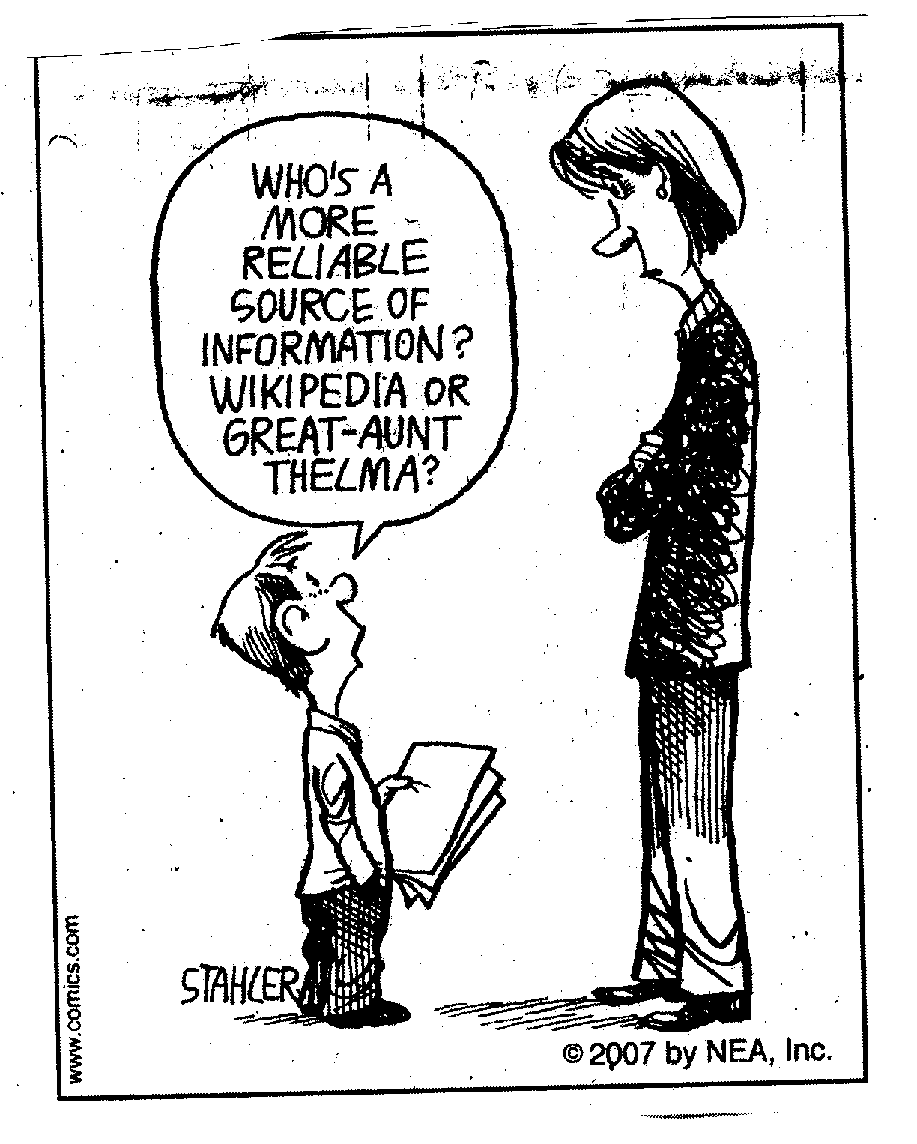
Extending the Active Learning Environment Using Wikis
Notes:
Ok so what’s a wiki….the most famous is wikipedia. They are basically a web page that a group of people can collectively contribute and edit content on a related topic.

Slide 13
Sources for Wikis
Wikispaces
Google Sites
Blackboard
Notes:
Here are some of the wikis I use, or have used in my courses.

Slide 14
Some Wiki Issues….
Getting Student’s to use it….
Control over content….
Access and Availability….
Archiving….
https://wiki.mst.edu/imp/
Notes:
These are some of the issues you will need to deal with when setting up your wiki. I address most of these issues on the wiki so you can see how I have chosen to handle these concerns.

Slide 15
Extending the Active Classroom
Introductory Igneous and Metamorphic Petrology & Petrography
(Undergraduates – Required for all majors)
Gallery Walk Follow Up
Peer Evaluations
Notes:
This is an example from past years of the follow ups to the gallery walks. You may notice that the contributions improve in quality as the semester matures.

Slide 16
Rubric for Peer Evaluation
Category | Scoring scheme |  | Score
Organization of Content | 4 | Content is well organized and easy to navigate. Headings are appropriate and informative. Bulleted lists are used to group material as necessary.
 | 3 | Content is organized using some headings and/or bullets. However the overall organization can be difficult to follow in places.
 | 2 | The content is somewhat logically organized, but headings and bullets are needed.
 | 1 | The material presented is disorganized and it is difficult to follow or to find information.
Also: Editing Accuracy; Content Clarity; Technical Skills;
Notes:
This year, with the help of Dan Cernusca, students will use a rubric to evaluate the contributions of other groups to the wiki. This should help to increase the ownership stake in developing a collaborative set of notes and solutions for skills and problem solving related to the course content.

Slide 17
Learning potential | 4 | The content of the Wiki posting fully and correctly answered the question posed and provided adequate discussion of the topic. This significantly increased my understanding of the topic and principles presented in lecture.
 | 3 | With one or two exceptions, the content of the Wiki posting fully and correctly answered the question posed and provided adequate discussion of the topic and increased my understanding of the topic and principles presented in lecture.
 | 2 | More than half of the content of the Wiki posting fully and correctly answered the question posed and provided adequate discussion of the topic. This posting somewhat increased my understanding of the topic and principles presented in lecture but not sufficiently to fully understand the material.
 | 1 | The content of the Wiki posting totally missed answering the question posed and failed to provide adequate discussion of the topic. This posting did not help to increase my understanding of the topic and principles presented in lecture.
Learning Potential
Notes:
I want the class to realize this is a very important component in developing their contributions. The main goal here is learning the material. Creating a wiki contribution is promoting learning without the teacher….a form of self- or peer-learning…

Slide 18
Extending the Active Classroom
Advanced Structural Geology
(upper level undergraduate & graduate students)
Class Projects
Notes:
This is a wiki for an advanced class project. Some of these students contributed to the wiki well after the course ended! In addition students from another university participated in this wiki by providing comments…that is really extending the learning environment!

Slide 19
What’s Next for Wikis?
Notes:
My opinion – I see wikis replacing the need for text books. Can you imagine advertising a university experience where you don’t have to buy a textbook…all the course information is available on line….

Slide 20
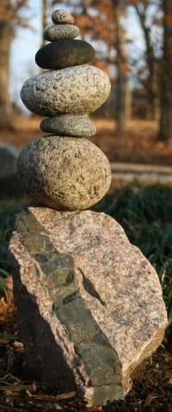
Discussion
Dr. John P. Hogan
jhogan@mst.edu
Notes:
Please feel free to email me with any comments or suggestions…I’m just getting started with this project and I really am a “Digital Immigrant” so they would be very much appreciated.

