Slide 1
Assessment Matters!
Evaluation Tools and Feedback Strategies in a Blended Classroom
Irina Ivliyeva
Arts, Languages, and Philosophy Department
Missouri S&T (formerly UMR)
ivliyeva@mst.edu

Slide 2
Content
Terminology; subject background; students and classes;
Evaluation, Assessment, Feedback: students’ motivation; strategies, tools and practical examples;
Pedagogical implications for enhancing the interactive learning environment.
Notes:
The amount of literature on assessment and evaluation is parmauntable. Different authors give different definitions of what… is et.
I propose that we examine definitions for Dictionaries

Slide 3
I. Terminology and Definitions
Blended (hybrid) classroom
Assessment
Feedback
Evaluation
Communication

Slide 4
What is “Hybrid” or “Blended”?
Web-based learning activities are introduced to complement face-to-face (FTF) work;
FTF time is reduced, though not eliminated altogether;
Web-based and face-to-face components are designed to interact pedagogically.
Notes:
Identified basic trends

Slide 5
“Hybrid” or “Blended” classroom by % Content Delivered Online
Blended/ Hybrid 30 to 79%
blends online and face-to-face delivery;
substantial proportion of content delivered online;
uses online discussions and some face-to-face meetings.

Slide 6
What is Assessment?
- educational evaluation: a method of evaluating student performance and attainment.
Synonyms: evaluation, appraisal, estimation, measurement, judgment, review, consideration, opinion.
Encarta® World English Dictionary[North American Edition] © & (P) 2009 http://www.bing.com/Dictionary/search?q=define+assessment&form=QB
Notes:
Objective vs. subjective

Slide 7
What is Feedback?
- response, comments in the form of opinions about and reactions to something, intended to provide useful information for future decisions and development.
Synonyms: response, reaction, comment, criticism, advice, pointer, opinion, view, reply.
Encarta® World English Dictionary[North American Edition] © & (P) 2009 http://www.bing.com/Dictionary/search?q=define+feedback&FORM=DTPDIA

Slide 8
What is Evaluation?
- assessment of value: the act of considering or examining something in order to judge its value, quality, importance, extent, or condition.
Synonyms: assessment, appraisal, estimation, calculation, valuation, estimate.
http://www.bing.com/Dictionary/search?q=define+Evaluation&form=QB
Encarta® World English Dictionary[North American Edition] © & (P) 2009

Slide 9
What is Communication?
- the exchange of information between people, e.g. by means of speaking, writing, or using a common system of signs or behavior;
- rapport: a sense of mutual understanding and sympathy.
Synonyms: contact, interaction, transfer, consultation, exchange, transmission.
Encarta® World English Dictionary[North American Edition] © & (P) 2009 http://www.bing.com/Dictionary/search?q=define+Communication&form=QB

Slide 10
"The single biggest problem in communication is the illusion that it has taken place."
~ George Bernard Shaw

Slide 11
II. Assessment of Learning Outcomes
What do we assess:
Students’ Competencies
Students’ Behavior
Students’ Skills
Instructors’ effectiveness of teaching
Quality of classroom communication

Slide 12
“Feedback is the breakfast
of champions.” ~ Ken Blanchard

Slide 13
The Importance of Giving Feedback
To promote learners’ motivation.
To provide learners with the sense of their own achievement.
To extend the learning and thinking process beyond the (final) grade.

Slide 14
Problems with Assessment/Feedback
What exactly is grading: commenting, marking, giving feedback, assessing, evaluating, correcting, etc…
Instructor’s role: coach or referee, counselor or judge?
How to make A/F objective?

Slide 15
Types of Feedback
Statistical feedback
Personal (human) feedback

Slide 16
Statistical feedback
- is quantifying students’ performance:
study habits comparison;
correlation: completed activities and performance on the assessment;
characteristics of learners’ behavior.

Slide 17
Personal feedback
is individually tailored feedback.
Challenges:
emotionally charged;
time consuming;
explicit or implicit ?
verbal or non-verbal?
Notes:
Save time on implement, collect, process

Slide 18
Assessment /Feedback and Technology
Advantages:
using technology, data can be collected and analyzed quickly;
fast turnaround time for providing more meaningful feedback;
saving paper and… time.
Notes:
Save time on implement, collect, process

Slide 19
III. Students and classes
Fall 2009
Elementary Russian 001 (language class, instruction in Russian) – 19 students.
Spring 2010
Russian Civilization 360 (upper level humanities class, instruction in English) – 19 students.

Slide 20
Elementary Russian 001

Slide 21
Russian Civilization 360

Slide 22
IV. Evaluation and Assessment Tools
Examples:
First email and initial survey (Russ 360)
Grade survey (Russ 001)
Self-assessment (Russ 001)
Blogs (Russ 360)

Slide 23
Student - instructor interactions
Email invitation to class and Blackboard postings (syllabus, etc.);
Request to fill out online survey;
Print out, sign and bring to class “Permission to use” forms;
Finally, first face-to-face meeting in class.

Slide 24
Student Permission-to-Use Form
Date__________ Student’s Name_________ Course and Term___________ Instructor’s Name__________________
I grant the instructor identified above unlimited permission to make public or reference those items checked in the list below. This permission applies to work I have completed in the course indicated.
_______Sound recordings of my voice
_______Examples of my written work
_______My comments in e-mails
_______My comments in chats
_______My comments in electronic forums
_______My name as part of a directory listing of students in the class
_______ My blog postings on Blackboard
_______ My postings on Wiki pages on Blackboard
I understand that when my work is used, if possible, an acknowledgement identifying the work as mine will be included.
Signature___________________ Date___________________

Slide 25
The First Email
From: Irina Ivliyeva [mailto:ivliyeva@mst.edu] Sent: Saturday, January 09, 2010 1:53 PM To: "MST-RUSSIAN-360-1A-71282-SP2010" Subject: Welcome to “Russian Civilization 360” in the Spring semester 2010!: MST-RUSSIAN-360-1A-71282-SP2010
Please log into the Russian 360 class on Blackboard and follow the instructions below: 1) Under “Course information” you will find your syllabus. Please read it before you come to your first class on Tuesday, January 12. 2) Under “Course information” you will find “Permission to Use Form”. Please print this page out, fill it out and bring with you to your first class meeting. 3) Under “Staff Information” you will find your instructor’s weekly schedule and contact information. Do not hesitate to contact your instructor when necessary. 4) Please complete this confidential online survey before our first class meeting. Click on the link below to take survey. http://www.surveymonkey.com/s/JHXBLS2 I am looking forward to seeing you in class on Tuesday, January 12 at 11 am, in 103 EMGT! -- Dr. Irina Ivliyeva

Slide 26
Russian Civilization 360

Slide 27
Russian Civilization 360: Survey results
Class profile:
19 enrolled, 11 surveys completed;
18 males, 1 female ;
8 Americans (native language – English);
11 foreign students (native language – Arabic).

Slide 28
Question 6. How did you first learn about Russian Civilization 360?
From a friend 63.6% (7)
From your advisor 0.0%
Directly from the instructor 27.3% (3)
From the Registrar’s web page 0.0%
From the Undergraduate catalogue 9.1% (1)
Flyer advertisement in the building 18.2% (2)
Email 0.0%
Search Engine 0.0%
http://www.surveymonkey.com/s/JHXBLS2

Slide 29
Question 7. Give at least one example of an image, impression, or concept of Russian culture you may have had before signing up for this course.
Group-orientated society.
Less concerned about individual rights and more focus on the entire nation and government.
The buildings and the cone tops. Not sure what they are actually called.
I find the Kremlin to be a ubiquitous icon of Russia.
Nothing (2 responses).
http://www.surveymonkey.com/s/JHXBLS2

Slide 30
Question 7. Give at least one example of an image, impression, or concept of Russian culture you may have had before signing up for this course.
New culture.
Russians love American gangster cinema.
Russians like things that are big.
Well i dont really know much about Russia beside its really big country, and that why i am taking this course to learn more.
Not a lot. i know the every one have to be with army. beautiful country.
None.

Slide 31
Elementary Russian 001

Slide 32
Russian 001 Fall 2009
The Grade Survey (after the midterm exam)
19 students enrolled, 14 completed this survey between November 5-18, 2009
Web link to Survey Monkey:
http://www.surveymonkey.com/s/B2B6QVG

Slide 36
8. What do you think would help you bring your grade up on the next exam?
Studying more Wed, Nov 18, 2009 3:58 PM Find...
Rework the translations Tue, Nov 17, 2009 1:59 PM Find...
more studying Tue, Nov 17, 2009 8:00 AM Find...
more studying Mon, Nov 16, 2009 6:58 PM Find...
vocab studying Mon, Nov 16, 2009 5:26 PM Find...
Having more time. In some ways the test schedule seems exhausting, in others it does make sure you are keeping up. I feel like I'm slowly falling behind. Mon, Nov 16, 2009 5:22 PM Find...
Better memorization of grammar and vocabulary Mon, Nov 16, 2009 4:07 PM Find...

Slide 37
8. What do you think would help you bring your grade up on the next exam?
8. More effective studying/reviewing Mon, Nov 16, 2009 3:53 PM Find...
9. Keep Studying Mon, Nov 16, 2009 3:51 PM Find...
10. more study time Mon, Nov 16, 2009 3:40 PM Find...
11. More time after class to study. Wed, Nov 11, 2009 10:08 PM Find...
12. Studying more Tue, Nov 10, 2009 5:56 PM Find...
13. Study in Russia Tue, Nov 10, 2009 5:12 PM Find...
14. Study more, and study longer Tue, Nov 10, 2009 4:14 PM Find...

Slide 38
Self-Assessment
“A man cannot be comfortable without his own approval.”
~ Mark Twain

Slide 39
V. Self-assessment guidelines (in syllabus)
Describe your reasons for taking the class, your goals and expectations, and compare them with practical outcomes/results. Describe (briefly) your reading, writing, comprehension and speaking skills in Russian. Please share when and how you may be able to use the skills (job, graduate school, further studies, studies abroad, interpersonal communication, etc.). Evaluate your knowledge about Russia’s culture, traditions and customs before and after taking this class. Please tell us about your future plans (if any) regarding Russian.

Slide 40
Self-Assessment sample (Russ 001, male student, Math major)
I really enjoyed my semester taking Russian 001. I originally signed up for the class to fulfill a degree requirement because my department would not take my two years of Japanese as a foreign language credit. However over the course of the semester I found it every interesting. I had a very limited knowledge of Russian culture and language. I did not expect to learn much as we did in a semester, and was pleasantly surprised. I will continue in Russian 002, unfortunately I will graduate and be unable to take further courses after that.
Notes:
The final grade

Slide 41
Self-Assessment sample (Russ 001, male student, Math major)
I am hoping the graduate school I end up choosing has a Russian program so I can continue learning. One thing that has always bothered me about foreign language classes in the Midwest is the lack of native speakers to communicate with. However when I am not at school (summers, semesters off) I live and work in California. I was very surprised with how many Russian speakers I met in California.
Notes:
The final grade

Slide 42
Self-Assessment sample (Russ 001, male student, Math major)
Working at NASA has provided a surprising amount of Russian encounters. One night I had dinner and drinks with a former astronaut and a Russian laser physicist. I also found myself in a meeting with a former Russian cosmonaut. My knowledge of Russian culture before this class was very limited and may have even included some ideas from your talk on stereotypes.
Notes:
The final grade

Slide 43
Self-Assessment sample (Russ 001, male student, Math major)
My knowledge of the Russian language was also very limited. I feel more comfortable with Russian now, though some words that are full on consonants trip me up. I also worry about sounding "funny" when I speak, sounding with an American diction. After May, before returning to work and graduate school, I plan on taking a trip to Russia. I would really enjoy using what I learned, and getting more confident in my Russian language skills.
Notes:
The final grade

Slide 44
Blog Definition Functions
VI.
online diary on Web site; a frequently updated personal journal chronicling links at a Web site, intended for public viewing.
http://www.bing.com/Dictionary/search?q=define+blog&FORM=DTPDIA
Encarta® World English Dictionary[North American Edition] © & (P) 2009 Microsoft
To promote interaction;
To share ideas / peer evaluation;
To create the sense of community in class;
To reduce turnaround grading / feedback time;
To extend learning and communication beyond the classroom space and time;
To be available 24/7;
To save paper and ink.
http://blackboard.mst.edu/webapps/portal/frameset.jsp

Slide 45
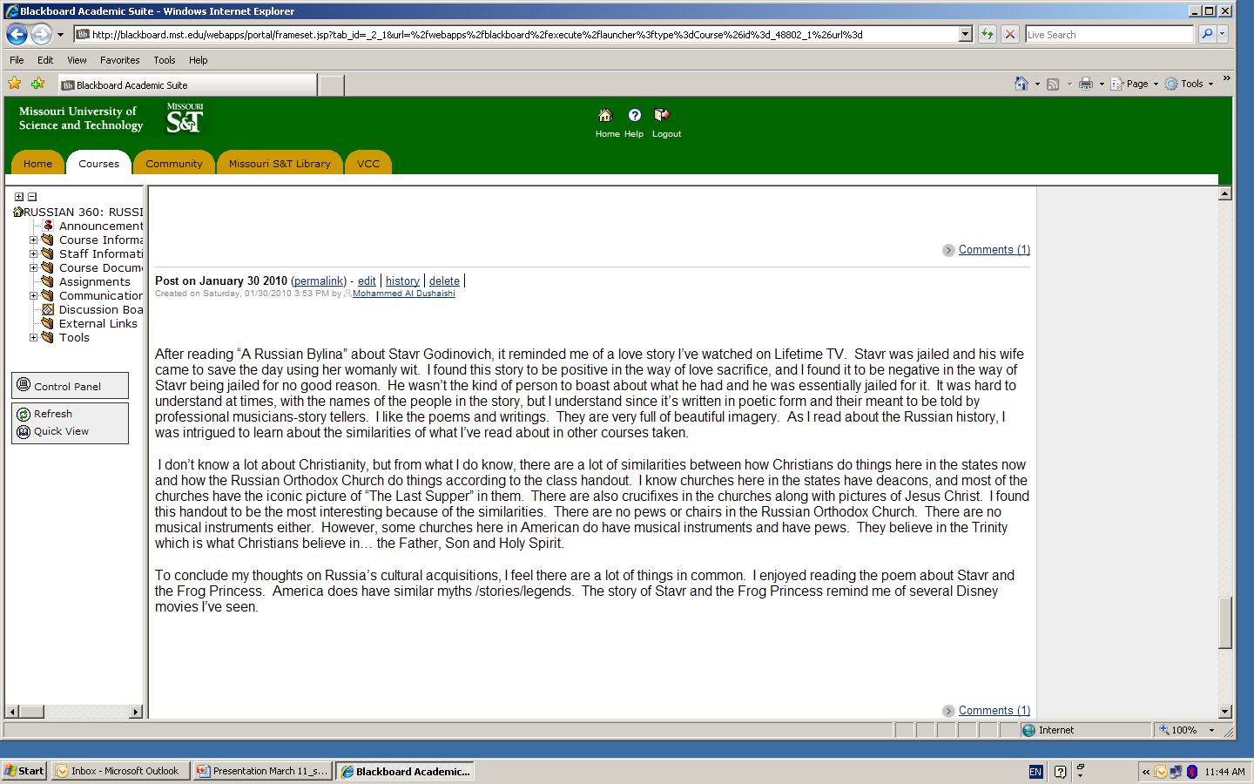

Slide 46
Benefits of Peer and Self-Assessment
improve students’ motivation and understanding of the assessment process;
increase students’ sense of involvement and ownership of the assessment process;

Slide 47
Benefits of Peer and Self-Assessment
practice advanced communication skills;
learn to be autonomous learners;
promote active learning;
be able to evaluate critically the quality of their own work – now and forever.

Slide 48
VII. Pedagogical Implications
“Good teachers are costly,
but bad teachers cost more.”
~Bob Talbert

Slide 49
3 Ps of Good Teaching
Personal contact
Positive reinforcement
Peer pressure
- Dr. Lance Haynes, ALP, Missouri S&T

Slide 50
In Lieu of Conclusion
Teaching from a Student's Perspective
(1 min. 37 sec.)
http://www.youtube.com/watch?v=K2lwKdKz2DY&feature=related
Traditional teaching (1 min. 17 sec.)
http://www.youtube.com/watch?v=C-S54bbX6eA&feature=related

Slide 51
In Lieu of Conclusion
“The mediocre teacher tells.
The good teacher explains.
The superior teacher demonstrates.
The great teacher inspires.”
~William Arthur Ward

Slide 52
References
Black, P and Wiliam, D (2002). Assessment for Learning: Beyond the
Black Box (2002). www.assessmentreform-group.org.uk/publications.html
Brown, H.D. (1994). Teaching by principle: An interactive approach to language pedagogy.
Englewood Cliffs, NJ: Prentice Hall.
Freeman, MA and McKenzie, J (2002). Implementing and evaluating SPARK, a
confidential web-based template for self and peer assessment of student teamwork: benefits of evaluating across different subjects. British Journal of Educational Technology, 33 (5), pp553-572. Cited at www.educ.dab.uts.edu.au/darrall/sparksite
Leont’ev, A. A. (1991). K opredeleniiu rechevoi situatsii. In Obshchaia metodika obucheniia
innostrannym iazykam (pp. 161-162). Moscow. Russkii iazyk.
Pellegrino, JW, Chudowski, N, Glaser, R (Eds) (2001). Knowing What Students
Know. Washington DC: National Academy of Sciences.
Ridgway J and McCusker, S (2003). Using computers to assess new educational goals. Assessment in Education: Principles, Policy and Practice, Vol. 10, no 3, pp. 309-328(20)
Ripley, M (2004). E-assessment question Foreign Languages and Higher Education: New Structures for a Changed World, MLA recommendations for teaching language: http://www.mla.org/flreport
Rowell, P.M. (2002). Peer interactions in shared technological activity: A study of participation.
International Journal of Technology and Design Education, 12 (1), 1-22.
Thompson, I. (1996). Assessing foreign language skills: Data from Russian. Modern Language Journal 80: 47-65.

Slide 53
Acknowledgments
Missouri S&T Arts, Languages, and Philosophy Department
Dr. W. Lance Haynes
My students
Missouri S&T Education Technology Department

Slide 54
Questions?

