Slide 1
eLearning Update
March 12, 2010

Slide 2
National Trends
Approximately 1.9 million students were studying online in the fall of 2003
In 2009, 11.9 million students took some or all of their classes online
Notes:
Approximately 1.9 million students were studying online in the fall of 2003
(Data from Sloan-C report, Entering the Mainstream: The Quality and Extent of Online Education in the United States, 2003 and 2004)
In 2009, 11.9 million students took some or all of their classes online
(Data from Campus Technology article: Most College Students To Take Classes Online by 2014: http://campustechnology.com/Articles/2009/10/28/Most-College-Students-To-Take-Classes-Online-by-2014.aspx?Page=1)

Slide 3
National Trends (cont.)
By 2014 online enrollment to skyrocket to 22 million
Source: Ambient Insight, “US Self-paced eLearning Market,” via Webinar entitled “Innovation in Educational Technology: The Virtualization of K-12 and Higher Education,” October 2009.
Notes:
By virtually every measure, electronic learning is experiencing unprecedented growth and will continue to do so for the foreseeable future.
Today 15.1 million students learn in face-to-face classrooms. By the year 2014 it’ll be down to a third of that number.
Today 10.7 million take some of their classes online but that number will skyrocket to 18.7 by 2014 – ALMOST DOUBLING in 5 years.
By 2014 the number of students taking their classes exclusively online almost triples.
By 2014 22 million students will be taking some or all of their classes online.
According to a recent DOE report, analysts determined that, online has advantages over face-to-face instruction, blended learning (a mix of face-to-face and online) has even more statistical advantage over face-to-face than purely online instruction has and they concluded that purely online learning results in better learning outcomes than purely face-to-face learning.**
This is a new phenomenon that is growing rapidly and becoming mainstream.
Even the CHE now has a special section on the Wired Campus.
Faculty are trying new ideas and deploying Web 2.0 tools like wikis, blogs, interactive learning objects, audio, video, and social networking solutions—helping them create a 21st century teaching, learning, and collaboration environment.
Faculty creating blended or hybrid courses too.
Students like to communicate digitally
[**FROM THE DOE REPORT per Offerman’s blog (July 7, 2009): What the analysts determined is that, while online has advantages over face-to-face instruction, blended learning (a mix of face-to-face and online) has even more statistical advantage over face-to-face than purely online instruction has. They concluded that purely online learning results in better learning outcomes than purely face-to-face learning.]

Slide 4
The Students of 2020
The traditional model is changing
In future, focus will be on convenience
Pressures on higher education to adapt
Increasing demand for more options
Implications for teaching
Student demographics changing
Notes:
The traditional model is changing:
Demonstrated by the proliferation of for-profit institutions and significantly higher enrollment levels at community colleges and nonprofit privates
The traditional four-year college experience will wane—it’ll still have a place but a smaller piece of the overall picture
Convenience is the future
Increased online attendance
Part-time status
Looking for lower cost alternatives
Multi-institution coursework
Mobile delivery and engagement
The conversion to convenience for students will multiply over the next decade
Students will expect access to courses from portable devices; for example: Rocky Keel’s multiple delivery modalities
Classroom discussions, office hours, lectures, study groups, and papers will be online; Web 2.0 technologies
Higher ed will need to adapt:
The changes we’re seeing will put pressure on universities to adapt
Universities are only slowly waking up to the need for substantial change
Those who have resisted putting courses online will have to expand online offerings quickly or lose market share
Increasing demand for more options in addition to face-to-face
We must be ready to offer both well and be nimble enough to change as the market changes
Implications for teaching:
Faculty may become less of an oracle and more or an organizer, facilitator, guide
More hands-on and authentic learning focused on problem-solving and problem posing
Focus more on competencies and outcomes
Student-focused
Independent and contextual learners
Learn portable skills
Information literacy and domain knowledge blended
Big picture thinking and critically engaged
Student demographics are changing

Slide 5
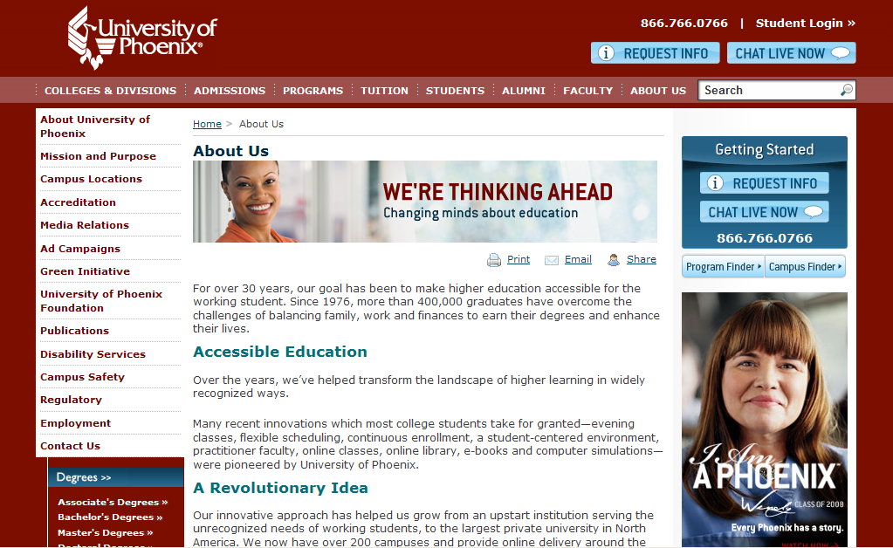
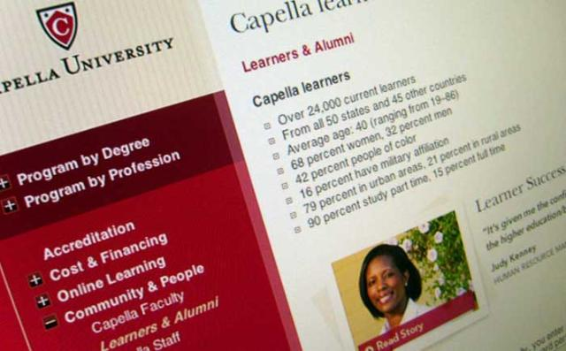
National Developments
Increasing role of for-profit universities
Notes:
There has been a robust expansion of online programs in both non-profit and for-profit institutions. The for-profit institutions are experiencing an explosion in demand and they are outspending their non-profit counterparts.
Therefore the role of for-profit universities is growing; for-profit universities will be educating 15% of all college students by 2020 compared to the 7% they are educating now (from the Students of 2020 report)
Capella University; nearly 31,000 learners from all 50 states and 56 other countries; average age: 39 (ranging from 19–92). Offers over 100 graduate and undergraduate degrees in business, healthcare, higher education, IT, K-12 education, mental health, public administration, and public safety. 90% study part-time and 40% are students of color.
University of Phoenix; currently 443,000 learners (up 22%). Serves students from over 80 countries. The University has over 100 undergraduate and graduate degree programs in business, technology, health care, and education. All students are working while earning their degrees. North America's largest private university system.
Kaplan University; currently 55,000 learners – Offers graduate, undergraduate, and continuing professional education through its online programs and its onsite campuses. Areas of study include education, business, technology, arts, healthcare, criminal justice, and law. Degrees include masters, bachelors, associates, and professional law, as well as certificate programs.
Fees for an undergraduate credit hour at these institutions run about $350-450
Fees for a graduate credit hour range from $350 – 900 depending on the discipline
Their success is due to: (From: For-profit colleges deserve some respect)
Focus on quality assurance, outstanding services, and flexible schedules that fit students lifestyles
Strong faculty members who combine theory with practical experience
Quality teaching and learning experience
Quality market-driven programs

Slide 6
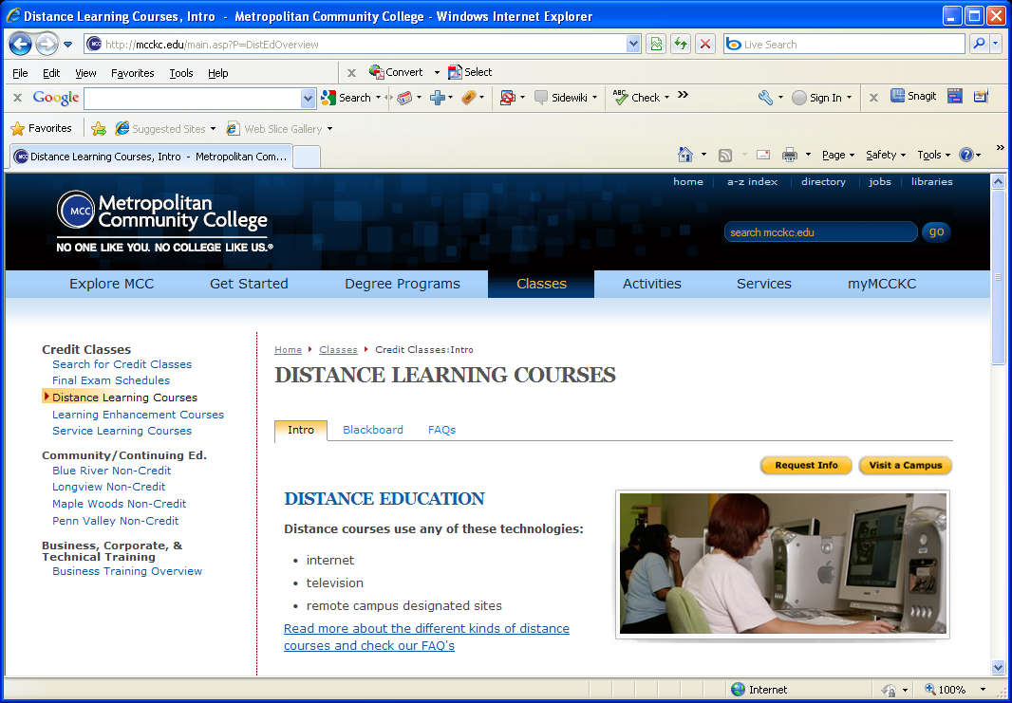
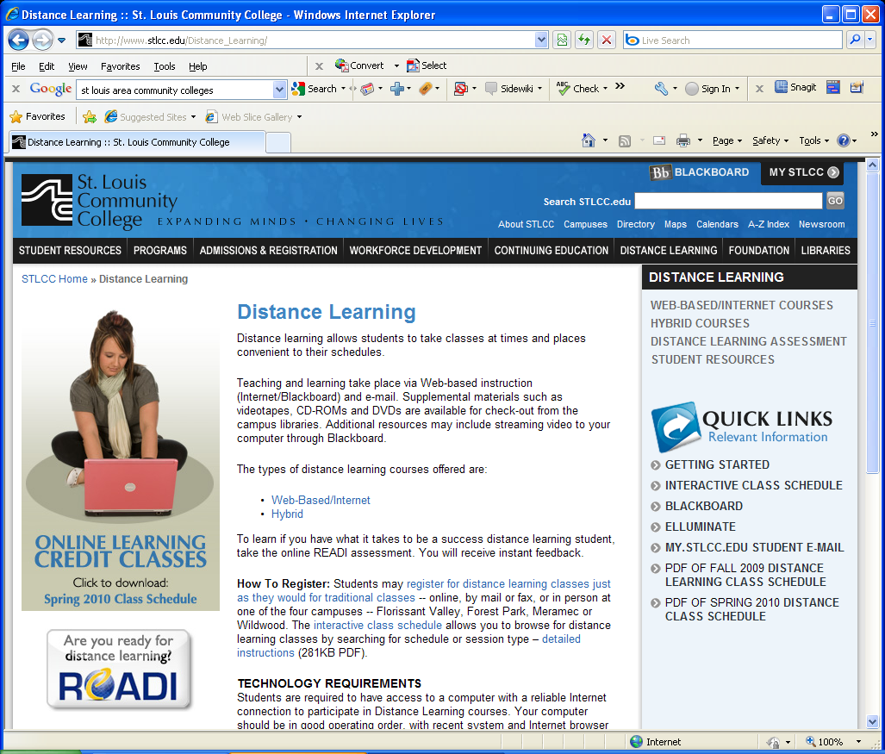
National Developments (cont.)
Community and independent colleges
Notes:
Community and independent colleges
Focus of Obama administration ($12 billion to provide additional federal support to community colleges in an effort to help 5 million Americans earn degrees and certificates over the next decade plus 10 billion in loans to help community colleges improve infrastructure).
Fall 2009 - Missouri’s community college opening day enrollment was up 12.8% (data from old board packet)
An increasing number of nontraditional and first-time students are enrolling in two-year colleges first
STLCC 13% increase in students from Summer 08 to Summer 09; more than 100,000 enrolled annually (credit courses, continuing ed& workforce development programs) [Their website doesn’t break online data out from the rest]
MetroCC: [Couldn’t find data specifically about online—sorry!]
Columbia College offers 19 accredited online associate, online bachelor's or online master's degree programs, with more than 600 online classes offered each session. Nearly 16,000 students take at least one online course each year at Columbia College.
[IS THIS DATA IN BOLD NECESSARY OR TOO FAR DOWN IN THE WEEDS?]
Their success is due to: (From: 7 trends in Community College)
Most having two–year programs online; increase in online offerings
Increased number of four-year degrees offered and awarded
Increased partnerships between community colleges and four-year institutions
Greater recruitment of baby boomers
Increase enrollment across different student groups
Increased partnerships with business
Increased response to globalization
They will continue to thrive based on price and convenience

Slide 7
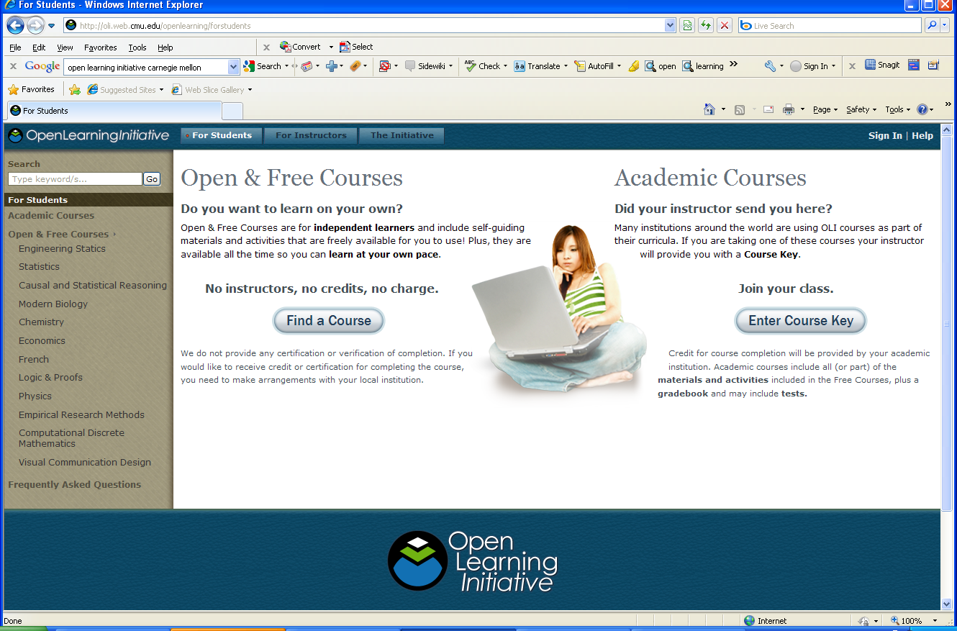
National Developments (cont.)
Open Learning Initiative
Notes:
Open Learning Initiative
Courses designed at Carnegie Mellon and University of Pittsburgh
Extremely well-done; continuous update mode
Look at how students learn and where they struggle and then modify courses
Available free to anyone who wants them – faculty can use them in any way they need to
Built by some of the best minds in the field who are matched up with the learning and cognitive science folks
Will continue to update courses and expand the menu of offerings

Slide 8
National Developments (cont.)
Significant shifts in newspapers, music, and travel have transformed industries
Peer-to-peer universities
iTunes University
Is the traditional classroom anticipating the rate of change?
Notes:
Competition from for-profit institutions and community colleges
Students will demand more options
Increase use of hybrid schedules
The residential campus experience expenses increasing
Students enjoy and expect technology
The landscape is changing very rapidly
Peer-to-peer universities:
Leverage the power of the Internet and social software to enable communities of faculty to support learning together by combining open educational resources and short university-level courses in order to offer high-quality low-cost education opportunities.
Additionally, peer-to-peer universities provide online students with a sense of community helping them navigate the wealth of open education materials available, creates small groups of motivated learners, and supports the design and facilitation of courses.
iTunes University: Launched less than three years ago, Apple's iTunes University offers college lectures on everything from Proust to particle physics to students and the public. Some universities make their lectures available to all, while others restrict access to enrolled students.
Audio/video for making lectures available to students: Wisconsin, Arizona State, Indiana, Illinois, U of Washington, Oxford, Vanderbilt, Duke, USC… many, many U’s use it. MU uses it but not sure the other UM campuses do…
Offers Open Courses created by Yale, Stanford, UC Berkeley, Oxford, Cambridge, MIT, etc: http://www.apple.com/itunesnews/itunesu/
Integrates with CMS

Slide 9
Change Strategy
Visits to national leaders for benchmarking purposes
Focus on support for campuses and faculty
Revenues remain on campus
Notes:
We visited some of the prestigious national leaders in online learning: University of Maryland, Penn State, University of Texas System TeleCampus, Colorado State, and University of Illinois
Looked at how some of the most successful programs were operating
Looked to see how they did it – where their focus was working. Examples:
Criminal justice program at Penn State;
Comments from turf management professor at Penn State;
“Course bank” where Penn State allowed others to buy seats in open courses for reduced cost – made programs available to others who would not have courses
Capella is a course development machine – over 300 courses developed or revised each year.
Have 90 instructional designers and production folks – focus now on learning outcomes
Are posting the results of their students who achieve competency in Transparency by Design effort
Clearly were good with customer service in the beginning – now focus on quality and a big focus on outcomes
We decided to alter our original strategy some after these visits:
To focus on supporting the campuses and our faculty;
And, that all revenues would remain on the campuses teaching the courses

Slide 10
Setting the Stage
Visited campus stakeholders
Identified best practices
Established eLearning Academic Council
Reviewing intellectual property policies
Notes:
This initiative is:
Purposeful
Driven out of Academic Affairs Office
Focused on faculty, faculty support, faculty interests
We made visits to campus stakeholders:
to determine barriers, challenges and opportunities
Barriers identified by the campus members of the eLearning Academic Council:
lack of instructional designers – to help faculty (course design AND production)
Lack of help desk support (various types)
Need to identify best practices – to avoid a long learning curve
Need to look for ways to engage faculty and provide incentives for involvement
Need commitment by campuses– to provide moral support as well as allocation of resources to this effort
Need a network of supporters who can share expertise - faculty as well as instructional designers
Need a repository of earning objects and tools
So, we began to identify best practices AND we established the Academic Council:
The role of the Academic Council is to provide advice, offer innovative ideas, negotiate disputes, help solve administrative and academic policy issues, and provide some general guidance and oversight for the UM eLearning initiative.
We began examining intellectual property policies
We brought Dr. Mike Offerman in from Capella—he made presentations to general officers, the Academic Council and other campus stakeholders
We made a recent visit to Capella
Took team of educational technology leaders/instructional designers from all campuses
To look at how they do instructional design, build excitement; consider possibilities

Slide 11
Developing a Strategic Plan
Distance learning consultants
Experience developing and directing University of Texas TeleCampus
Gathered information from surveys of campuses
Conducted site visits to all four campuses
Developed set of conclusions and recommendations
Notes:
We brought in the UT TeleCampus distance learning consultants and they:
Met with faculty, staff and administrators on each campus
Gathered information about program scope and size [add a few questions from survey here]
From the surveys and campus visits they determined:
We have a relatively small online presence;
There is confusion about how to teach online;
There is a need for faculty support Systemically, Pedagogically and Technically;
We need to focus on our traditional audience;
We need to increase access to UM;
We need to focus on the needs of students learning at a distance;
We need a comprehensive management strategy;
Looked at what the campuses were doing,what was possible, and what was going on nationally
Looked for areas where we had soft spots and could improve by focusing attention,time, and resources
Nothing here is rocket science – they identified key elements that need to be in a comprehensive program that they could not find consistently across the campuses.
Also looked for ways to scale efforts so we could make use of what has been developed nationally as support tools
From there they developed set of conclusions and recommendations –

Slide 12
Recommendations
Build System-wide portal with support services
Integrate system-wide efforts with campus-specific plans
Seed campus instructional design and technology support
Provide faculty development and mentoring
Opportunities include master courses, cooperative degrees and degree completion programs
Invest System-level resources to leverage campus talents and assets
Notes:
Their recommendations were that we should:
Build a System-wide portal with support services
Integrate system-wide efforts with campus-specific plans
Seed campus instructional design and technology support
Provide faculty development and mentoring
Opportunities include building master courses, cooperative degrees and degree completion programs
Collaborative program opportunities:
Nursing on 3 of 4 campuses
Health Professions?
Education?
Engineering?
Criminal Justice?
They recommended we invest System-level resources to leverage campus talents and assets
We are currently working with the chancellors to shape strategic directions based on this set of recommendations
DOES THIS STILL BELONG ON THIS SLIDE:
Campus efforts (allude to chancellor reports)??

Slide 13
Long-term Goals
Increase access to the University of Missouri
Increase course and program offerings and enrollments in online courses
Protect current enrollment base - provide alternatives for our “typical” students
Embrace technological capabilities
Foster educational quality
Increase revenue?
Notes:
Broad Goals - Identified by eLearning Academic Council
We need to increase access to higher education in Missouri:
Reach new audiences with this delivery mechanism; appeal to wider variety of learners and those at a distance
Reach students not reaching due to location or convenience – particular focus on changing demographics.
Most will likely be in Missouri; degree completion: 900,000 of adults with some college but no degree
We need to increase the number of programs and offerings available online:
Abrazo found that we have a relatively small online presence;
We need to bring more courses and programs online to stay competitive (particularly degree completion programs and general education courses when appropriate)
We need to increase online enrollments:
President's charge: Shoot for big target – that of doubling online enrollment (System-wide) in the next 5 years
We need to do this while protecting current enrollment base
Provide alternatives for our “typical” students – as they will likely want to mix the type of courses they enroll in – (particularly on two urban campuses).
Offer the courses they are currently taking elsewhere here
Increase the numbers of credit hours students taken by providing more convenient methods.
Focus on retaining students, reducing the time to graduation and on NEW enrollments.
Embrace technological capabilities
We need to improve teaching and learning through a focus on instructional design, involving faculty, and faculty development activities
There are large potential revenue opportunities

Slide 14
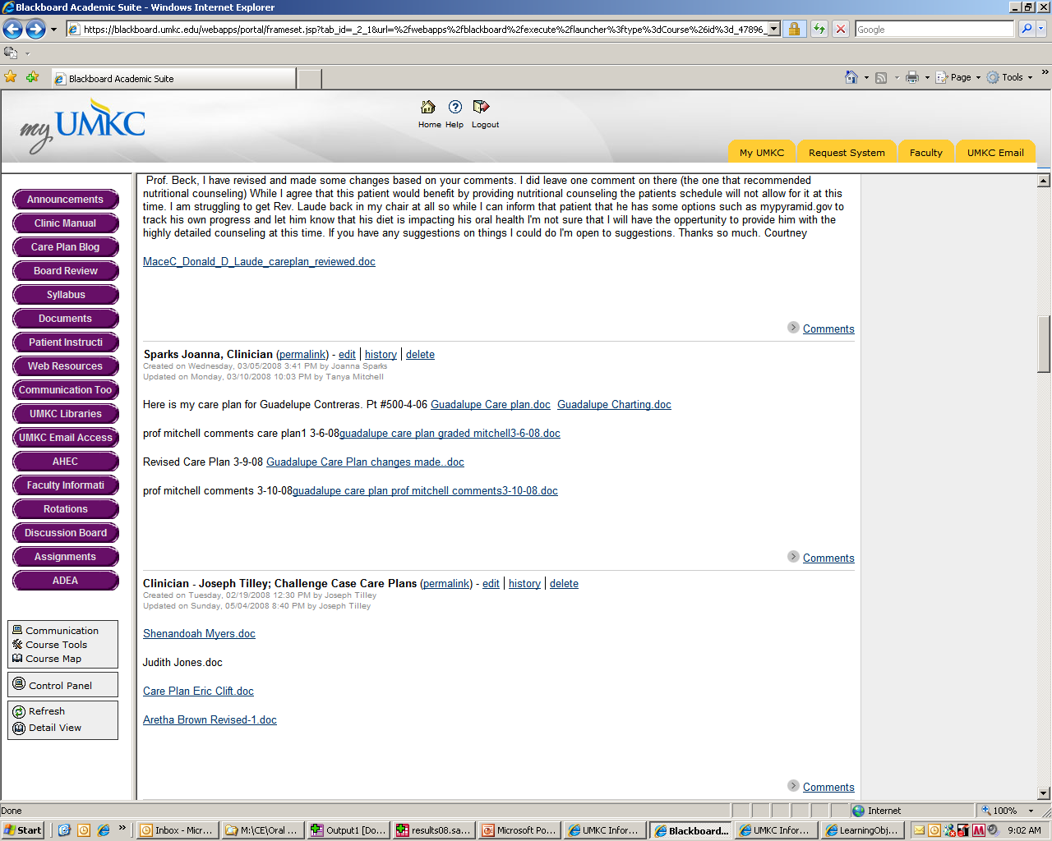
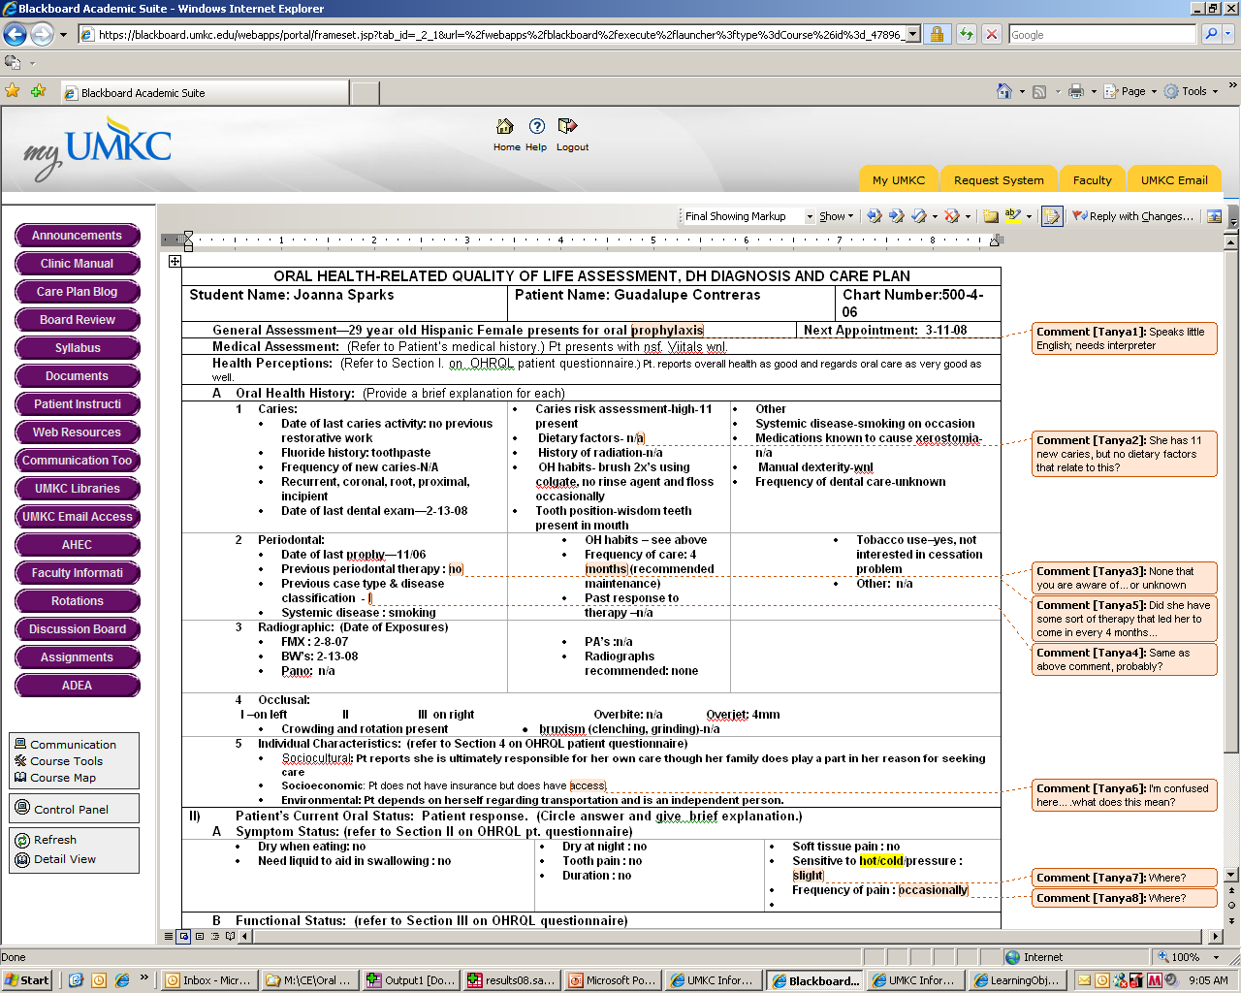
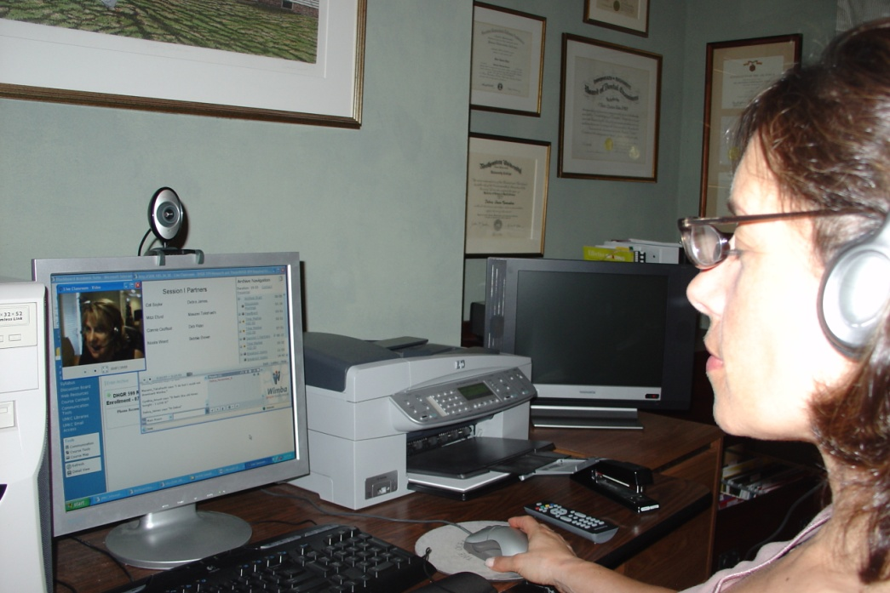
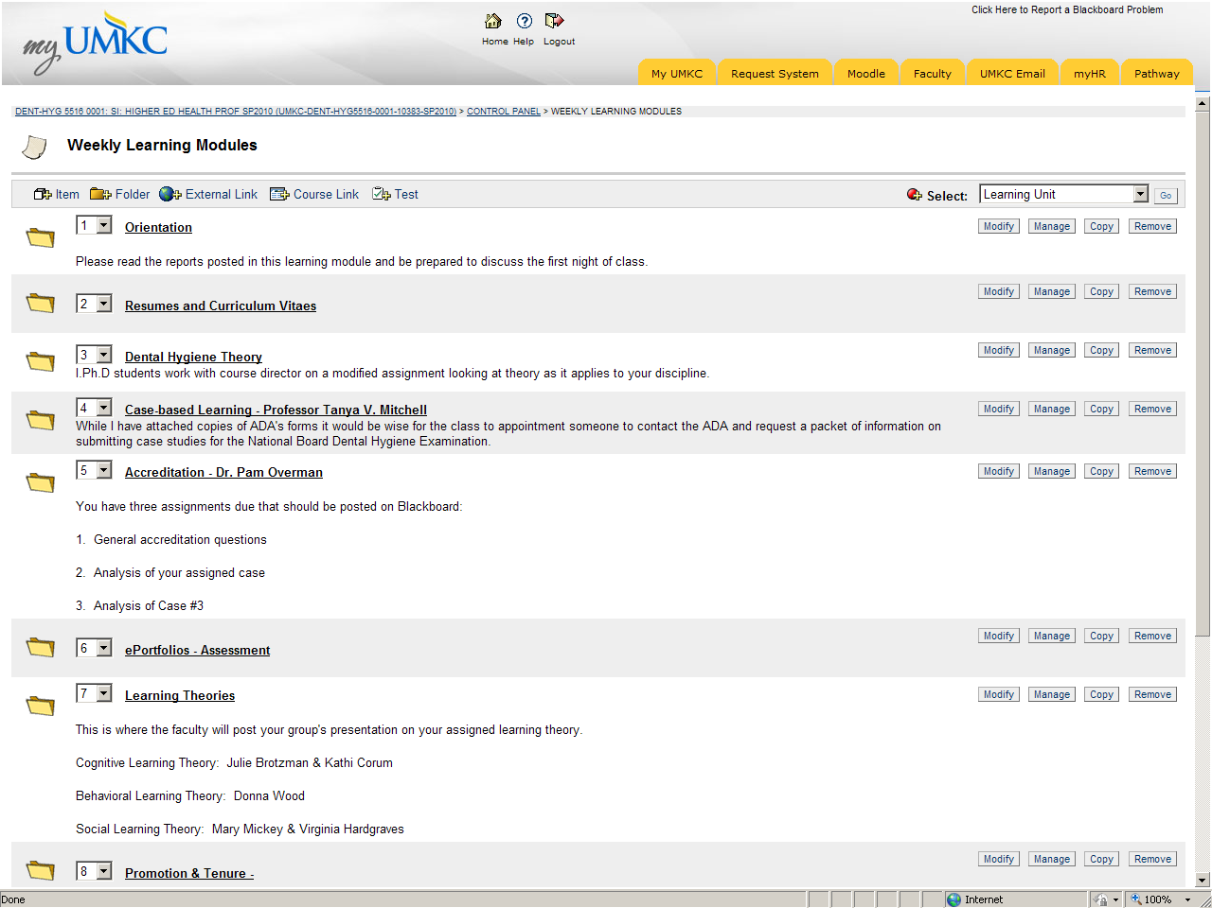
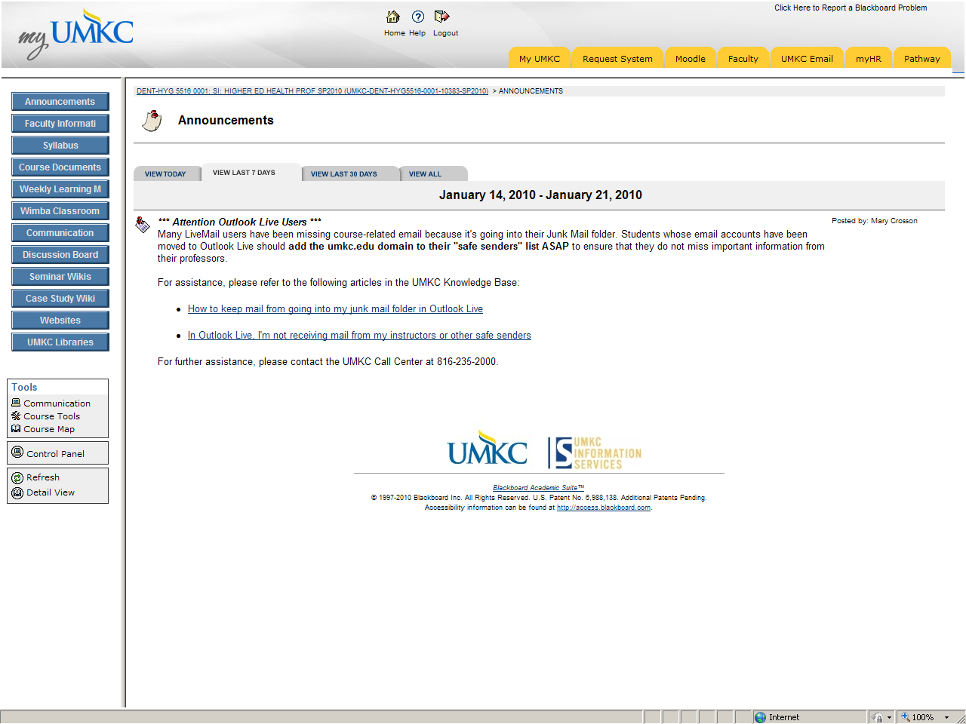
eLearning – New Way of Teaching
Elements that enhance online learning
Student engagement, course design, support
Notes:
We’ve been looking at what makes for an outstanding online course
Here is a quick look inside an online course
[play video of course inside Bb]
The best online courses are engaging, well-designed, and use authentic assessments.
The tools students need are accessible from within the course with just a click.
Faculty who teach them are creative, up-to-date, and flexible.
To get more UM courses there we’ve been gearing up to help with course design and technological and production support
One of the things we’ve done is to begin looking for learning objects, which are reusable resources, collections of information or tools used as modular building blocks to support learning.
[show Wolfram/Alpha]

Slide 15
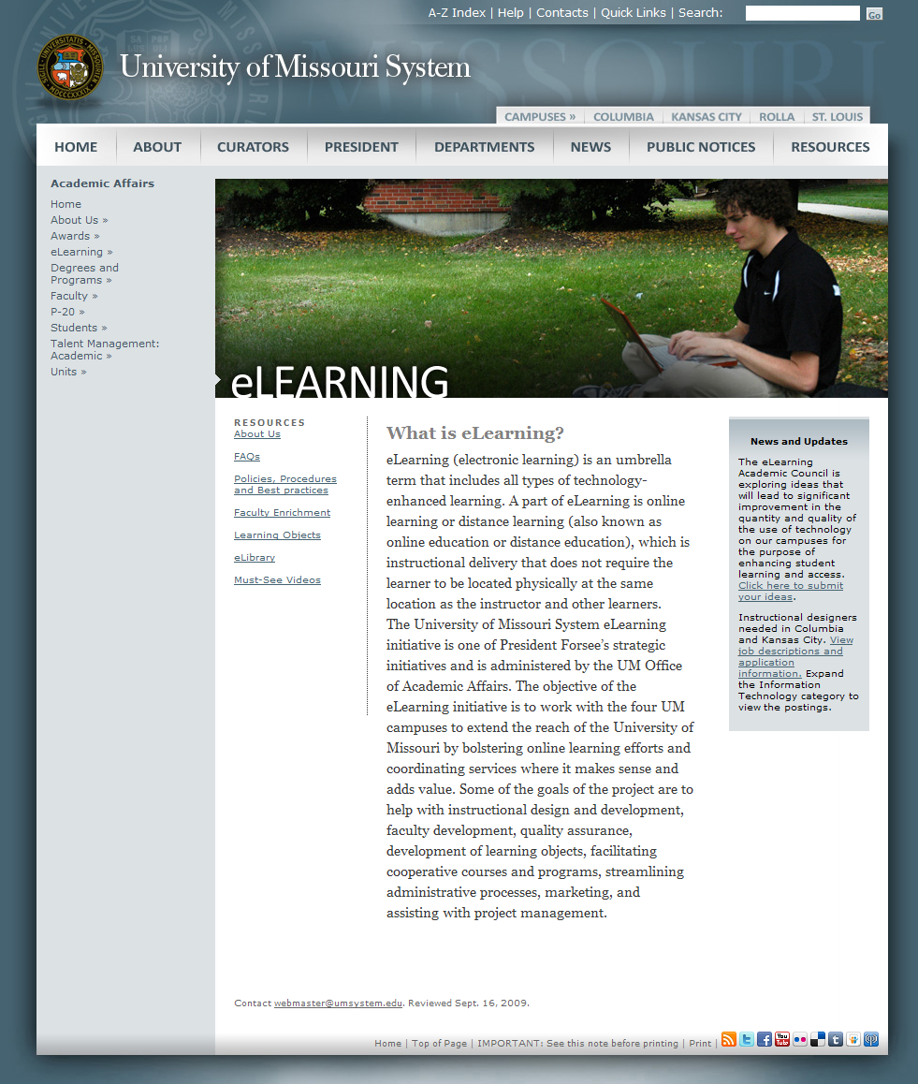
eLearning Support Tools
Web presence
eMentors program
Video interviews with early adopters
Online faculty tutorials
InfoScout Service
www.umsystem.edu/ums/departments/aa/elearning/
Notes:
Go to eLearning Web site and show FAQs; scroll down and click on the link to the wiki about wikis
Do a quick click through eLibrary
Go to the Faculty Development page and show the eMentors page; run a video for 30-45 seconds
Go back to the Faculty Development page and show the Online Tutorial
Go to main page and demo InfoScout

Slide 16
Current Developments
Building a framework for intercampus collaboration
Participating in Learning Technology Intercampus Collaboration (LTIC)
Leveraging campus development activities
System-level support for startup funding
Notes:
We’re building a framework for intercampus collaboration:
Our eLearning staff participate on the LTIC (Learning Technologies and Intercampus Collaboration) and other communication groups
The LTIC committee is a group of educational technologists, computer systems specialists and eLearning professionals that meet weekly to discuss educational technology issues
American Humanics; three UM campus collaboration on a certificate program
We’re leveraging campus development activities:
Leveraging use of faculty
Online tutorial work with campuses
Use of instructional designers and group; hope to share resources and expertise
Michael Wesch program in April at UMKC
Sharing of courses

Slide 17
Action Plans 2010
Build the portal
Fund and hire instructional design team for campuses and System
Set targets for each campus and include in Accountability Measurement System
Build faculty development program
Identify eLearning leaders and advocates
Fund exemplary campus eLearning projects
Notes:
[This is the new slide… need notes here or are you good to freelance?]

Slide 18
Investing in Development
Request for Proposals – two categories:
Single courses
Degree programs, certificate programs and course clusters
Priority will be given to:
High enrollment courses
Full degree programs
Degree completion programs
Graduate certificate programs
Clusters of courses in a single area with longer-term goal of complete program
Notes:
Two categories for RFP
Single courses
Degree programs, certificate programs and course clusters.
Priority will given to:
Emphasis on
Collaboration
Innovation
Leveraging resources
[This is the new slide… need notes here or are you good to freelance?]

Slide 19
Investing in Development
Emphasis on:
Collaboration
Innovation
Leveraging resources
Submission details:
Single courses - proposals due to System March 19
Degree programs, certificate programs and course clusters -- proposals due to System April 9
Campus submission due dates are earlier! Check with your Provost’s Office for details
Notes:
[This is the new slide… need notes here or are you good to freelance?]

Slide 20
Looking to the Future
Questions

