Slide 1
Student Perceptions of Technology
Or why you should learn to stop worrying and love technology…
Matthew Shaner
Supervisor, IT Relationship and Asset Management
MBA Candidate (May 2011)
shanerm@mst.edu

Slide 2
Meet Today’s Panelists
Laura Confer Student representative to the UM Board of Curators
Dr. Richard Hall IST Professor, co-director of campus IT evaluation lab
Dr. Morris Kalliny Assistant Professor of Marketing & International Business
Dr. Jeff Thomas Assistant Professor, Civil, Architectural & Environmental Engineering

Slide 3
One extreme…

Slide 4
Or the other

Slide 5
The Educause Study
Undergraduate students
Missouri S&T and nationwide
Data collected by random surveys to Missouri S&T freshmen and seniors
About 180 Missouri S&T students
About 25,000 students nationwide

Slide 6
Why you should care
Almost 92% of incoming freshmen said that available technology on campus was “important” or “very important” to them in choosing a college or university.
Nearly 50% of students nationwide said they are looking for classroom IT experiences to prepare them for workplace IT challenges.

Slide 7
Student IT Habits

Slide 8
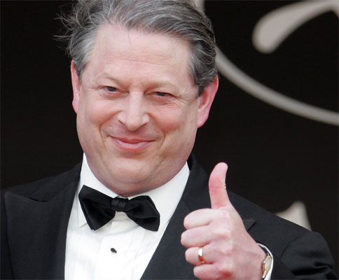
Time spent weekly on the Internet
 | Missouri S&T | National Avg.
0-15 hours
16-25 hours
26-40 hours
40+ hours
38.7% 48.1%
24.8% 26.5%
16.8% 16.6%
19.7% 8.8%
By Comparison
Average time Americans spend
watching TV every week:
28 hours

Slide 9
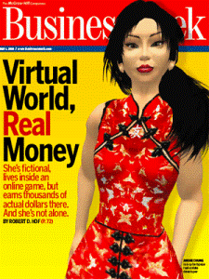
Virtual Worlds
 | Missouri S&T | National
Less than once a month
Monthly
Weekly
Daily
96.6% 96%
1.1% 1.5%
1.2% 1.5%
1.1% 0.7%
First Second Life-made millionaire:
Anshe Chung
2006

Slide 10
Multi-Player Online Computer Games
 | Missouri S&T | National
Less than once a month
Monthly
Weekly
Daily
66.8% 81.7%
5.6% 6.1%
18% 7.9%
9.6% 4.3%
If WoW were a country, it’s world rank, by population, would be:
75th
(ahead of Greece, but behind Zimbabwe)

Slide 11
Student IT Perceptions and Attitudes

Slide 12
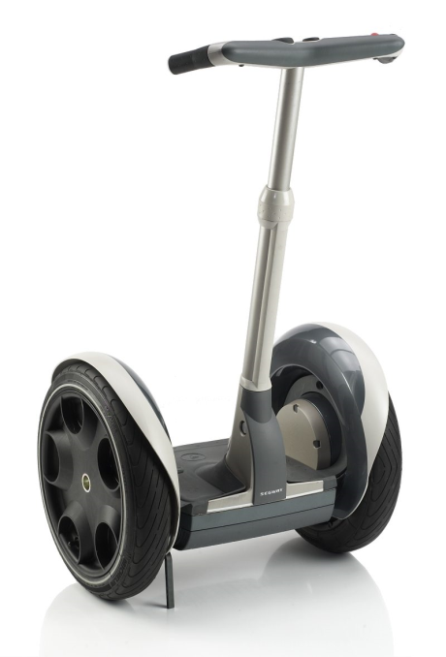
Student Technology Adoption
I use new technology…
 | Missouri S&T | Nationwide
Only when I have to
I'm usually one of the last
When most people I know do
Before most people I know
I'm usually among the first
3.4% 3.8%
6.7% 8.7%
43.8% 51.7%
31.5% 26.1%
14.6% 9.7%

Slide 13
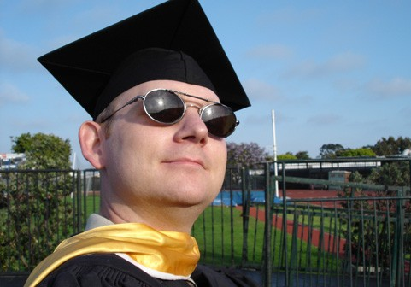
Tech-savvy professors?
How many of your instructors use IT effectively?
 | Missouri S&T | Nationwide
Almost None
Some
About half
Most
Almost All
Don't Know
4% 7.3%
31.1% 25.2%
18.1% 21.3%
32.2% 25.4%
13% 18%
1.7% 2.8%

Slide 14
Tech-savvy professors?
How many of your instructors have adequate IT skills for carrying out course instruction?
 | Missouri S&T | Nationwide
Almost None
Some
About half
Most
Almost All
Don't Know
5.6% 7.3%
31.6% 25.3%
15.3% 16.9%
32.2% 27.9%
12.4% 15.9%
2.8% 4.8%

Slide 15
IT and course involvement
I get more actively involved in courses that use IT
 | Missouri S&T | Nationwide
Strongly Disagree
Disagree
Neutral
Agree
Strongly Agree
2.8% 3.9%
15.7% 13.8%
44.9% 45.7%
28.2% 30.5%
8.4% 6.1%

Slide 16
IT and learning
The use of IT in my courses improves my learning.
 | Missouri S&T | Nationwide
Strongly Disagree
Disagree
Neutral
Agree
Strongly Agree
3.9% 2.7%
8.4% 8.9%
39.9% 39.1%
37.6% 41.1%
10.2% 8.2%

Slide 17
Online course material
I skip classes when materials from course lectures are available online
 | Missouri S&T | Nationwide
Strongly Disagree
Disagree
Neutral
Agree
Strongly Agree
28.7% 33.8%
29.8% 30.9%
24.2% 19.6%
14% 13%
3.4% 2.9%

Slide 18
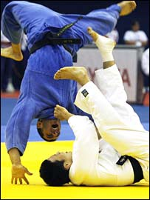
Takeaways
Students seem to have a “filter” for technology adoption
“Fun” vs. effective
Doesn’t take into account discipline-specific teaching methods
?
or

Slide 19
Panel discussion
Presentation and study are available online at:
http://web.mst.edu/~shanerm

