Slide 1

Optimizing the
Use of Clickers in the Classroom
Klaus Woelk
Assistant Chair/Associate Professor
Chemistry Department
Center of Educational Research and Teaching Innovation (CERTI)

Slide 2
Writing Multiple-Choice Questions http://tep.uoregon.edu/resources/assessment/multiplechoicequestions/importantconsider.html
Important Considerations
What role should testing play in the learning process?
How can tests create a real dialogue between ourselves and our students about what students do and do not understand?
How can we avoid using tests to simply punish or reward cramming?

Slide 3
Writing Multiple-Choice Questions http://tep.uoregon.edu/resources/assessment/multiplechoicequestions/importantconsider.html
Some suggestions
Use frequent, small quizzes and tests rather than monolithic once-or-twice per-term exams.
Give students instant feedback on their performance (for example, putting the correct answers up on an overhead after all the tests are turned in).
Consider allowing students to take quizzes first as individuals and then the same quiz again in groups.

Slide 4
Writing Multiple-Choice Questions http://tep.uoregon.edu/resources/assessment/multiplechoicequestions/importantconsider.html
Multiple-choice questions are easiest to write when there is a definitively right or wrong answer.
Multiple-choice testing of more interpretive material should always include an appeal mechanism in which students can and must make a written, evidence-supported case for their answer

Slide 5

Taxonomy of Clicker Utilization
6 basic categories
  3 categories to test the current standing or stipulation of students
    Attendance
    Preparedness
    Interest
  3 categories to probe into the learning progress
    Learning
    Understanding
    Applying
I am
I do

Slide 6
Click ― I am here
Attendance:
Taking and honoring attendance reduces the number of students dropping out or finishing with low grades (D’s and F’s).
Doing it with clickers is particularly efficient in large entry-level classes.

Slide 7
What does the term “mole” refer to?
A small rodent digging through our backyards
Avogadro’s number
The number 6.02214 × 10²³
Loschmidt’s number
A TV reality show of physical and mental challenges
A Mexican hot sauce (from the Aztec word “molli”)
A small dark spot on the skin (melanocytic naevus)
0
25 of 100

Slide 8
Click ― I am prepared
Preparedness:
Clicker quizzes on assigned reading assure preparedness for the topics covered in class.
Well-picked question and appropriate grading are essential.

Slide 9

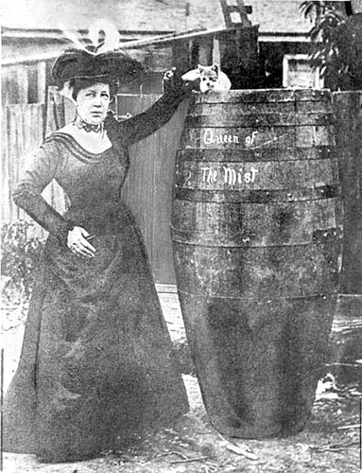
Trivia question:
The first person to survive plunging over Niagara Falls in a barrel was a 63 year old woman.
Fact
Crap
Annie Taylor did it in 1901, and afterwards was quoted as saying: “No one ought ever do that again.”
0
29 of 100

Slide 10
Click ― I am interested
Motivation:
Polling on common knowledge or opinions (even on controversial issues or common misconceptions) creates initial interest and motivation.
It is crucial that students have developed trust in the technology, especially, if responses are collected anonymously.

Slide 11
Question before teaching about concentration:
What mass of salt (NaCl) is found in the blood stream of a normal human? Please estimate!
50 mg
500 mg
5 g
50 g
500 g
5 kg
0
30 of 100

Slide 12
Click ― I learn
Learning:
On-the-spot assessment improves student alertness and offers immediate feedback on the learning progress to both student and instructor.
Repeating a question or posting a similar one can be used for progress evaluation and student satisfaction.

Slide 13
Are you really testing learning?
The true shape of the Earth is best described as a
… perfect sphere
… perfect ellipse
… slightly oblate sphere
… highly eccentric ellipse
0
32 of 100

Slide 14
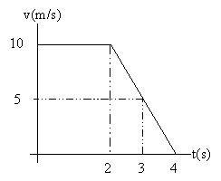
Given the v - t graph to the left, determine the particle's acceleration when t = 3.
-1.67 m/s²
- 5 m/s²
-10 m/s²
-15 m/s²
none of the above
0
40 of 100

Slide 15
Click ― I understand
Understanding:
Asking about a subject matter in different ways provides insight into students’ understanding.
Active learning is fostered by encouraging peer discussion and instruction during the response time or by a repeated poll if the responses are split between different answers.

Slide 16
Is a concept understood?
At which location would an observer find the greatest force due to Earth's gravity?
The north pole
The middle of everywhere
The tropic of Cancer (23.5 N)
The equator
0
29 of 100

Slide 17
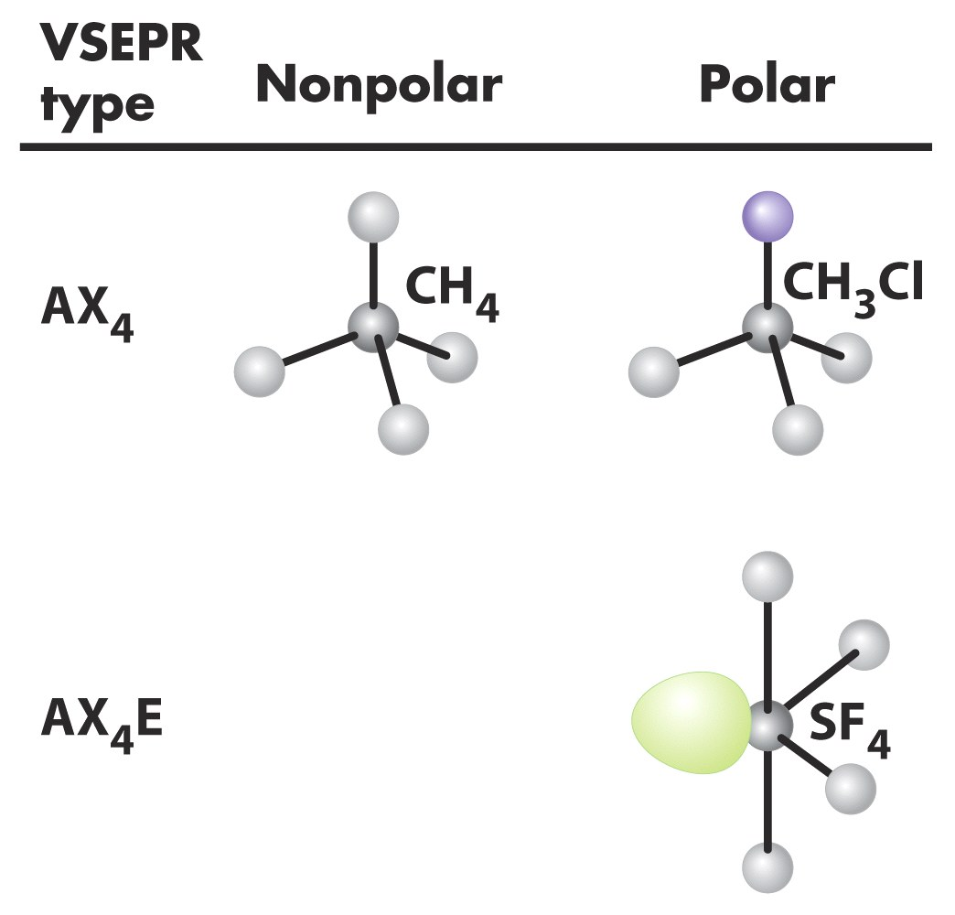
Sulfur tetrafluoride is a polar molecule.
Fact
Crap
0
32 of 100

Slide 18
Click ― I apply
Applying:
Conceptual knowledge and mastery is created when clicker questions branch into areas beyond the material covered in class or in the textbook requiring the application of newly taught concepts to real-world or open-ended problems.

Slide 19
To facilitate the conversion of H₂S₂O₈ to yield S₂H₄, you must add as a key reactant …
… a strong acid.
… a weak acid.
… a base.
… an oxidizing reactant.
… a reducing agent.
… a polar solvent.
… a non-polar solvent.
… nothing (the reaction will occur by itself).
0
34 of 100

Slide 20
Summary
Clickers are found in many highschool, college, and university classrooms
They provide more than just immediate feedback to instructor and students
Six basic ways of utilizing the power of clickers
    Attendance
    Preparedness
    Initial interest and motivation
    On-the-spot assessment (formative assessment)
    Active learning (peer discussion and instruction)
    Problem-based, deep learning (mastery of concepts, applications to real-world, or open-ended problems)
I am
I do

Slide 21
Open-ended Problems:
What is a valid Lewis Structure for the cyanate ion?
¯ N = C = O
N ≡ C = O ¯
N – C – O ¯
¯ ¯ N – C ≡ O ⁺
N ≡ C – O ¯
N – C = O ¯

Slide 22
Using Open-ended Problems
Click ― I will be here
Click ― I will be prepared
Click ― I will be interested
I will

Slide 23
Summary
Clickers are found in many highschool, college, and university classrooms
They provide more than just immediate feedback to instructor and students
Six basic ways of utilizing the power of clickers
    Attendance
    Preparedness
    Initial interest and motivation
    On-the-spot assessment (formative assessment)
    Active learning (peer discussion and instruction)
    Problem-based, deep learning (mastery of concepts, applications to real-world or open-ended problems)
I am
I do

