Slide 1
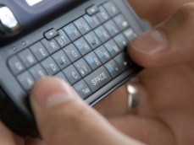
Texting as a Teaching Tool
im vry bsy rght now im lernin ☺

Slide 2
Texting as a Teaching Tool
Klaus Woelk
Assistant Chair/Associate Professor
Department of Chemistry, Missouri S&T

Slide 3
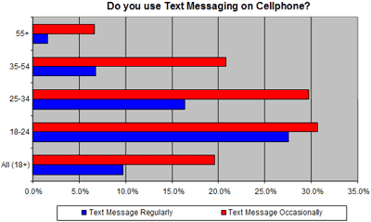
Texting as a Teaching Tool
from: http://www.imediaconnection.com/content/6271.asp

Slide 4
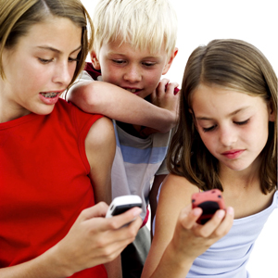
Texting as a Teaching Tool
BF Boyfriend or Best Friend BRB Be Right Back G2G Gotta Go GF Girlfriend H&K Hugs And Kisses IRL In Real Life JIC Just In Case JK Just Kidding L8R Later LOL Laugh Out Loud NP No Problem OMG Oh My Gosh P911 Parent Alert POS Parent Over Shoulder TMI Too Much Information TTYL Talk To You Later
from: http://www.textually.org/textually/archives/2009/02/?p=2

Slide 5
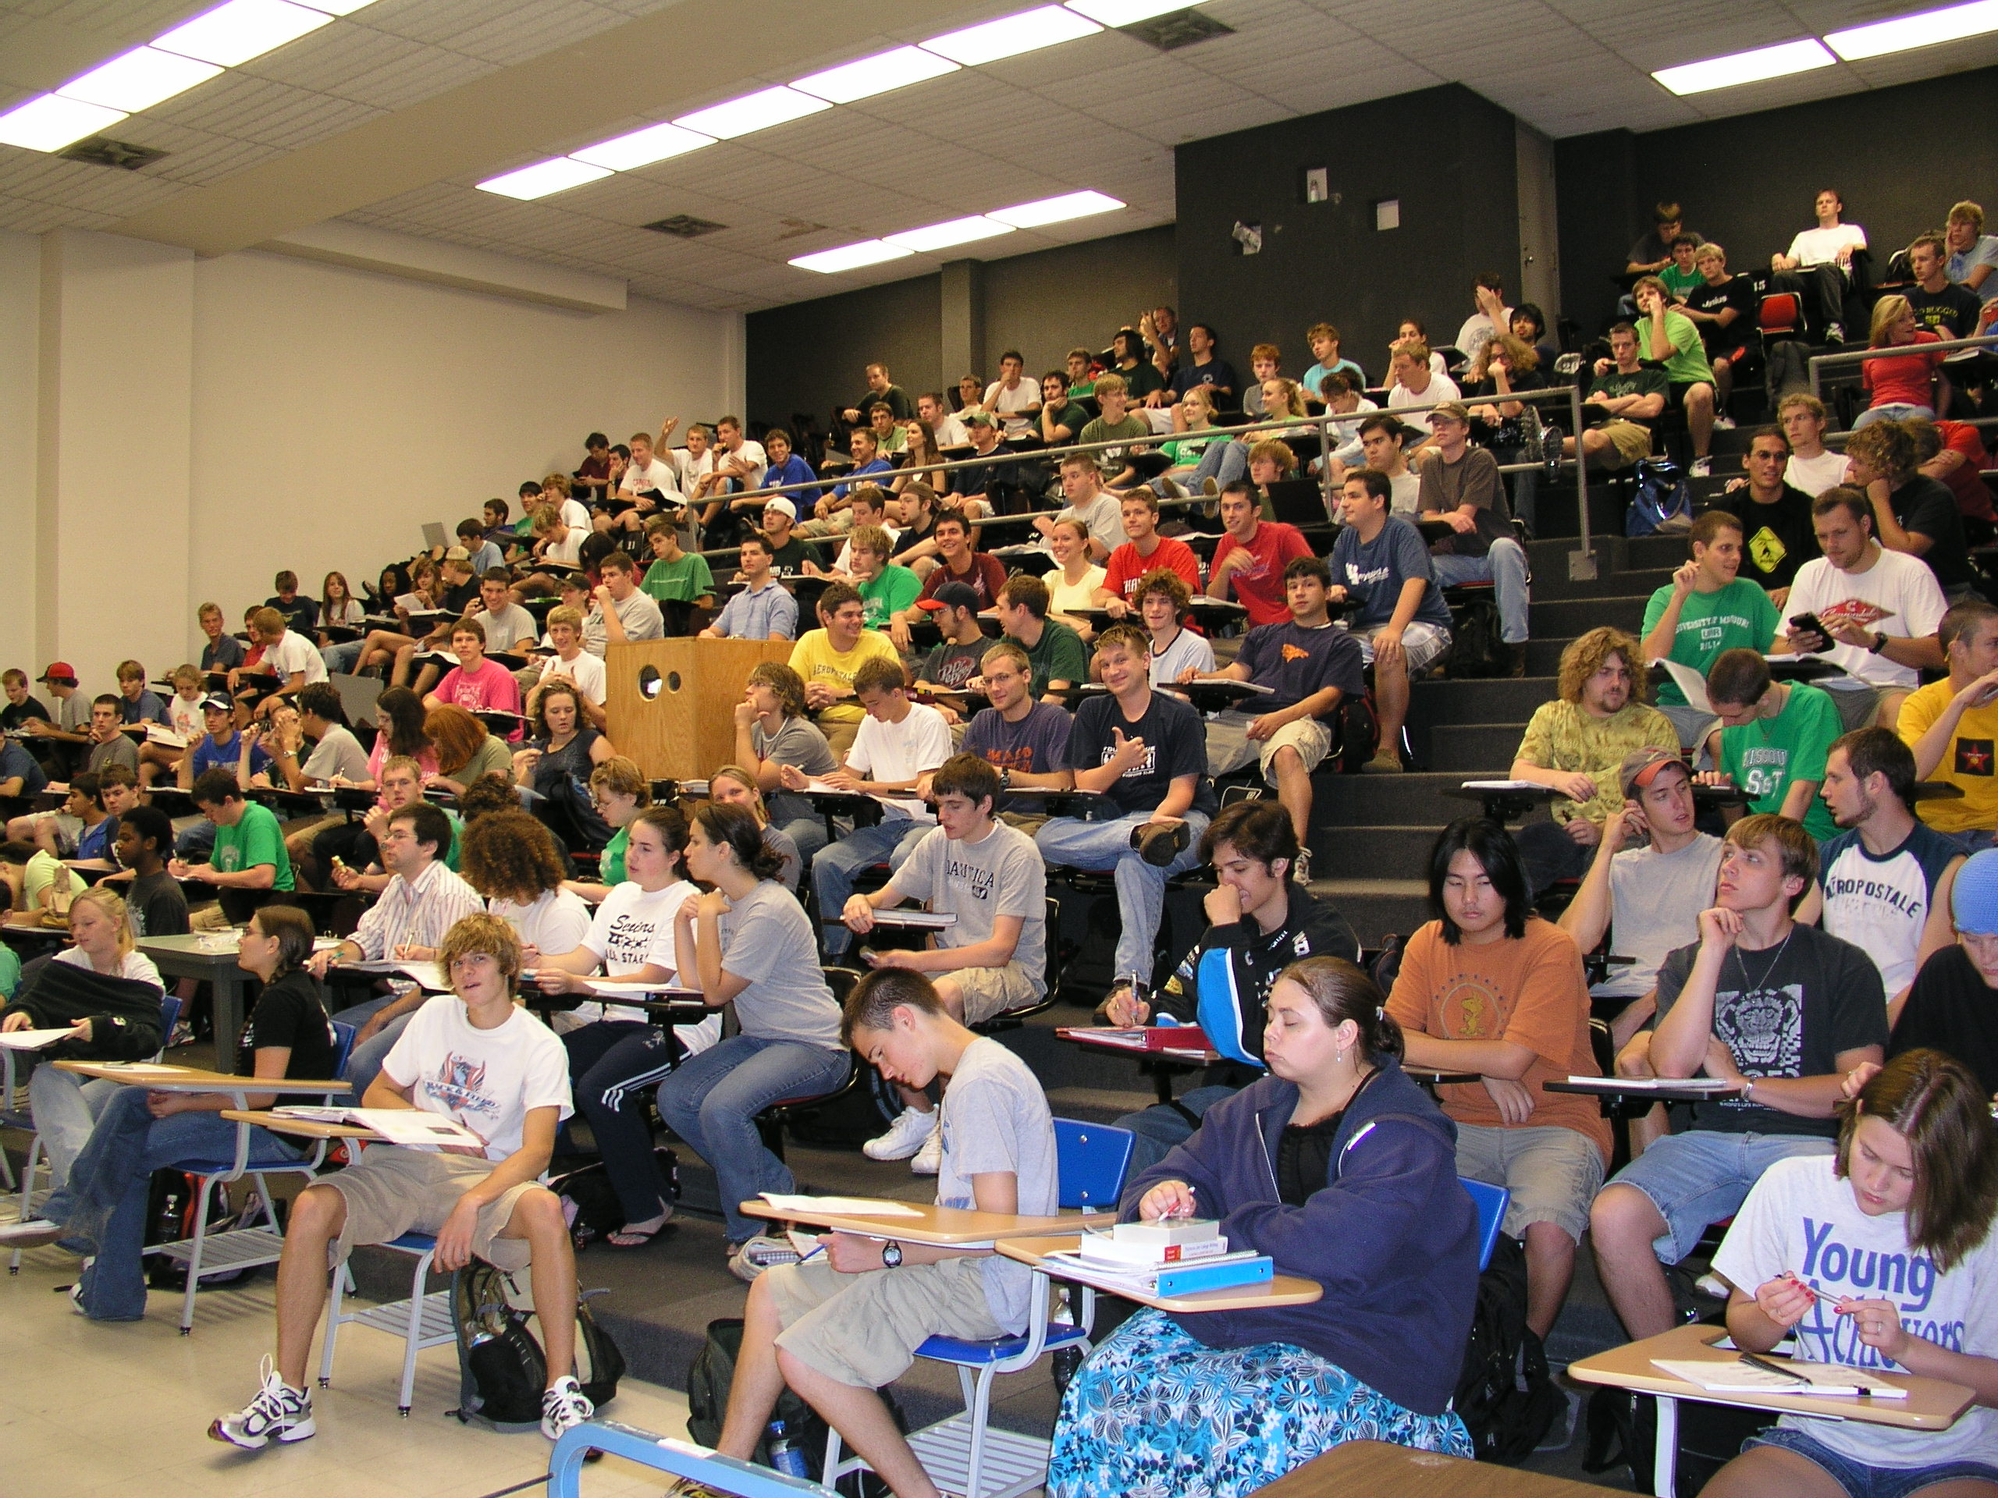

Slide 6
My Fall Semester 2009 Class
General chemistry (Chem 1, 189 students)
86% freshman, 9% sophomore, 5% other
Engineering students (82%)
29% mechanical and aerospace, 12% electrical and computer, 12% civil and environmental, 12% chemical, 6% metallurgical and ceramics, 6% architectural, 9% other, 14% undeclared
Non-major science students (9%)
47% biology, 41% computer, 12% other
Chemistry students (6%)
Others (3%)
mostly undeclared

Slide 7
Maximize Your Studies
Attend Class
Read Text
Take Notes
From Reading
During class
Consolidate
Do Problems
Homework
Do unassigned problems (they come in pairs)
Practice, practice, practice
Ask Questions
Be specific
Keep your hand up
Politely interrupt
Texting (SMS)
Classroom Etiquette
Cell phones on home or vibrate
Talk only during discussions

Slide 8
In-class Telephone Number for texting comments or questions:
(573) 612-1-MST
or:
(573) 612-1678

Slide 9
Seven Principles for Good Practice in Undergraduate Education*
Adopted by the UM Board of Curators for the
UM Strategic Action Plan ”A Design for the Future” (1999).
Faculty Members are urged to:
Encourage Student-Faculty Contact
Encourage Cooperation Among Students
Encourage Active Learning
Give Prompt, Frequent, Informative Feedback
Emphasize Time on Task
Communication High Expectations
Respect and Encompass Diverse Talents and Learning Styles
* modified slightly from: Chickering and Gamson (AAHE Bull. vol 39(March), 3-7, 1987)
http://lead.mst.edu/sevenprinciples/index.com

Slide 10
Seven Principles for Good Practice in Undergraduate Education
Principle 1: Encourage Student-Faculty Contact
Frequent student-faculty contact is a key factor in student motivation, involvement, and learning.
Faculty concern helps students get through rough times and continue to strive for success.
Devise methods that actively and successfully promote student-faculty contact with both individual students and larger groups of students.
http://lead.mst.edu/sevenprinciples/commentary.html

Slide 11
receiving Text messages in the Classroom
Create internet phone & texting account (e.g. Google Voice)
Download internet browser refresher
shareware or freeware
automatically refreses webpages after a preset interval
Bring a laptop computer to class
connect through wireless university connection
set refresher to about 1 minute
deactivate screen saver and power-save mode

Slide 12
receiving Text messages in the Classroom
Directly
casually monitor activities on laptop computer
react immediately
distraction from teaching
Indirectly
TA monitors activity on laptop computer
TA extracts appropriate questions and comments for immediate response
delay between question and answer (immediacy)

Slide 13
Categories of Text messages
Messages that should be addressed immediately
Messages that could be addressed immediately
Messages addressed at the beginning of the next lecture
Messages posted on the discussion board
Inappropriate Messages
Funny Messages

Slide 14
messages that should be addressed immediately
Why is titanium(IV) oxide an answer for PbO2?
Why is n2o4 a species when its a compound
What is meant by the term 'elemental modification'?
Does it matter where you start putting the first group of 2 valence electrons in a lewis structure?
Could you explain in a little more detail how the mass of carbon-12 is obtained and why it is used in obtaining masses of other elements

Slide 15
messages that should be addressed immediately
The 0 at the end of .0310 is not significant!
I can understand three sig figs on the second question, but requesting two sig figs on the balloon question was completely illogical
Why is it that you expect 2 sig figs on the balloon question, resulting in an unchanged answer, yet expect three sig figs on the next, where the third fig is 0?

Slide 16
messages that Could be addressed immediately
So a molecule with many bonds has less energy overall but the bonds themselves are shorter and stronger. Is this correct?
I sorry. for some reason i dont understand whats happening on the london dispersion forces slide
Could you do a couple examples of writing empirical formulas?

Slide 17
messages that Could be addressed immediately
Can we text questions about homework at night so they can be answered the next day?
Are we allowed food or drink?
What is the policy for laptop use in the classroom?
What is the total number of points possible in the class?
Is there a special format for taking notes?
When and where is the chem retake?

Slide 18
messages addressed at the beginning of the next lecture
Why are elements that have been created in a lab still included even though they are not naturally occurring?
Could u put on blackboard a couple of sheets of nomenclature problems with some of each type with an answer sheet for practice
Can u do a problem similar to the breathalyzer problem on saturday's homework thats due sat? Its a nightmare.
Are there any good websites to help us visualize lattice arrays?

Slide 19
messages addressed at the beginning of the next lecture
What is the difference between dissolving and disassociating? Is there a difference?
It's spelled disassociate.
WordReference.com English Dictionary
disassociate:
part; cease or break association with; "She disassociated herself from the organization when she found out the identity of the president“
dissociate:
to undergo a reversible or temporary breakdown of a molecule into simpler molecules or atoms; "acids dissociate to give hydrogen ions"

Slide 20
messages Posted on the discussion board
Could it not be plausible that potential energy does not exist and the increase in kinetic energy is the energy from somewhere else being transfered?
Since Na and Cl are strong electrolytes, does the electricity from the radiofrequency generator ignite them?
I sense the water engine angers you klaus. Why are you so passionately against advancement? Are the oil companies lining your pockets?
Is the government paying you to tell us the salt powered car will not work?
Are you being paid by the oil companies to shoot down alternative energy solutions? Oil is just as inefficient

Slide 21
Inappropriate messages
How is 10g of water equal to 5 mole
Excuse my ignorance, but in what universe did I wake up into that 10g of water is 5 mol?
excuse my ignorance but what universe did i wake up in where students are so conceited they publically put down an excellent teacher 4 making a simple mistake

Slide 22
Inappropriate messages
Wish i had dr mao u suck at teaching
You are a good teacher and i like how you explain your power points in depth and make sure we understand them. Whoever sent the hateful message is an idiot.
I appologize for sayin that rude. Comment...was havin a bad day but it was vry immature...im sorry

Slide 23
Funny messages
If H2O is on the inside of a fire hydrant whats on the outside? . . . . K9P! Lololol
I have a .001M concentration. How do I pay attention?
What's the chemical name for beer?
Be Er
9.012 167.26 = 176.27 g/mol
Li Te
6.941 133.54 = 133.54 g/mol

Slide 24
Funny messages
I am tired today. Can u talk in german? Maybe it will wake me up
Why do we need to know chemistry if the world is going to end in 2012, that is according to the Mayan Calender?
Even if I knew that tomorrow the world would go to pieces, I would still plant my apple tree.
Martin Luther

Slide 25
Funny messages
I have an A in here...i'm an endangered species.
Turns out my suitemate has an A too. That means our room makes up a third of the total A's. That makes our room a protected habitat reserve practically.
Don't laugh. We could be killed off.
Still laughing, tsk tsk. There are A poachers out there. I'm scared.

Slide 26
Funny messages
I have a C in the class...since A's are in a "protected habitat"...since animals in excess are hunted, should people with a C or lower be scared to go in their room???
The endangered species gives their regards to professor klaus this fine morning.
So, what about those of us with a B? If Cs in excess r hunted and As r endangered, does that make us safe?
…

Slide 27
Funny messages
Can you tell the girl that sits in the front row who was wearing a white shirt on monday that she is gorgeous?
Look now the girls are trying to remember what color shirt they had.
But really she is adorable. I'm too nervous to ask her on a date though. Klaus help me. You look like you were a player at one time
Lets see how many girls wear white shirts during the next class.
…

Slide 28
Final message
Dont waste my time with pointless text questions. Please thank you

