Slide 1
The Plagiarist’s Dilemma: Game Theory and Academic Integrity
Notes:
RAZ

Slide 2
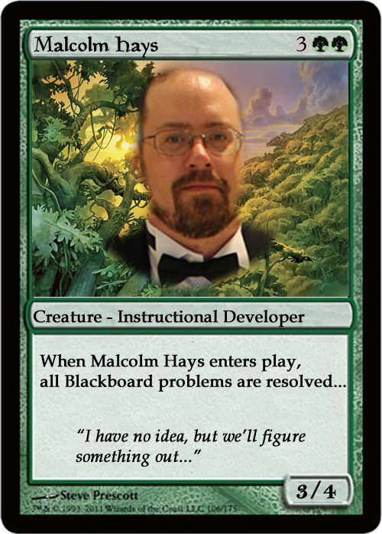
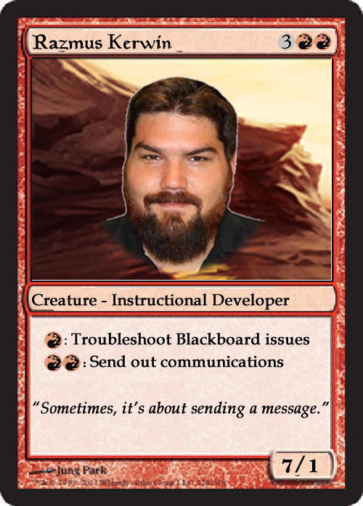
Razmus Kerwin
Notes:
MALCOLM / RAZ

Slide 3
Notes:
MALCOLM

Slide 4
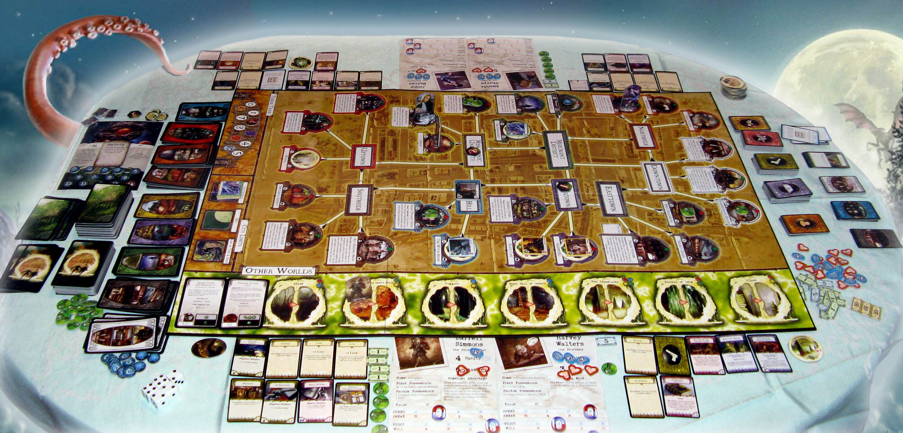
Classic Game Theory Scenario…
Notes:
RAZ

Slide 5
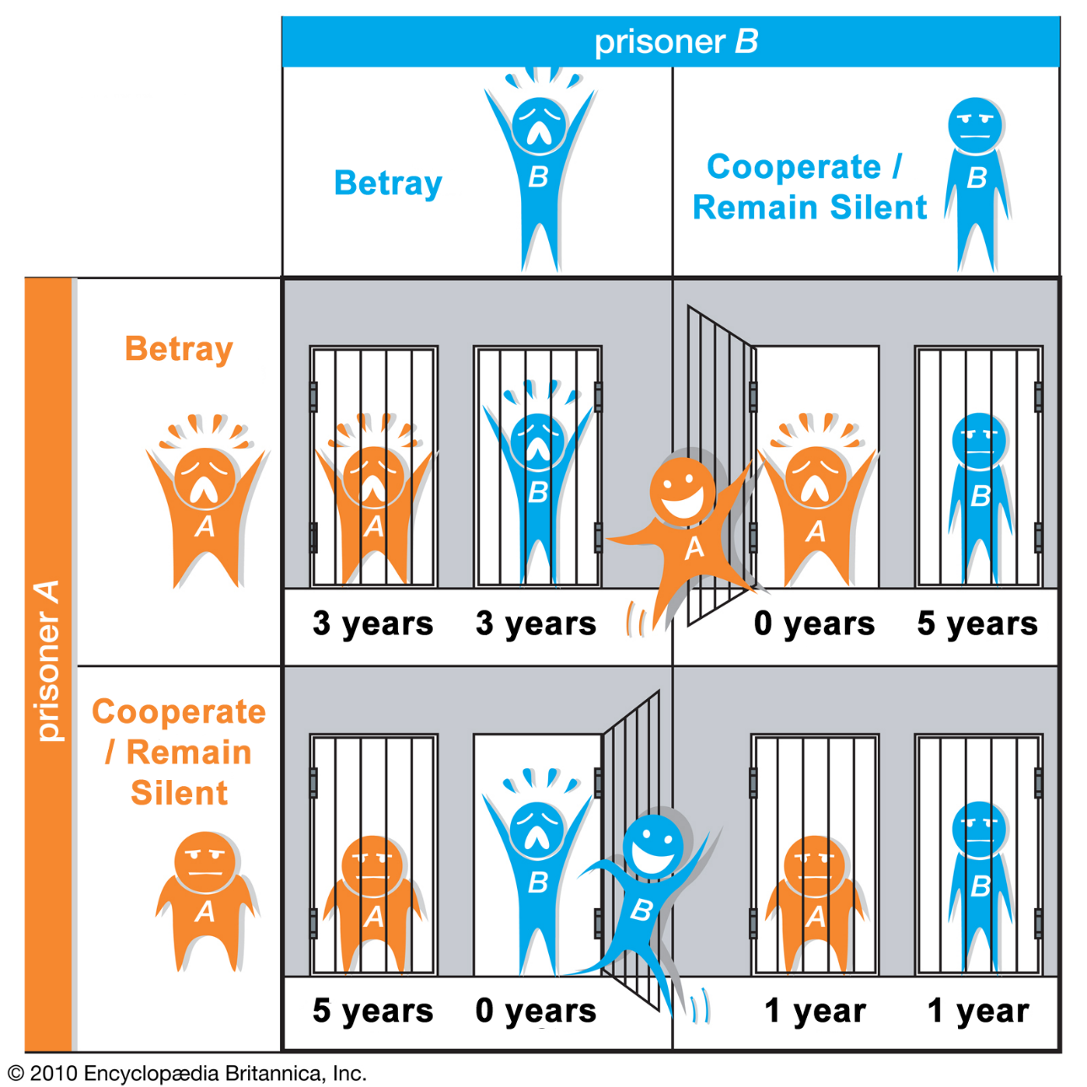
Prisoner’s Dilemma
Notes:
MALCOLM
Prisoner’s Dilemma is an instance where two people are forced to “compete” against each other for some sort of reward (in this case, not being thrown in jail for an extended period of time).
They do not have any way of communicating with each other.
Each player is forced to make a choice—either betray their comrade, or remain silent (cooperate with their comrade unbeknownst to the other party)
The most “rational” choice is for each player to betray the other party, thus hoping their partner in crime will remain silent, in which case the party that betrays the other goes free.
The most “logical” choice is for both parties to remain silent—each serves some amount of time, but will be free in relatively short order compared to being betrayed by the other party.

Slide 6
Prisoner’s Dilemma
Ultimately an exercise in cost-benefit analysis
Each participant makes a choice:
Which option will yield the most benefit for me based on assumptions I must make?
Will the other party betray me?
Will the other party cooperate with me and stay silent?
Has many different applications in the real world
Environmental studies
Animal behavior
Psychology
Economics
Sports (e.g. steroid use / doping)
Student behavior
Notes:
RAZ

Slide 7
Prisoner’s Dilemma: Iterated Snowdrift
Risk of being exploited through defection is lower
Individuals always gain through cooperation
2 people separated by a snowdrift
Either one person shovels, no-one shovels, or both shovel
If only one person shovels, the other one receives the benefit
Similar to group-work where all participants have choice on how much to contribute to the overall effort.
Notes:
MALCOLM
Researchers from University of Lausanne and University of Edinburgh suggest the Iterated Snowdrift Game may reflect real-world social situations.
2 people separated by a snowdrift.
Each has the option to shovel a path through the snow.
One can shovel, both can shovel, or no one shovels.
If one person shovels, then both benefit, but this requires more time/effort and may cause resentment from the person who shoveled against the person who didn’t.
If both shovel, then they receive the most benefit in the least amount of time/effort. Then they can go have a drink together, celebrating a job well-done!
In group-work situations (e.g. writing a research paper or collaborating on a report), participants who do little to no work can reap the benefits of those who do the most work.

Slide 8
Plagiarist’s Dilemma
Variation of the Prisoner’s Dilemma
Students in a class have the option to cheat or not cheat.
Each choice has its pros and cons
Notes:
RAZ
The Plagiarist’s Dilemma is a variation of the Prisoner’s Dilemma as an exercise in cooperation (not plagiarizing) or betrayal (plagiarizing)
Each student in the class has the option to conform to societal expectations (not plagiarize) or not (plagiarize)
And of course each choice has its pros and cons

Slide 9
Plagiarist’s Dilemma Matrix
 | Integrity | Plagiarize
Integrity | May take longer to graduate Students receive solid education Students develop positive work/study habits | Education/degree is devalued Students aren’t prepared for jobs Students don’t meet educational goals Honest students are penalized
Plagiarize | Education/degree is devalued Students aren’t prepared for jobs Students don’t meet educational goals Honest students are penalized | Institution becomes devalued Education/degree is devalued May be blacklisted from publications Academic awards (degrees) may be revoked
Notes:
RAZ
Students can either act with Integrity or Plagiarize.
If most or all students act with Integrity
May take longer to complete a college degree
All students are able to apply themselves and work hard (hard work is its own reward, after all)
Each student receives a solid education, assuming each is applying him or herself to the tasks required
Students develop positive work and study habits and will carry over ethical behavior in the classroom to other aspects of life (presumably)
If a sizable fraction of students are able to plagiarize or cheat in class:
Students demonstrate they have no integrity—this can and will carry over into other behaviors outside of the classroom.
They are devaluing the quality of their education and their degree whether they realize it or not
This can impact their employment later on when they are found out that they plagiarized in college.
Honest students are penalized for behavior that they have nothing to do with.
If all or most students engage in plagiarism:
This can devalue the entire institution.
Many opportunities for gainful employment will be lost.
In their professional career, if it is discovered they plagiarized, they may be blacklisted from academic and trade journal publications
Again, the degree is devalued.
This can influence unethical behavior outside of the classroom.
Academic degrees can be revoked (and have been in the past).
Students who plagiarize in order to participate in sports may cause their school to lose past championship awards (see University of North Carolina).

Slide 10
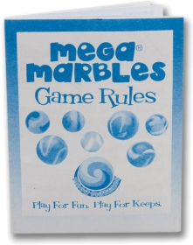
Student Perceptions of the Rules of the Game…
Notes:
MALCOLM

Slide 11
Why do students plagiarize?
Image courtesy of: http://elearninginfographics.com/college-plagiarism-infographic/
Notes:
RAZ
Students were never taught how to properly cite reference materials for research projects
They may be ignorant of the huge number of sources that each need to be cited properly (e.g. print materials v. online).

Slide 12
Why do students plagiarize?
Image courtesy of: http://elearninginfographics.com/college-plagiarism-infographic/
Notes:
RAZ
Students may be unsure of how to properly cite materials
Point them to online references on how to cite. (Purdue’s OWL is a great resource!)
Students may confuse plagiarism with paraphrasing (which also needs to be handled correctly).

Slide 13
Why do students plagiarize?
Image courtesy of: http://elearninginfographics.com/college-plagiarism-infographic/
Notes:
MALCOLM
Students were never taught how to properly conduct research
Especially important for undergrads who may be considering graduate school

Slide 14
Why do students plagiarize?
Image courtesy of: http://elearninginfographics.com/college-plagiarism-infographic/
Notes:
MALCOLM
Students simply haven’t been taught about the concept of plagiarism (i.e. stealing someone else’s ideas is wrong!).

Slide 15
Why do students plagiarize?
Image courtesy of: http://elearninginfographics.com/college-plagiarism-infographic/
Notes:
RAZ
Teachers may not be in the habit of enforcing ethical standards of their profession or institution.
“It’s OK if students copy off each other as long as the work gets done!”
In rare cases, faculty may encourage plagiarism

Slide 16
Why do students plagiarize?
Image courtesy of: http://elearninginfographics.com/college-plagiarism-infographic/
Notes:
RAZ
Websites can offer “plagiarism free” papers for a nominal fee
http://homework-buy.info
If professor doesn’t know, then nobody gets hurt

Slide 17
Why do students plagiarize?
Image courtesy of: http://elearninginfographics.com/college-plagiarism-infographic/
Notes:
MALCOLM
What is the real purpose of education?
Students have to reflect on why they are attending school (especially higher ed) in the first place.
Ultimate Goal: Turn students into life-long learners—Then students will be prepared to learn whatever they need to learn to be successful at whatever they choose to do.

Slide 18
Why do students plagiarize?
Image courtesy of: http://elearninginfographics.com/college-plagiarism-infographic/
Notes:
MALCOLM
Everyone else does it, why not me?
Compare to “doping” culture in professional athletics—If everyone “dopes”, then ultimately no one gets an unfair advantage, even though there may be long-term health effects down the line.
National cheating scandals in recent events—University of North Carolina involved professors, athletes, and administrators
Entire fake classes were created to hand out easy grades, unbeknownst to the coaches
“Cheating” program lasted nearly two decades, involving nearly 3100 students, about half of which were athletes

Slide 19
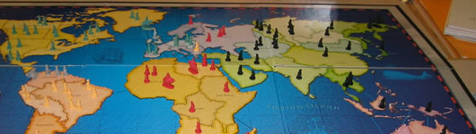
The Games People Play…
Notes:
RAZ

Slide 20
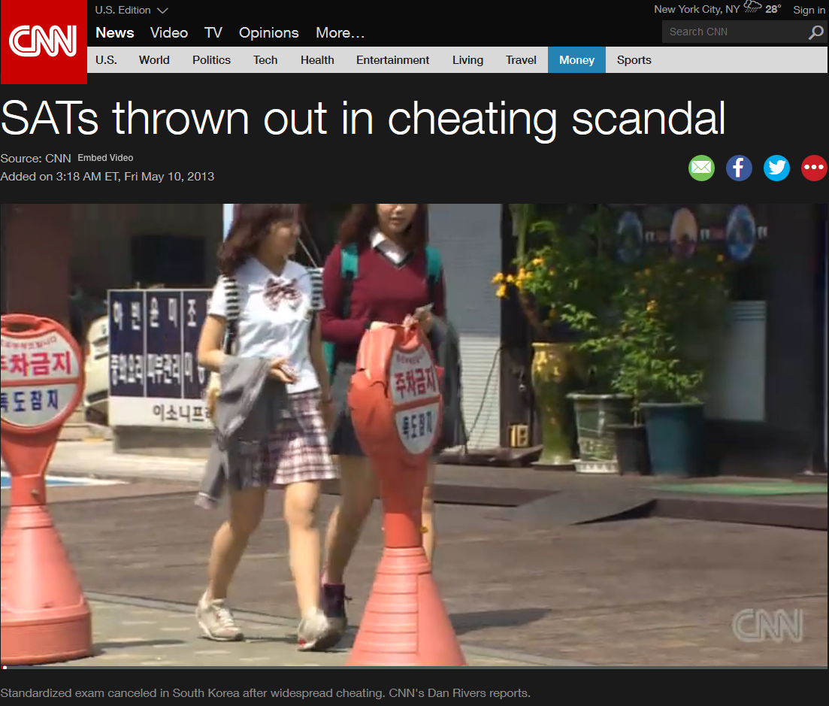
Plagiarism/Cheating in the News
SATs in South Korea (2013)
SOURCE: http://www.cnn.com/videos/world/2013/05/10/dnt-rivers-skorea-sat-scandal.cnn
Notes:
MALCOLM
Students in South Korea attend “cramming schools” to prepare for the SAT prior to attending university in the USA.
Many students have been caught cheating by obtaining questions for the SAT from students who had already taken the test in Thailand (different time than South Korean students)
So pervasive that SATs in May 2013 were canceled.
In many cases, the parents of students are the ones who shell out money (maybe $10,000 or more!) for the opportunity for their children to cheat.
Education is VERY competitive in South Korea
Students at South Korea’s most expensive boarding school are innocent, but are penalized because they are considered part of the “cheating culture” that has sprung up.
These innocent students are forced to make alternative plans to attending an American university (may have to go elsewhere).

Slide 21
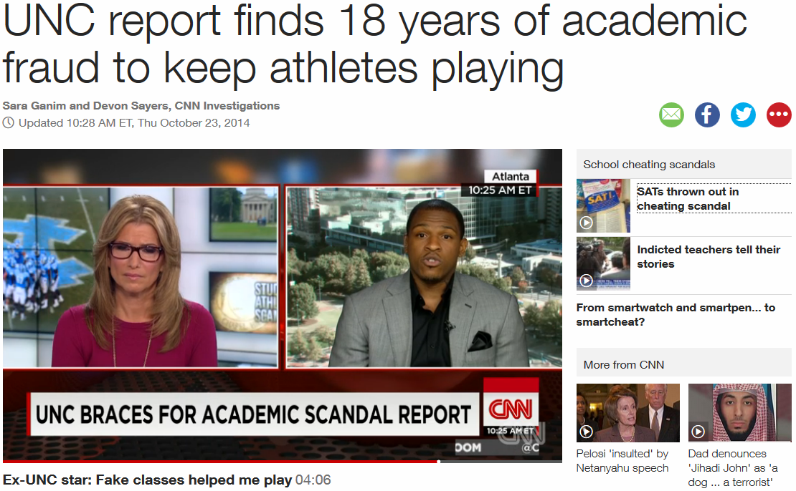
Plagiarism/Cheating in the News
University of North Carolina (2014)
SOURCE: http://www.cnn.com/2014/10/22/us/unc-report-academic-fraud/
Notes:
RAZ
Advisors funneled athletes/students to “paper classes”—they existed on paper but students didn’t have to do any real work or attend class.
They had to at least turn something in, but the person in charge of grading just gave them an “A for effort”, basically.
AT LEAST 3,100 students over 18 years took these fake classes, though the prosecutor in charge of the case admits this is probably only a fraction of the true number.
Several of UNC’s national championships over the past 18 years may be revoked due to the cheating scandal.
Four employees were fired while five more were disciplined. Another honorary employee had their status revoked.
One professor and his assistant were blamed for this

Slide 22
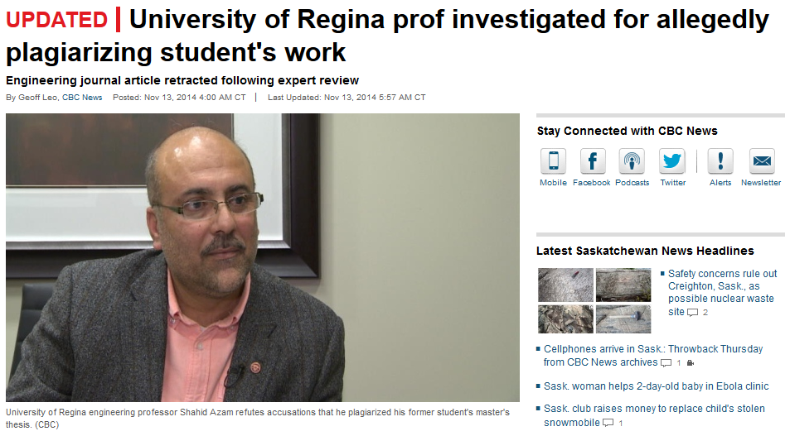
Plagiarism/Cheating in the News
University of Regina in Canada (2014)
SOURCE: http://www.cbc.ca/news/canada/saskatchewan/ university-of-regina-prof-investigated-for-allegedly-plagiarizing-student-s-work-1.2832907
Notes:
MALCOLM
Professor Shahid Azam was accused of not crediting the thesis of a former student (Arjun Paul) in an article published in Environmental Geotechnics.
After investigation, Environmental Geotechnics retracted the article.
Azam acknowledges similarities between his article and the student’s thesis.
He argues that where there are similarities, that is because those sections in the student’s thesis were written by Dr. Azam himself.
Dr. Azam further argues that the student didn’t have the technical writing experience necessary nor did he have “the experience to select, analyze and interpret data from the literature and draw meaningful conclusions” while compiling his thesis.
Independent investigation from Edward Eckel of Western Michigan University (who has published papers about plagiarism involving masters theses) says Azam’s behavior “falls under the category of plagiarism.”
Eckel also points out that Dr. Azam’s defense admits that he essentially oversaw awarding a master’s degree in engineering to an unqualified student.

Slide 23
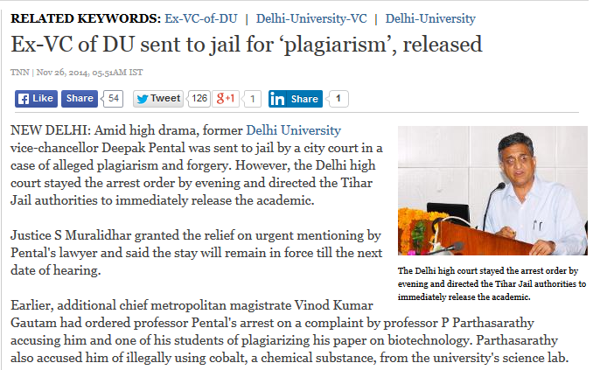
Plagiarism/Cheating in the News
Ex-VC of Delhi University Jailed (2014)
SOURCE: http://timesofindia.indiatimes.com/india/Ex-VC-of-DU-sent-to-jail-for-plagiarism-released/
articleshow/45278628.cms
Notes:
RAZ
Deepak Pental, former Vice Chancellor of Delhi University in India was accused of plagiarism and forgery.
He was sent to jail based on a complaint by professor P Parthasarathy, who accused him of plagiarizing a paper on biotechnology.
Dr. Pental was also accused of “illegally using cobalt, a chemical substance, from the university’s science lab.”
His lawyers were able to get him freed shortly thereafter on the grounds that the charges were bailable and that the court had acted “prematurely”.
A student is actually at the center of the scandal. The student worked for P. Partha Saradhi and also worked for Pental. Dr. Partha Saradhi suggested that the student plagiarized his work and that Pental was complicit in the act.
The fact that a professor was actually imprisoned (however briefly) for plagiarism is highly, highly unusual.

Slide 24
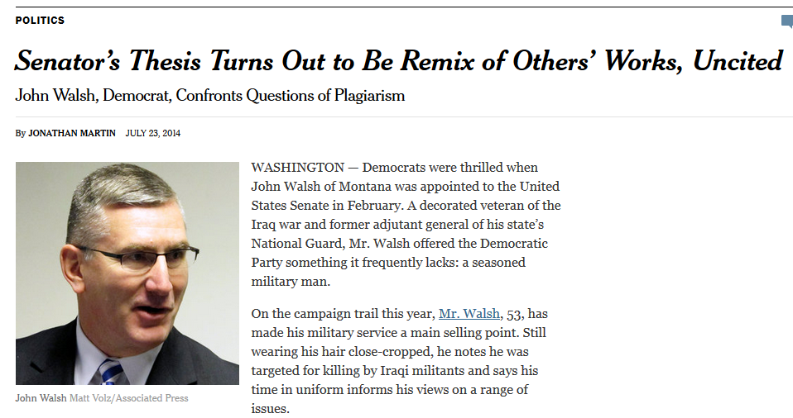
Plagiarism/Cheating in the News
Senator John Walsh’s election bid (2014)
SOURCE: http://www.nytimes.com/2014/07/24/us/politics/montana-senator-john-walsh-plagiarized-thesis.html
Notes:
MALCOLM
John Walsh of Montana appointed to United States Senate in February 2014.
Ran for re-election as a Democrat, used his military credentials as part of his campaign strategy.
An examination of his final paper for his master’s thesis at the Army War College revealed that at least 25% of the thesis was lifted from other sources without proper attribution (plagiarized).
The six recommendations that serve as the conclusion of his paper (“The Case for Democracy as a Long Term National Strategy”) are taken nearly word for word from a Carnegie Endowment for International Peace document over the same topic.
Eventually, it was revealed that less than 25% of the his thesis was wholly original. The rest of it was cribbed from other sources (sometimes with attribution but often without).
Walsh dropped out of the race in August, 2014.
In October 2014, the Army War College said it would revoke his degree and scrape his name off the plaque that displays the names of its graduates.
This is one of the few instances where claims of plagiarism have directly impacted an election.
John Walsh’s political career and military career are now tainted forever.

Slide 25
Don’t play their game…Make them play yours!
Notes:
RAZ

Slide 26
Strategies to Minimize Plagiarism
Teach students about authorship conventions and how to avoid plagiarism
Teach students important skills
Summarizing
Paraphrasing
Critical analysis
Referencing and citation
Include assessments that force students to practice these skills
SOURCE: 36 strategies to minimise (sic) plagiarism. (n.d.) Retrieved March 8, 2015, from http://www.utas.edu.au/__data/assets/pdf_file/0010/348328/36_strategies_to_minimise_plagiarism.pdf
Notes:
MALCOLM
Students should first be taught the standard conventions of authorship and how to avoid plagiarism
Many skills are involved in this initial step
Summarizing
Paraphrasing (correctly)
Developing critical analysis ability
Proper referencing and citation
Use assessments that will force students to continually practice and reinforce these skill sets

Slide 27
Strategies to Minimize Plagiarism
Counter plagiarism through the design of assessment tasks
Randomize questions and answers on electronic quizzes and assignments
Avoid asking students to collect, describe and present
Make them analyze and evaluate
Use alternatives to standard “essay type” questions
Case studies are more difficult to plagiarize
Have students give brief presentations
SOURCE: 36 strategies to minimise (sic) plagiarism. (n.d.) Retrieved March 8, 2015, from http://www.utas.edu.au/__data/assets/pdf_file/0010/348328/36_strategies_to_minimise_plagiarism.pdf
Notes:
RAZ
Plagiarism can often be countered by designing assessment tasks that minimize the possibility of plagiarism.
Randomizing questions/answers on electronic quizzes/tests
Use random question pools that cover the same concepts but give each student different question sets
Avoid asking students to simply collect, describe, and present information—make them analyze, evaluate, and synthesize an argument (higher-order Bloom’s taxonomy)
Use alternatives to the standard essay question—give them case studies, or other complex assignments that are more difficult to plagiarize
Have students give brief presentations over their research projects—It may be a simple progress report or a presentation over their conclusions (with recommendations for further study)

Slide 28
Strategies to Minimize Plagiarism
Ask for evidence!
Annotated bibliography—forces students to analyze their sources for relevance on their research topic
Use a meta-essay or meta-assignment where students have to answer question “What did you learn?”
Insist on evidence for significant claims
Return assignments to be redone if students can’t meet the criteria for evidence
SOURCE: 36 strategies to minimise (sic) plagiarism. (n.d.) Retrieved March 8, 2015, from http://www.utas.edu.au/__data/assets/pdf_file/0010/348328/36_strategies_to_minimise_plagiarism.pdf
Notes:
MALCOLM
Ask students to provide evidence that they have not plagiarized as part of the assignment.
Annotated bibliographies force students to analyze their sources for relevance and importance to their argument.
A meta-essay where students answer the question “What did you learn from this assignment?” also forces them to analyze the assignment and gives them an opportunity for self-reflection.
Can be handled many different ways – e.g. a Journal entry in Blackboard/Canvas/LMS
Insist students provide evidence for significant claims. If students can’t meet the criteria for evidence, then return the assignment to be redone until they are able to do so (at least, until the final deadline, of course). Multiple drafts for long assignments should always be encouraged!

Slide 29
Strategies to Minimize Plagiarism
Make positive use of collaborative work
Have students work together in groups but submit individual assignments
Include a mechanism to account for “shirkers”
Ensure criteria for evaluating group work is clearly understood
Provide peer-evaluations for group work and include that as part of the overall assessment
SOURCE: 36 strategies to minimise (sic) plagiarism. (n.d.) Retrieved March 8, 2015, from http://www.utas.edu.au/__data/assets/pdf_file/0010/348328/36_strategies_to_minimise_plagiarism.pdf
Notes:
RAZ
You can also minimize the plagiarism in collaborative/group work by emphasizing it as a positive exercise
Make students work together in groups, but have them turn in individual assignments
You should include some sort of mechanism to account for “shirkers” or those who don’t contribute much to the group assignment
Always ensure that the criteria for evaluating group work is clearly understood.
Make use of the tools available for evaluating who has contributed to the group project
Wikis and blogs, for instance, track user history
Provide peer-evaluations for group work and include that as part of the overall assessment
EXAMPLES: Ceramic Engineering, Mechanical Engineering

Slide 30
Strategies to Minimize Plagiarism
Familiarize yourself with resources that can be used for plagiarism/cheating
Use a search engine to find sites students may use.
Show students that you know how to use the Internet, too!
Demonstrate the PROPER way to search on the web!
SOURCE: 36 strategies to minimise (sic) plagiarism. (n.d.) Retrieved March 8, 2015, from http://www.utas.edu.au/__data/assets/pdf_file/0010/348328/36_strategies_to_minimise_plagiarism.pdf
Notes:
MALCOLM
Students are crafty, so you need to know what resources they may use for plagiarism
Use a search engine (e.g. Google) to find sites that students may use (e.g. Wikipedia)
Demonstrate to students that you also know how to use the Internet to find resources
Show students the RIGHT way to search for materials on the web
Local campus Library almost certainly willing to help!

Slide 31
Strategies to Minimize Plagiarism
Use detection software and other tools
Have students submit assignments electronically.
Run assignments through software that checks for similarities with other papers (e.g. Turnitin, iThenticate)
Use deterrence penalties and ENFORCE THEM!
E.g. first offense results in failing assignment, second means failing the subject, third results in institutional disciplinary action, etc…
Archive student work for later cross-checking
SOURCE: 36 strategies to minimise (sic) plagiarism. (n.d.) Retrieved March 8, 2015, from http://www.utas.edu.au/__data/assets/pdf_file/0010/348328/36_strategies_to_minimise_plagiarism.pdf
Notes:
RAZ
Use plagiarism detection software and other tools
Have students submit assignments electronically. This makes it easier to cross-check the paper through detection software and against the Internet.
Run the assignment through software that checks for similarity with other papers (e.g. Turnitin and iThenticate).
Use deterrence penalties and ENFORCE THEM!
Each school is a bit different, but every school has their own policies in place to deal with plagiarism
Archive student work for later cross-checking in future semesters
A common tactic is for students to re-use papers from upperclassmen who took the same course

Slide 32
Strategies to Minimize Plagiarism
Respond quickly to incidents of plagiarism!
Be firm and fast in responding
Blatant examples of plagiarism should be dealt with immediately
Sometimes, it’s about sending a message!
SOURCE: 36 strategies to minimise (sic) plagiarism. (n.d.) Retrieved March 8, 2015, from http://www.utas.edu.au/__data/assets/pdf_file/0010/348328/36_strategies_to_minimise_plagiarism.pdf
Notes:
RAZ
Respond quickly to incidents of plagiarism
Be firm and fast in responding
Blatant examples should be dealt with immediately
Also, reaffirm the penalties to the rest of the class should someone be caught plagiarizing (don’t identify the plagiarist, of course, as that would probably run afoul of FERPA—they’ll know who they are!)
Sometimes, it’s about sending a message!

Slide 33
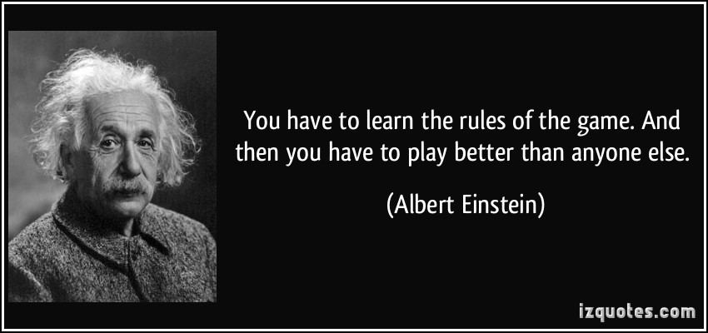
You can win the plagiarist’s dilemma!
Notes:
MALCOLM

