Slide 1
Guided Discovery through the Digital Extracurriculum: Celebrating Lifelong Learning, Participatory Culture, and Affinity Spaces
Kelly L. Jones, Ph.D.

Slide 2
We hold the mirror.
Notes:
As L&D professionals, we act as mirrors, allowing others to learn; Reflect, clarify, or walk through (transform). It’s difficult to focus on our own learning when our work is focused on the development of others. As student-centered teachers, we need time away from the classroom for inspiration and practices that help cultivate our own curiosity, creativity, and metacognition.

Slide 3
Notes:
Group Discussion
Think of something you are an expert at that has nothing to do with your profession. How did you learn it? Why did you learn it?

Slide 4
Notes:
Expert Blind Spot

Slide 5
Pedagogical Content Knowledge (PCK)
Pedagogy
Content
Context
Lee Shulman
Notes:
neuroscience and motivation (curiosity, story, discovery)

Slide 6
Notes:
GROUP DISCUSSION
How does it feel to be at the beginning of a learning curve?
How does the “ah-ha” moment feel?

Slide 7
A Lifelong Learning Framework
“It will go on in clubs, churches, cinemas, theatres, concert rooms, trade unions, political societies, and in the homes of the people where there are books, newspapers, music, wireless sets, workshops, gardens and groups of friends.”
--Basil Yeaxlee, 1929
Notes:
Education as part of living is a theme that Basil Yeaxlee develops in the first book-length exploration of lifelong education in 1929. He drew on the work of Lindeman and others, and upon his own extensive experience within adult education in Britain. He had helped organize the adult learning and social programmes of the YMCA (e.g. around the extensive provision for soldiers during the First World War), and was a pivotal figure in gaining recognition for adult education as a field of practice in the UK (partly through his work for educational settlements and the British Institute of Adult Education.
In Lifelong Education, Yeaxlee looks back at many of the themes of The 1919 Report and argues for a ‘ much wider and fuller lifelong education’ (Yeaxlee 1929: 34).

Slide 8
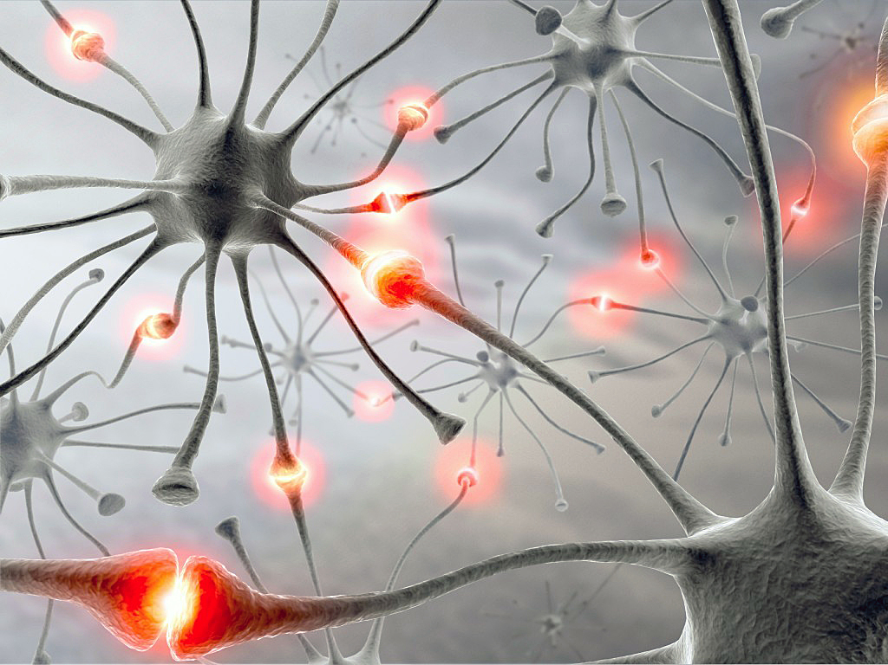
Guided Discovery in the Digital Age
Self Directed Learning (Maurice Gibbons)
Personal Learning Network (Jane Hart)

Slide 9
Silver bullet, magic pill, secret key…
Notes:
Read widely, outside of your field
Learn from and with others
Explore libraries and bookstores and stumble upon things (tell mt Brave New World story here)
Puzzles and mysteries
The power of wonder
Curiosty is fuel for intrinsic motivation
Find what fascinates you
Learn a new skill
Ask and reflect
People, not google
Stay open and suspend judgment

Slide 10
Seek questions, not just answers
https://4-24project.org

Slide 11
21st Century Lifelong Learning Praxis
Digital Extracurriculum
Participatory Culture (Henry Jenkins)
Affinity Spaces (James Paul Gee)
Notes:
Participatory culture is a term coined by Jenkins (2006) to describe a culture “in
which fans and other consumers are invited to actively participate in the creation and circulation of new content” (p. 331). The concept provides a way of examining our ever- changing relationship with media and popular culture within the contemporary shift from consumer to producer. Jenkins (2006) explains, “Rather than talking about media producers and consumers as occupying separate roles, we might now see them as participants who interact with each other according to a new set of rules that none of us fully understands” (p. 3). Participatory culture is changing the ways in which schools, communities and professions function
Affinity spaces are interest-based and are not formed by similarities in participants’ ages, races, gender, or geographic locations. Gee’s (2004) theory of affinity spaces connects with the third characteristic of participatory culture, which is “some type of informal mentorship whereby participants learn from those in the community with more experience” (Jenkins et al., 2009).

Slide 12
Sharing Our Processes
Notes:
Top dozen lifelong learning tools; I’m like a lifelong learning scribe...
Infed, linkedin, fb, twitter, podcast app, audible app, TED app, improv, nanowrimo, glass blowing, phone, books, atd, lean in

Slide 13
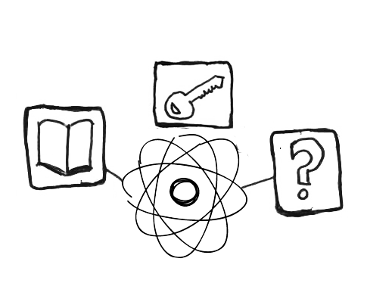
Building Your Lifelong Learning Toolkit
Notes:
List 5-10 tools and share with the group

Slide 14
Takeaway Idea: Lifelong Learning Journal
Notes:
Power of reflective journaling
Bullet journaling, Passion Planner, apps and online tools
Question, examine, explore the emotions of the learning curve, remember what it was like to learn your discipline
Pick one thing and use this for 90 days; see what you learn about the topic and about yourself

Slide 15
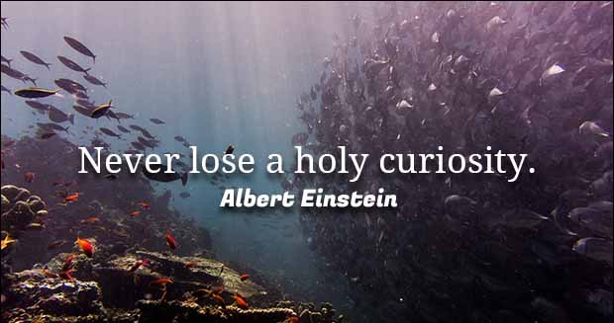
Notes:
The important thing is not to stop questioning… Never lose a holy curiosity. Albert Einstein

Slide 16
Continue the Conversation…
Kelly L. Jones, Ph.D. @DrKellyJones
Email: kellyleejones@gmail.com
http://southernfriedscholar.com
The icons on slide 12 were created by Jody Lumsden. She can be reached at Jody@learnbypixel.com

Slide 17
References
Antikainen, A., Houtsonen, J., Huotelin, H. and Kauppila, J. (1996) Living in a Learning Society: Life-Histories, Identities and Education. London: Routledge.
Edwards, E., Hanson, A. and Raggett, P. (eds.) (1996) Boundaries of Adult Learning, London: Routledge.
Faure, E. and others (1972) Learning to Be. Paris: UNESCO.
Field, J. (2000) Lifelong Learning and the New Educational Order, Stoke of Trent: Trentham Books.
Gee, J. P. (2012). Social linguistics and literacies. New York, NY: Routledge.
Jenkins, H. (2006). Convergence culture: Where old and new media collide. New York, NY: New York University.
Smith, M. K. (1996, 2001) ‘Lifelong learning’, the encyclopedia of informal education, http://www.infed.org/lifelonglearning/b-life.htm.
Shulman, L. S. (1986). “Those who understand: Knowledge growth in teaching.” Educational Researcher Feb. 1986: 4-14.
Tight, M. (1996) Key Concepts in Adult Education and Training, London: Routledge.
Yeaxlee, B. A. (1929) Lifelong Education, London: Cassell.

